Slide 1
Understanding Worldviews
Core Faith- Lesson 2
A Study by Hampton Keathly IV Modified by Dr. James F. Davis, PhD

Slide 2
Copyright Notice
You may download this presentation on your computer for personal study or you can print it or use it in a multimedia presentation for yourself and others as long as you give the printed material away and do not charge for it. In this case, free means free. It cannot be bundled with anything sold, nor can you charge for shipping, handling, or anything. It cannot be posted on other websites or servers. It is provided for personal study or for use in preparation and presentation of sermons, Sunday school classes, undergraduate or seminary religion classes or other non-commercial study. Material in the presentation may be edited (added to , deleted or changed) on the condition that no revision contradicts the Bible.org doctrinal statement and that substantive revisions are identified as being the work of a reviser and not that of Dr. Davis.

Slide 3
Then
It used to be that most people in America believed
there was a God,
the Bible was God’s word.
in heaven and hell
even the Apostles Creed or something to close it
Hurdles to the Gospel were apathy, lack of personal response, wrong views of how to get to heaven

Slide 4
Now that has all changed
Many people now
don’t believe in God.
don’t believe the Bible is the Word of God.
don’t agree on issues of morality and sin.
don’t accept the foundational tenets of Christianity
Now, if you try to present the gospel to someone, you’re more likely to have them say, “That’s just your opinion.” Or “That may be true for you but not for me.”
(See Jim Keller, The Supremacy of Christ and the Gospel in a Postmodern World. Audio message from desiringgod.org).

Slide 5
Crucial Questions in a Post Modern World
How does Christianity fit into the larger contexts of other world views?
Is there a God?
Why is there evil and suffering?
How do we know?

Slide 6
Christianity/Theism in Worldview Contexts
Theism
Theism is the belief that there is a personal God outside of time and space who created the universe out of nothing and is involved in events (supernaturally). He reveals himself to man through nature and through the Bible (Christians) or the TANAK = Old Testament (Jews) or the Koran (Muslims). He sets the rules for mankind. And there will be eternal consequences for breaking the rules. Deism a form of theism. God created everything, but is no longer involved in creation.

Slide 7
Christianity/Theism in Worldview Contexts
Pantheism
Everything is god. Everything material is an illusion. Humans are gods. Knowledge is getting in touch with the cosmic consciousness. One of the favorite terms you’ll hear from pantheists is “enlightenment.” History is cyclical and men are reincarnated until they realize their own divinity. This world view is the basis for Hinduism, Buddhism, Christian Science, and New Age teaching.

Slide 8
Christianity/Theism in Worldview Contexts
Naturalism (Modernism)
There is no God. There is no supernatural. We live in a closed system and the world and mankind just evolved. Men are just the product of their environment. Morality is decided by man. Reason and science are basis of authority and pursued for the good of mankind. There is no purpose to history; it just happens. When you die, you cease to exist.

Slide 9
Christianity/Theism in Worldview Contexts
Pluralism (Post-Modernism)
Pluralism is sort of a cafeteria style world view. People mix and match various aspects of the other world views.
Reject idea of objective truth
Suspicious and skeptical of authority
In search of identity apart from knowledge but through relationship
No morality, only expediency
In search of transcendence, spirituality, but not religion
In quest of meaningful community
The “knowing smirk” at anyone who says they know the truth (Graham Johnston, Preaching to a Post-Modern World, Baker, 2001, 26)

Slide 10
Christianity/Theism in Worldview Contexts
 | Theism | Pantheism | Naturalism (Modernism) | Pluralism (Postmodernism)
God | Personal | Impersonal | Non-existent | Non-existent
World | Creation | Spiritual | Evolution | Evolution
Man | Like God | Is God | Like Animals | Like Animals
Immortality | Resurrection | Reincarnation | Annihilation | Annihilation Reincarnation
Destiny | Glorification | Absorption | Extinction | Extinction
Authority | Divine Revelation | Spiritual Enlightenment | Human Reason | Culture
Truth | Absolute | Personal | Objective /Science | Relative/Cultural
Evil | Rebellion/Sin | Illusion | Ignorance | Culturally Defined
History | Linear | Cyclical | Chaotic | Re-Defined

Slide 11
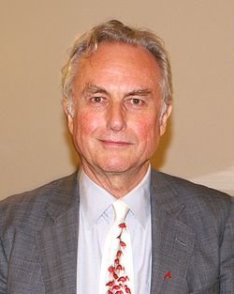
Is there a God? Atheist quotes
“We are all atheists about most of the gods that humanity has ever believed in. Some of us just go one god further.”
Richard Dawkins, author of The God Delusion

Slide 12
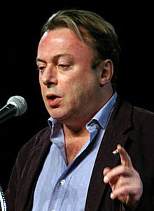
Is there a God? Atheist quotes
“That which can be asserted without evidence, can be dismissed without evidence.”
Christopher Hitchens, author of God is not Great

Slide 13
But is there no evidence for God?
1:18 For the wrath of God is revealed from heaven against all ungodliness and unrighteousness of people who suppress the truth by their unrighteousness, 1:19 because what can be known about God is plain to them, because God has made it plain to them. 1:20 For since the creation of the world his invisible attributes – his eternal power and divine nature – have been clearly seen, because they are understood through what has been made. So people are without excuse. 1:21 For although they knew God, they did not glorify him as God or give him thanks, but they became futile in their thoughts and their senseless hearts were darkened. 1:22 Although they claimed to be wise, they became fools (Rom 1:18-22 The NET Bible).

Slide 14
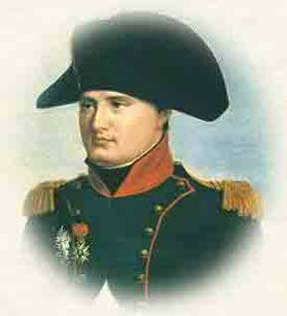
Evidence for God: The Cosmological Argument
The story is told of Napoleon Bonaparte who while on one of his ships at night heard some of the sailors mocking the idea of God. As he pointed up to the stars he said “Gentlemen, you must get rid of those first.

Slide 15
Evidence for God
First one has to say that rejection of God is primarily a moral (sin) problem and intellectual arguments will not solve this. If someone does not want to be morally accountable to God they will not accept even good arguments.
The Bible presupposes a belief in God and much of the Bible is defining who the true God is. “In the beginning God created . . . . (Gen 1:1).
But do we just have to accept the existence of God by faith, or is our belief in God based on evidence too? It’s that old presuppositionalism and evidentialism thing again.
God gave Moses signs to prove to Israel that God had sent him and to prove to pharaoh that the God of Israel was the one true God (Ex 4:1-9). Thomas needed evidence (Jn 20:25).

Slide 16
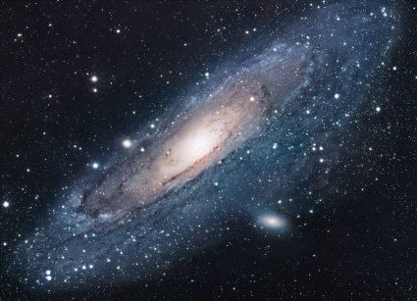
Evidence for God: The Cosmological Argument
The basic cosmological argument is that everything that exists has a cause, and since the universe exists, it must have a first cause.
If the universe began to exist then the universe has a cause
The universe began to exist
Therefore the universe has a cause

Slide 17
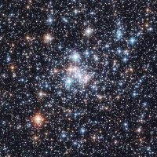
Evidence for God: The Cosmological Argument
We sometimes hear that the universe was caused by “Chance,” but there are two problems with this:
1. Chance can’t cause something. Chance is not a being. It is just a mathematical probability.
2. When you look at the odds (what the chances are), it becomes evident that it is not a probability – it is an impossibility.

Slide 18
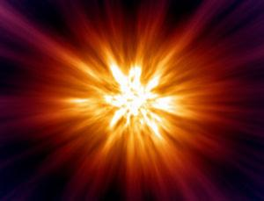
Evidence for God: The Cosmological Argument
The “Big Bang” presupposes matter/energy before the “Bang” happened but where did this come from? What or Who caused this?

Slide 19
Evidence for God: The Cosmological Argument
To try to get around this, some say that the universe is eternal. Carl Sagan said, “The universe is all there is, and was and ever will be.”
There are two logical problems with the view that the universe is eternal:
1. Scientists have discovered that the universe is expanding and if you go back far enough, the expansion had to have started some time in the past.
2. The Kalam argument stresses that the universe had to begin to exist a finite time ago. You can’t get to “now” if you start from infinity because “now” never arrives. Only if you have a finite beginning can you arrive at “now.” (http://en.wikipedia.org/wiki/Kalam_cosmological_argument)

Slide 20
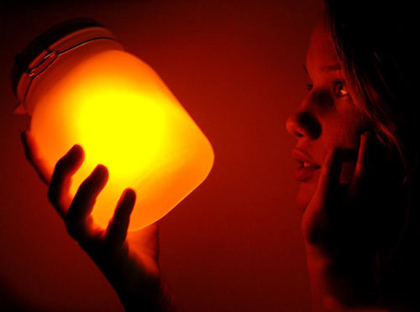
The First Law of Thermodynamics
Simply the first law of thermodynamics is also referred to as the conservation of energy. It is an established scientific fact.
The law in essence states that Energy/Matter cannot be created or destroyed in a closed natural system.
So the existence of matter and energy must have come about by a supernatural event a force outside of the system. (See Jeff Miller, PhD, http://www.apologeticspress.org/apcontent.aspx?category=9&article=2106)

Slide 21
The Second Law of Thermodynamics
Simply the second law of thermodynamics that is energy is becoming less usable. It is also called the law of entropy. It also is an established scientific fact. Things are winding down, becoming more disorderly, the energy is continually being spread out in less and less usable forms
Since the universe contains highly concentrated energy sources (e.g., sun) it cannot be eternal but must have had a beginning.
(See Jeff Miller, PhD, http://www.apologeticspress.org/apcontent.aspx?category=9&article=2106)

Slide 22
Evidence for God: The Cosmological Argument
Therefore, that first cause must be something
outside of time and space (since the universe came into being at some time in the past)
immaterial (since the universe is made up of matter)
powerful enough to “create” everything
personal – take dominos falling for example…. Each domino falling is caused by the one before it, but you fall into an infinite regress unless you have someone pushing that first domino over. That first event is caused by an “agent.” Some being who chose to start the process.
What would be an adequate cause for the effect of the creation of the universe? Some Being like the God of the Bible….

Slide 23
Evidence for God: The Teleological Argument
The basic teleological argument is that since the world is so complex and so ordered, it had to have been designed/created by some intelligent being. The design points to a Designer
A car points to a manufacturer, a watch points to a watchmaker, an I-Phone points to Steve Jobs etc.

Slide 24
Evidence for God: The Teleological Argument
The universe and everything in it is too complex, orderly, adaptive, apparently purposeful, and/or beautiful to have occurred randomly or accidentally.
Therefore, it must have been created by an intelligent, wise, and/or purposeful being.
God is that intelligent, wise, and/or purposeful being. ( Based largely on Wikipedia, http://en.wikipedia.org/wiki/Teleological_argument)

Slide 25
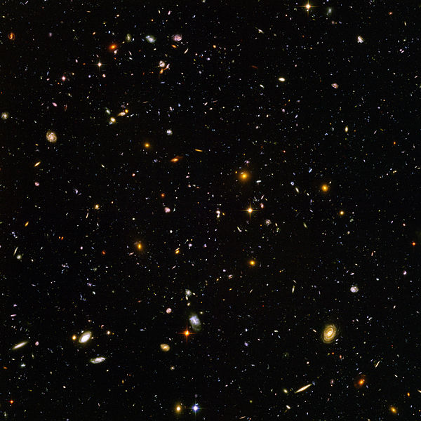
Hubble Telescope: Every Light Represents One Galaxy

Slide 26
The Moral Argument
The Moral Argument is that since everyone has conscience and a concept of right and wrong, this must reflect some higher conscience or higher moral absolute.
If God does not exist objectionable moral values do not exists
Objectionable moral values do exists
Therefore God exists

Slide 27
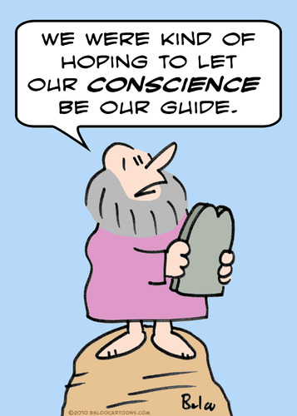
The Moral Argument
For whenever the Gentiles, who do not have the law, do by nature the things required by the law, these who do not have the law are a law to themselves. They show that the work of the law is written in their hearts, as their conscience bears witness and their conflicting thoughts accuse or else defend them (Rom 2:14-15 NET Bible)

Slide 28
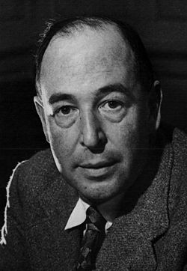
The Moral Argument
C.S. Lewis points out that when someone quarrels, they are not just saying that something the other person did displeases only them. They are appealing to some standard of behavior that says what that other person did was wrong.
Where does this sense of fairness come from? (See Mere Christianity for more on this argument)

Slide 29
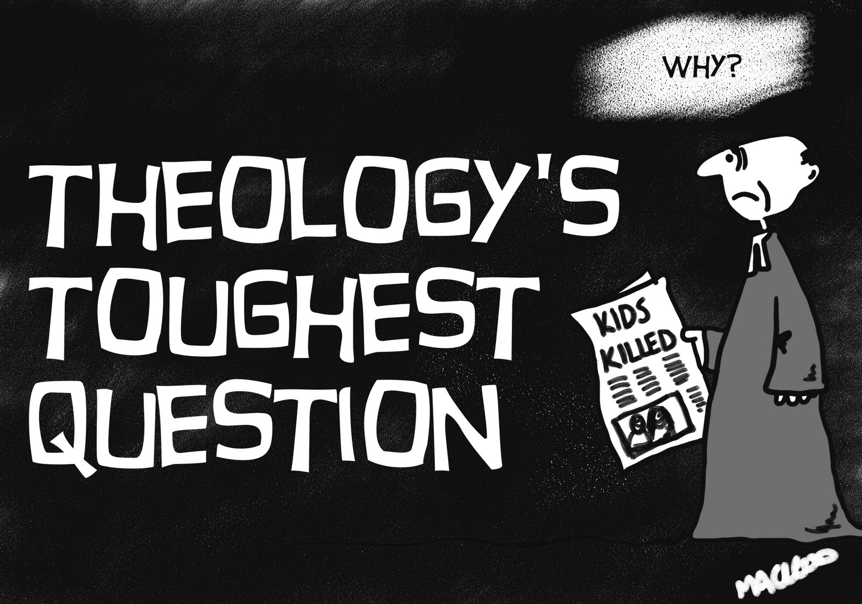
Why is there evil and suffering?
A major objection to the existence of God.
If God is good and God is great (all-powerful) then how can there be evil in the world? Since there is evil, there must be no God. Or if there is a God, he must not be good or he must not be all-powerful.
This problem is also called theodicy.

Slide 30
Why is there evil and suffering?
There is no logical fallacy in that statement of the problem of evil…
God is good.
God is all-powerful.
God created the world.
The world contains evil.

Slide 31
Why is there evil and suffering?
Where is the contradiction? What they really mean is this:
God is good.
God is all-powerful.
God created the world.
The world shouldn’t contain evil.
The world contains evil.
But that the world should not contain evil is just an assumption on their part

Slide 32
Why is there evil and suffering?
Objective evil presupposes Objective Good
Shadows prove the existence of sunshine

Slide 33
Possible Responses to Theodicy
1) Necessary for free-will to work
If it was impossible to disobey God, then we’d never have to choose to obey. We would be like robots.

Slide 34
Possible Responses to Theodicy
2) Necessary for human spiritual growth
If there are no dangers, difficulties or disappointments in life, how can we gain character traits such as patience or endurance?

Slide 35
Possible Responses to Theodicy
3) Necessary to promote the greater good and God’s glory
The chief purpose of life is to glorify and know of God. It is not human happiness! God's role is not to make life comfortable for us. However, if we recognize that the evil, which causes human suffering, is leading people to know God, then there is a greater good.

Slide 36
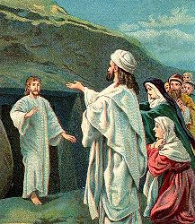
Possible Responses to Theodicy
Example of Lazarus getting sick and dying.
When Jesus heard this, he said, “This sickness will not lead to death, but to God’s glory, so that the Son of God may be glorified through it” (John 11:4).

Slide 37
Possible Responses to Theodicy
4) Temporal suffering compared to eternal glory
In 2 Cor 4:16-18 Paul compares the suffering of this life with the eternal weight of glory. Compared with eternity with God the sufferings of this world are a “slight, momentary affliction.”
Eternal Glory

Slide 38
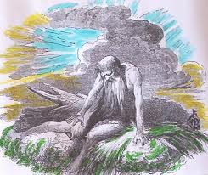
Possible Responses to Theodicy
5) It is too complicated for us to understand
Even if we can see some possible purpose in some evil/suffering, there are events which we can’t understand and we just have to recognize we are finite creatures who can’t know God’s purpose in allowing those things.

Slide 39
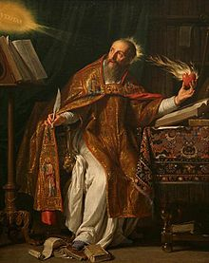
Summary Thoughts?
Sin and evil are not creations of God. They are a deprivation of God’s creations. Just like darkness is the absence of light and cold is the absence of heat, evil is really the absence of good. This was one of Augustine’s arguments.

Slide 40
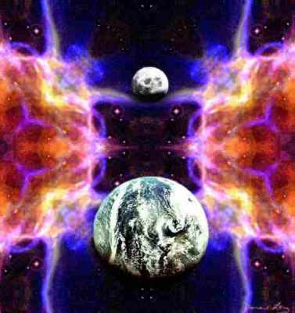
Summary Thoughts?
The Bible Says:
God created the world and it was “good. Gen 1”
However, man sinned and brought sin and suffering into the world (Gen 3)
God is in the process of eradicating sin, suffering and Satan and it will happen in His perfect timing (Rev 20-22)
Then I saw a new heaven and a new earth, for the first heaven and earth had ceased to exist . . . He will wipe away every tear from their eyes, and death will not exist any more – or mourning, or crying, or pain, for the former things have ceased to exist. (Rev 21:1, 4)”

Slide 41
Discussion Questions?
What are some responses you have received when trying to present the gospel?
Why is the gospel particularly offensive in a pluralistic society?
How much allowance should be made in contextualizing a gospel presentation? What can be changed? What must not be changed?

Slide 42
Discussion Questions?
How did Paul’s Presentation of the Gospel to the Thessalonians differ from that to the Athenians in Acts 17? Can we learn any lessons from this?
What evidence is persuasive to you that the God exists?
Do Atheists have to take some of their presuppositions on “faith” or is it all “science”? What do they take on “faith”?

Slide 43
Discussion Questions?
Why do you think God allows evil and suffering? Can any good come out of it?
What would you tell a friend who is undergoing great suffering and questioning whether or not God cares or even exists?

