Slide 2
Unbreakable Faith
How God’s Perfections Give Life, Joy, and Thriving Assurance in a World of Unbelief
Notes:
Good morning, it is great to see you all again, even though you are some of the most ignorant people on the earth.
If it were not for the fact that food was stored and prepared inside, you wouldn’t have sense to come in out of the rain. Members of the flat earth society, you are hopelessly stuck in the darkness of Medieval superstition. You stubbornly reject science and reason to take comfort in blind faith in unscientific fantasies. You are narrow-minded bigots, the cause of everything wrong in the world, and your book, while including some wisdom for living, is choked full of ridiculous fantasies that cannot be taken literally or seriously. Your “god” is a murderous tyrant, unfit for worship or polite conversation.
That is, if Christopher Hitchens, Richard Dawkins, and countless self-appointed authorities on the internet are to be believed (btw, the late Mr. Hitchens has since changed his mind). Some of you more seasoned saints are well-accustomed to such language. But for the new believer or college freshman, the vitriol of unbelief can be shocking. My introduction may have been the morning lecture.
Yet, the sophisticated arguments of unbelief can disturb the peace and assurance of any saint, while an antagonistic culture tempts and intimidates us to dilute, neglect, or deny the more offensive aspects of the Gospel.
But, what if reality is quite the opposite of what Dawkins and company so colorfully describe? What if unbelief is actually built on unreasonable, unsupportable, and unscientific blind faith, while Christianity is reasonable, scientific, and supported by the entirety of the known universe, in addition to the clear and convincing evidence of Scripture? And what if this can easily be shown to be true? What if all Christians could have their faith and assurance strengthened such that the best arguments of unbelief are no longer intimidating? What if the best arguments of unbelief can easily be shown to be false?
Well, stay tuned and stay put, as our questions are all answered in the affirmative. God will have the last word, but our faith need not be disturbed until He does.<NEXT>

Slide 3
Course Texts
Notes:
Books for the course include God the Reason, which contains most of the course content and should be read concurrently with the presentations. It also provides a helpful resource and review once the course is concluded. The Box is a short application of the principles of the course, applied in several fun discussions between an atheist and Christian. These are available online at Amazon and other booksellers.

Slide 4
Introduction
Part 1
The Attitude, Definition, and Place of Apologetics
Notes:
To introduce the course, we will first take a look at the Attitude, Definition, and Place of Apologetics.
<NEXT>

Slide 5
The Attitude of Apologetics
Notes:
[READ SLIDE]
Or, the proper, God-honoring attitude to defend and proclaim the Gospel of Christ in the face of unbelief. As we begin, we need to adjust our spiritual bearings and be mindful of how God would have us approach our topic, as this can be a very contentious arena, as some of you already know. To do this, we will examine how we should view Christian knowledge, or theological knowledge in general, because apologetics, or how we defend and proclaim the Gospel of Christ in the face of unbelief is a theological activity, founded upon and flowing from the knowledge of God. Indeed, as we will see, everything in the universe, ultimately, is a theological issue. <NEXT>

Slide 6
What Is Theology?
Theology is the study of the person and works of God.
Notes:
We begin with a brief definition… [READ SLIDE] and no study is more important than the study of our Creator, Sustainer, and Redeemer. <NEXT>

Slide 7
Notes:
Unbelievers, however, often dismiss the study of God as irrelevant or even dangerous. And strangely enough, even professing Christians sometimes dismiss theology as irrelevant, unimportant, or even destructive to the Christian life. Some from ignorance, some from arrogance, some from an experience with a pompous theology teacher or recent seminary graduate who talked the talk, but did not walk the walk, etc., etc. People find all kinds of reasons. But whatever the reason… <NEXT>

Slide 8
What Is Theology?
Theology, or the study of God, can never be the problem, any more than God is the problem.
Notes:
Theology, or the study of God, can never be the problem, any more than God is the problem. <NEXT>

Slide 9
What Is Theology?
The fault, dear Christian, lies not in the study of God, but in ourselves, in our sinful nature, in our ignorance of the excellence of God and His works.
Notes:
The fault, dear Christian, lies not in the study of God, but in ourselves, in our sinful nature, in our ignorance of the excellence of God and His works, and what He has called each of us to do. <NEXT>

Slide 10
Wrong Approaches to Theology
Notes:
To properly understand the proper attitude for our endeavor, we’ll look at two particularly harmful approaches to theology. <NEXT>

Slide 11
Wrong Approaches to Theology
Truth and “knowledge” without love and application
Notes:
The first is [READ SLIDE] Intellectual knowledge of God is possible without a love and willful obedience to God. We call this a kind of head knowledge without heart knowledge.
Notice knowledge is in quotes, as a true knowledge of God leads to a love of God and an application of His truth.
<NEXT>

Slide 12
Wrong Approaches to Theology
“If I have prophecy, and know all mysteries and all knowledge; and if I have all faith, so as to remove mountains, but do not have love, I am nothing.”
1 Corinthians 13:2
Notes:
Scripture tells us… [READ SLIDE]
Knowledge is worthless without love and application. <NEXT>

Slide 13
Notes:
This loveless knowledge is what Scripture says “puffs up” or makes proud, whereas a true knowledge of God produces humility. <NEXT>

Slide 14
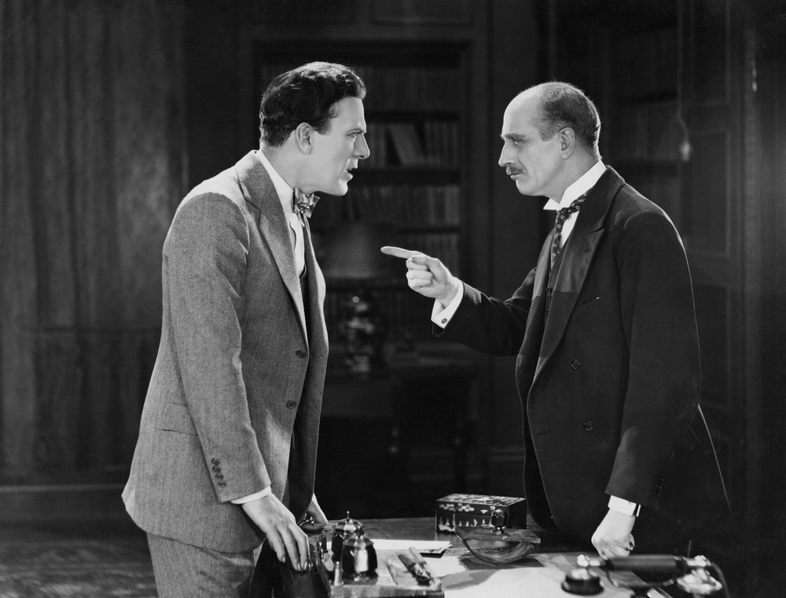
Notes:
This is a critical point, for even if we should win the battle of a discussion or argument, we can lose the war by our attitude. Arrogance is a particularly prevalent and pernicious sin in the arena of defending the faith. <NEXT>

Slide 15
Wrong Approaches to Theology
The best argument for the reality and glory of the Gospel, second to God’s testimony in Scripture, is a changed life. Talk is cheap.
Notes:
And when all is said and done, the best argument for the reality and glory of the Gospel, second to God’s testimony in Scripture, is a changed life. Talk is cheap. <NEXT>

Slide 16
Wrong Approaches to Theology
Well-reasoned arguments are easy compared to humble love and faithfulness in the face of irrational, petty, and sometimes vicious opposition.
Notes:
Well-reasoned arguments are easy compared to humble love and faithfulness in the face of irrational, petty, and sometimes vicious opposition. <NEXT>

Slide 17
Notes:
And so much more in this cynical age where people need to see the real deal, where Christians walk the talk. And as somebody once said, preach the Gospel, and if necessary, use words. Of course, we are to use words, but… <NEXT>

Slide 18
Wrong Approaches to Theology
Next to Scripture, the best argument for Christ is His character displayed in us.
Notes:
[READ SLIDE]
<NEXT>

Slide 19
Wrong Approaches to Theology
“Prove yourself doers of the word, and not merely hearers who delude themselves.”
James 1:22
Notes:
[READ SLIDE]
<NEXT>

Slide 20
Wrong Approaches to Theology
We can deceive ourselves by thinking that knowing about God, without a love to God, is the same as knowing God personally or savingly. Even demons know about God.
Notes:
We can deceive ourselves by thinking that knowing about God, without a love to God, is the same as knowing God personally or savingly. Even demons know about God. <NEXT>

Slide 21
Wrong Approaches to Theology
“Love” and “application” without truth and knowledge
Notes:
The opposite error to truth without love, is a kind of “love” and “application” without truth and knowledge. Notice again the quotation marks. True love comes from true knowledge of God, and what we apply is theological truth, Scripture. Without true knowledge of God, one cannot love God, and one has nothing to apply.
This particular error can actually be more destructive than the previous one. <NEXT>

Slide 22
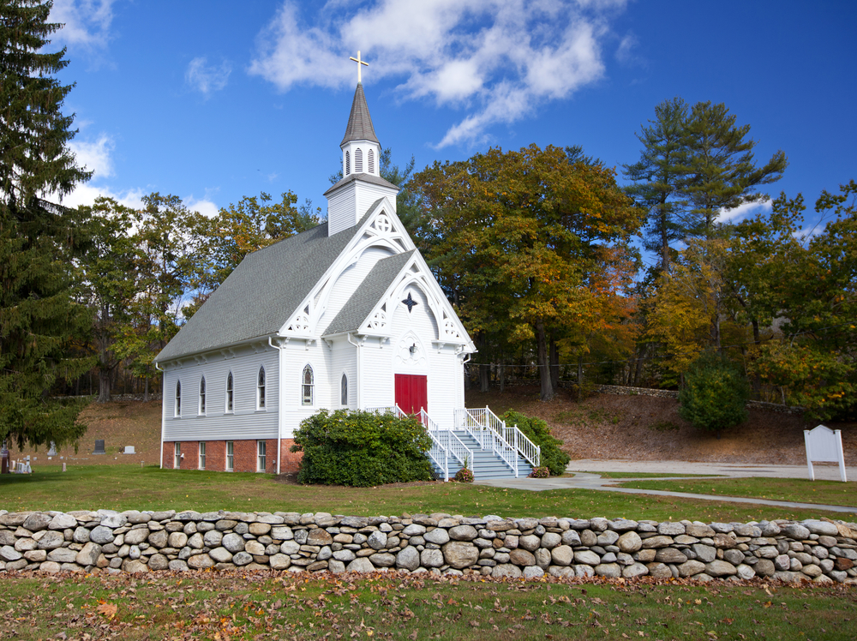
“Love” and “application” without truth and knowledge
Notes:
For those of you familiar with the 18th Century Great Awakening in the American Colonies, the greatest “revival” in the history of America, you may recall that Jonathan Edwards concluded that biblical and theological ignorance was behind the errors that produced the greatest damage to the Awakening. Some of its loudest and most zealous supporters brought the greatest shame upon the Awakening by their mistaken “theological ideas.” <NEXT>

Slide 23
Wrong Approaches to Theology
Zeal without knowledge is dangerous and destructive.
Notes:
Zeal without knowledge is dangerous and destructive. Love and application require the objective, propositional truth of Scripture, without which, we have nothing to offer. <NEXT>

Slide 24
Wrong Approaches to Theology
“Brethren, my heart's desire and my prayer to God for them is for their salvation. For I bear them witness that they have a zeal for God, but not in accordance with knowledge.”
Romans 10:1-2
Notes:
[READ SLIDE]
Zeal without knowledge makes trouble and gets no one to heaven. <NEXT>

Slide 25
Wrong approaches to theology can lead to:
Notes:
Wrong approaches to theology can lead to a host of problems. We won’t spend time on this, so I will just quickly scroll through a few examples. <NEXT>

Slide 26
Wrong approaches to theology can lead to:
wrong views of God and His works
Notes:
[READ SLIDE]
If blasphemy is saying false and dishonoring things about the person and works of God, then this is a particularly troubling result. We risk the idolatry of worshipping a false “god” by making God into our own image, according to our own fallen desires. <NEXT>

Slide 27
Wrong approaches to theology can lead to:
wrong views of God and His works
a false gospel
Notes:
[READ SLIDE]
We can end up presenting a watered-down, false, or poisonous medicine to a world in need of the true and uncompromised Gospel of Christ. <NEXT>

Slide 28
Wrong approaches to theology can lead to:
wrong views of God and His works
a false gospel
the true Gospel with wrong motives
Notes:
[READ SLIDE]
Even if we get the facts straight, a proper Gospel presented with wrong motives is unacceptable worship and service before God. <NEXT>

Slide 29
Wrong approaches to theology can lead to:
wrong views of God and His works
a false gospel
the true Gospel with wrong motives
dishonor to God in service to God
Notes:
[READ SLIDE]
Even with proper motives, incorrect theology can lead to our dishonoring God with all our strength and zeal. <NEXT>

Slide 30
Wrong approaches to theology can lead to:
wrong views of God and His works
a false gospel
the true Gospel with wrong motives
dishonor to God in service to God
a false profession and false security
Notes:
[READ SLIDE]
<NEXT>

Slide 31
Wrong approaches to theology can lead to:
a focus on technique over prayer
Notes:
[READ SLIDE]
A particular problem of our modern age. <NEXT>

Slide 32
Wrong approaches to theology can lead to:
a focus on technique over prayer
a focus on results over faithfulness
Notes:
[READ SLIDE]
Another particular problem of our modern age. This is a sure way, especially in an increasingly apostate world, to have… <NEXT>

Slide 33
Wrong approaches to theology can lead to:
a focus on technique over prayer
a focus on results over faithfulness
burnout and loss of joy
Notes:
[READ SLIDE]
And lastly, and most importantly, an improper approach to theology can result in… <NEXT>

Slide 34
Wrong approaches to theology can lead to:
a focus on technique over prayer
a focus on results over faithfulness
burnout and loss of joy
eternal condemnation
Notes:
[READ SLIDE]
What, then, is the proper approach to theology and apologetics? <NEXT>

Slide 35
The Proper Approach to Theology
Seeking the knowledge of God, in order to love, honor and obey God,
for the glory of God.
Notes:
[READ SLIDE]
<NEXT>

Slide 36
The Proper Approach to Theology
The end of all learning is to know God, and out of that knowledge to love and imitate Him.
— John Milton
A Puritan Golden Treasury, Banner of Truth Trust.
Notes:
John Milton put it this way… [READ SLIDE]
<NEXT>

Slide 37
The Definition of Apologetics
Notes:
What, then, is the definition of apologetics? <NEXT>

Slide 38
Definition of Apologetics
From Apologia: A defense, a reply to an accusation or judgment*
“hear the defense I now make” (Acts 22:1)
“defense against the charges” (Acts 25:16)
“my reply to those who sit in judgment” (1 Cor. 9:3)
“vindication” (2 Cor. 7:11)
* A Greek-English Lexicon of the New Testament, Bauer, Arndt, Gingrich, 96.
Notes:
The term apologetics, comes from the Greek word apologia, which simply means… [READ SLIDE]
John Bunyan introduces Pilgrim’s Progress with an “apology for his book,” defending his use of allegory to teach theological lessons. Part of Calvin’s motivation for the Institutes was to present an apology, a defense of Protestant Christianity to King Francis I of France.
Please turn with me to 1Peter 3:15 where we find a verse that will provide us with a definition of apologetics. <NEXT>

Slide 39
Definition of Apologetics
“But sanctify Christ as Lord in your hearts, always being ready to make a defense to everyone who asks you to give an account for the hope that is in you, yet with gentleness and reverence.”
1 Peter 3:15
Notes:
[READ SLIDE]
<NEXT>

Slide 40
Definition of Apologetics
Key Elements:
Notes:
From this verse we learn several important principles of apologetics, such as…
<NEXT>

Slide 41
Definition of Apologetics
Key Elements:
Lordship of Christ
Notes:
[READ SLIDE]
<NEXT>

Slide 42
Definition of Apologetics
Key Elements:
Lordship of Christ
Readiness
Notes:
[READ SLIDE]
<NEXT>

Slide 43
Definition of Apologetics
Key Elements:
Lordship of Christ
Readiness
Defense
Notes:
[READ SLIDE]
<NEXT>

Slide 44
Definition of Apologetics
Key Elements:
Lordship of Christ
Readiness
Defense
Proclamation and Explanation
Notes:
[READ SLIDE]
<NEXT>

Slide 45
Definition of Apologetics
Key Elements:
Lordship of Christ
Readiness
Defense
Proclamation and Explanation
Gentleness and Reverence
Notes:
[READ SLIDE] The context of 1Peter 3:15 is important. Look with me, beginning in verse 8… [READ through v. 17]
<NEXT>

Slide 46
Definition of Apologetics
“To sum up, all of you be harmonious, sympathetic, brotherly, kindhearted, and humble in spirit: ⁹ Not returning evil for evil or insult for insult, but giving a blessing instead; for you were called for the very purpose that you might inherit a blessing…
Notes:
[READ SLIDE]
<NEXT>

Slide 47
Definition of Apologetics
¹⁰ For, ‘Let him who means to love life and see good days refrain his tongue from evil and his lips from speaking guile.’ ¹¹ ‘And let him turn away from evil and do good; let him seek peace and pursue it.’ ¹² ‘For the eyes of the Lord are upon the righteous, and His ears attend to their prayer…
Notes:
[READ SLIDE]
<NEXT>

Slide 48
Definition of Apologetics
but the face of the Lord is against those who do evil.’ ¹³ And who is there to harm you if you prove zealous for what is good? ¹⁴ But even if you should suffer for the sake of righteousness, you are blessed. And do not fear their intimidation, and do not be troubled…
Notes:
[READ SLIDE]
<NEXT>

Slide 49
Definition of Apologetics
¹⁵ but sanctify Christ as Lord in your hearts, always being ready to make a defense to everyone who asks you to give an account for the hope that is in you, yet with gentleness and reverence; ¹⁶ and keep a good conscience so that in the thing in which you are slandered…
Notes:
Now here’s our verse… [READ SLIDE]
<NEXT>

Slide 50
Definition of Apologetics
those who revile your good behavior in Christ may be put to shame. ¹⁷ For it is better, if God should will it so, that you suffer for doing what is right rather than for doing what is wrong.”
1 Peter 3:8-17
Notes:
[READ SLIDE]
<NEXT>

Slide 51
Definition of Apologetics
The defense and proclamation of the Gospel and all of God’s revealed truth, in a gentle and reverent method and manner, that properly honors Christ as Lord of all.
Notes:
With this in mind, and combining the elements of v. 15, we have a brief definition: “Apologetics is… [READ SLIDE]
And, as the perfections of God are the foundation of all meaningful thought and statements of truth, so they are not only the foundation of apologetics, but of all theology, philosophy, and life, both now and in glory forever.
How and why this is true, and the profound and comprehensive implications of this simple truth, will be the subject of the course. <NEXT>

Slide 52
The Place of Apologetics
Notes:
Now, what is the relationship of theology and philosophy to apologetics? <NEXT>

Slide 53
Theology and Apologetics
Notes:
For one, they both address… <NEXT>

Slide 54
Theology and Apologetics
God
Man
Reality
Notes:
[READ SLIDE]
<NEXT>

Slide 55
Theology and Apologetics
God
Man
Reality
Truth Knowledge
Authority
Notes:
They both address… [READ SLIDE]
<NEXT>

Slide 56
Theology and Apologetics
God
Man
Reality
Truth Knowledge
Authority
Ethics
Notes:
And they both address how we are to live, or ethics. <NEXT>

Slide 57
Theology and Apologetics
God
Man
Reality
Truth Knowledge
Authority
Ethics
Apologetics is essentially a theological task
Notes:
Therefore, apologetics is essentially a theological task. <NEXT>

Slide 58
Theology
Apologetics
Notes:
While sharing the same content or subjects as theology, as represented by the same colors, apologetics is a subset of theology, with a more narrow focus, viewing truth as it relates to arguments raised against the validity of Christianity and Scripture.
Not all would agree with this picture, however. <NEXT>

Slide 59
Theology and Apologetics
Philosophy
Notes:
One prominent view believes philosophy is the starting point that provides the principles and methodology used by apologists… <NEXT>

Slide 60
Theology and Apologetics
Philosophy
Apologetics
Notes:
to establish the truth and authority of Scripture, which then… <NEXT>

Slide 61
Theology and Apologetics
Philosophy
Apologetics
Theology
Notes:
…provides the basis for doing theology. Here, apologetics is not a subset, but a precursor to theology.
This implies, however, that a higher authority than God’s Word exists. And it implies that Scripture must be validated or certified by this higher authority. <NEXT>

Slide 62
Theology and Apologetics
Philosophy
Apologetics
Theology
Notes:
And as philosophy is done by people, it puts Scripture, in a sense, under the authority and the opinions and interpretations of people. <NEXT>

Slide 63
Theology and Apologetics
Theology
Philosophy
Philosophy
Apologetics
Apologetics
Theology
Notes:
The view presented in this course, however, is that Christian philosophy and apologetics are the product of theology. The necessity of theology as the starting point will become clear as the course progresses.
The basic truth that undergirds this approach is this... <NEXT>

Slide 64
The Foundation of Apologetics
As God is the source and sustainer of all things, so we depend upon God for all truth, knowledge, and authority.
Notes:
[READ SLIDE]
We, along with the entire world, depend upon God for everything, and that includes doing philosophy, apologetics, and, of course, theology. <NEXT>

Slide 65
The Foundation of Apologetics
God is the proper starting point for all meaningful thought and statements of truth.
Notes:
Therefore, [READ SLIDE]
How and why this is true is a central aspect of this course. This is not just an apologetics course, but a course in how to think, how to be a Christian, how to be human, how to develop a comprehensive, satisfying, God-honoring worldview. The principles taught in this course are fundamental to all aspects of life, including all theological study. Who is God? Who are we? How do we know, and how do we know what is true? What constitutes authority, truth, knowledge? How and why do we need Scripture? How should we think and live? <NEXT>

Slide 66
The Foundation of Apologetics
Knowledge of God
is the foundation of all proper thinking and living.
Notes:
The… [READ SLIDE]
He created and sustains all things and is therefore the source of all truth and knowledge of all things.
Therefore… <NEXT>

Slide 67
The Foundation of Apologetics
Theology
Philosophy
Philosophy
Apologetics
Apologetics
Theology
Notes:
…the knowledge of God and His universe, as He has revealed them to us… <NEXT>

Slide 68
The Foundation of Apologetics
Scripture
Philosophy
Theology
Apologetics
Philosophy
Apologetics
Theology
Notes:
… in Scripture, is the proper starting point and basis for apologetics, philosophy, theology, and all right thinking.
Of course, philosophy has not always been done this way, and Christians do not always do apologetics, and even theology, this way. But, when we examine the nature and implications of God’s attributes, God as the necessary starting point for all thought will become obvious. <NEXT>

Slide 69
The Foundation of Apologetics
Notes:
So, thus far we have briefly examined…
<NEXT>

Slide 70
The Foundation of Apologetics
The Proper Approach to Theology
Notes:
[READ SLIDE]
<NEXT>

Slide 71
The Foundation of Apologetics
The Proper Approach to Theology
The Definition of Apologetics
Notes:
[READ SLIDE]
<NEXT>

Slide 72
The Foundation of Apologetics
The Proper Approach to Theology
The Definition of Apologetics
The Relationship of Apologetics to Theology
Notes:
[READ SLIDE]
Which brings us to… <NEXT>

Slide 73
The Foundation of Apologetics
The Proper Approach to Theology
The Definition of Apologetics
The Relationship of Apologetics to Theology
The Proper Approach to Apologetics
Notes:
[READ SLIDE]
<NEXT>

Slide 74
The Proper Approach to Apologetics
To seek the knowledge of God and a God-honoring worldview, in order to love, honor, and obey God in the defense and declaration of the Gospel of Christ, to His glory.
Notes:
[READ SLIDE]
<NEXT>

Slide 75
Answering Objections to Apologetics
Notes:
Now, let’s answer a few objections to doing apologetics. <NEXT>

Slide 76
Answering Objections to Apologetics
“Apologetics is only for the most learned Christians, not all Christians.”
Notes:
[READ SLIDE]
Though in different ways and capacities (Romans 12:3-4), all Christians are called to defend and proclaim the Gospel (1 Peter 3:15).
All Christians are to be diligent students of Scripture (Acts 17:11) in order to grow in the grace and knowledge of the glorious person and works of God, to glorify Him and make Him known, to earnestly contend for the once-for-all-delivered-faith of the saints, and to give an answer of the hope that is within us. <NEXT>

Slide 77
Answering Objections to Apologetics
“Apologetics is only for the most learned Christians, not all Christians.”
“Apologetics is too philosophical and leads away from the simplicity of devotion to Christ.”
Notes:
[READ SLIDE] It can be, especially when philosophy, not theology, provides the starting point. But this does not argue against a proper, biblical approach.
Proper apologetics is fundamentally grounded in what Scripture has revealed to us about the person and works of God and our relationship to Him, and is rooted in Scripture from beginning to end (1 Corinthians 1:18-25; 2:6-13).
Also, the Gospel is both simple and infinitely profound. The study of theology (including apologetics), by God’s grace and power, will produce in us a comprehensive biblical worldview (i.e., a proper God-honoring understanding of God, His creation, and his ordering of all things for His purposes). <NEXT>

Slide 78
Theology (including apologetics) properly understood and applied, will protect us from going astray from the simplicity of love and devotion to Christ.
Notes:
[READ SLIDE]
<NEXT>

Slide 79
Answering Objections to Apologetics
“God does not need us to defend Himself.”
Notes:
[READ SLIDE] Very true. He needs nothing, but has graciously called and commanded us to participate in His marvelous plan of redemption, and that includes contending for the faith. In the same way, God is sovereign in salvation, but He has graciously called us to be His instruments in bringing the Gospel to the lost.
Jude 3 tells us… <NEXT>

Slide 80
“Beloved, while I was making every effort to write you about our common salvation, I felt the necessity to write to you appealing that you contend earnestly for the faith which was once for all delivered to the saints.”
Jude 3
Notes:
[READ SLIDE
Note that much in the New Testament is written to correct error in order to defend the faith. <NEXT>

Slide 81
Answering Objections to Apologetics
“God does not need us to defend Himself.”
“People are only saved by the Spirit of God and the Word of God, so just preach the Gospel.”
Notes:
[READ SLIDE] Yes, very true, but the Gospel presents a worldview contrary to all other worldviews, and calls for repentance from a false worldview… <NEXT>

Slide 82
God
Man
Reality
Truth Knowledge
Authority
Ethics
Notes:
…including false views of God, man, reality, knowledge, truth, authority, and how we should live. <NEXT>

Slide 83
God
Man
Reality
Truth Knowledge
Authority
Ethics
God
Man
Reality
Truth Knowledge
Authority
Ethics
Notes:
The Gospel calls unbelievers to repent of an entire worldview, and we need to understand it, and how and why Christ is the necessary fix. We must understand the comprehensive nature of sin. We speak of total depravity, but often forget that it includes a wrong view of truth, knowledge and authority, from which unbelievers need to repent. It is a huge, monumental, and comprehensive thing that we are asking people to repent of. If we do not understand these things, we may ask unbelievers to repent of some things while the biggest and most important things remain untouched.
So yes, it is all God’s work, but… <NEXT>

Slide 84
Answering Objections to Apologetics
God has called us to know well the problem and solution.
Notes:
[READ SLIDE]
Indeed, the better we understand the problem, the more we will grasp the necessity of Christ as the only possible solution. <NEXT>

Slide 85
Answering Objections to Apologetics
In exposing sin of unbelief, we highlight the need of God’s grace in the saving Gospel of Christ (Romans 1-3).
Notes:
In exposing sin of unbelief, we highlight the need of God’s grace in the saving Gospel of Christ (Romans 1-3). <NEXT>

Slide 86
Answering Objections to Apologetics
In exposing sin of unbelief, we highlight the need of God’s grace in the saving Gospel of Christ (Romans 1-3).
+
In defending the faith, we proclaim the Gospel and the truth of Scripture.
Notes:
And In defending the faith, we proclaim the Gospel and the truth of Scripture. <NEXT>

Slide 87
In learning answers to attacks on our faith:
Notes:
[READ SLIDE]
<NEXT>

Slide 88
In learning answers to attacks on our faith:
we build up our faith and the faith of others,
Notes:
[READ SLIDE]
<NEXT>

Slide 89
In learning answers to attacks on our faith:
we build up our faith and the faith of others,
we boost our trust in the truth and sufficiency of Scripture, and
Notes:
[READ SLIDE]
<NEXT>

Slide 90
In learning answers to attacks on our faith:
we build up our faith and the faith of others,
we boost trust in the truth and sufficiency of Scripture, and
we sharpen our ability to present and defend the Gospel in a gracious, undisturbed manner that honors to Christ (Phil. 1:27-28).
Notes:
[READ SLIDE]
Apologetics helps us to think and approach difficult questions in way that honors God. <NEXT>

Slide 91
Answering Objections to Apologetics
Notes:
Additional objections to apologetics include: <NEXT>

Slide 92
Answering Objections to Apologetics
“Studying Apologetics is not practical.”
Notes:
Some say that studying apologetics is not practical. But, since apologetics is part of theology (the study of God), to say it is not practical is to say that the study of God in Scripture is not practical. Yet, what can be more practical, foundational, and necessary to a Christian than the knowledge of God? Created and sustained by God, living in His universe, breathing His air, eating his food, with the brain and body He gives us, and somehow it is not practical to know about Him and know Him?? Moreover… <NEXT>

Slide 93
Apologetics/theology are practical because:
To be wrong about God is to worship an idol, a god of our own making.
Notes:
[READ SLIDE]
<NEXT>

Slide 94
Apologetics/theology are practical because:
To be wrong about God is to worship an idol, a god of our own making.
To know God is eternal life: “And this is eternal life, that they may know Thee, the only true God, and Jesus Christ whom Thou hast sent” (John 17:3).
Notes:
[READ SLIDE
<NEXT>

Slide 95
Apologetics/theology are practical because:
Love of God flows from the knowledge of God, through the Word of God and the illuminating work of the Holy Spirit giving us sight and understanding of the Word of God (Col. 2:1-3).
Notes:
[READ SLIDE
<NEXT>

Slide 96
Apologetics/theology are practical because:
The true knowledge of God is the foundation of faithful, joyful, fruitful, persevering obedience from a grateful heart of love to God (2 Cor. 5:14).
Notes:
[READ SLIDE
<NEXT>

Slide 97
Apologetics/theology are practical because:
The study of apologetics as part of theology furthers a comprehensive biblical understanding of God and His world.
Notes:
[READ SLIDE
You cannot get any more practical than that. <NEXT>

Slide 98
Answering Objections to Apologetics
“Studying Apologetics is not practical.”
“Knowledge makes proud”
Notes:
Another objection says that “knowledge makes proud,” and, indeed, it certainly can and does. But, knowledge without love makes proud, while true knowledge of God produces humility. <NEXT>

Slide 99
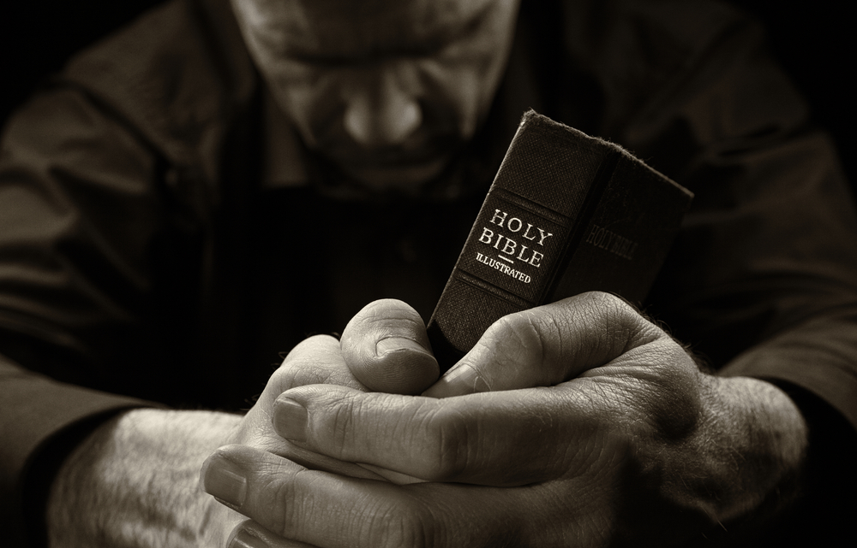
Notes:
Knowledge of God’s holiness and majesty reveals the great evil of our sin, the necessity and justice of God’s wrath against us, the infinite love, mercy, and grace of God in sending His Son for our salvation, the infinite glory of Christ in voluntarily taking upon Himself the infinite wrath of the Father in our place, and God’s amazing grace in adopting unworthy, wicked sinners, to be His children in His kingdom. <NEXT>

Slide 100
Answering Objections to Apologetics
The problem with pride is we don’t see our smallness in light of God’s greatness.
Notes:
[READ SLIDE]
…and we learn of our smallness compared to God’s greatness by knowledge of Him. <NEXT>

Slide 101
Answering Objections to Apologetics
The only solution to the sin of pride is knowing God.
Notes:
[READ SLIDE]
He gave us this infinite blessing despite our infinite unworthiness and unrighteousness. But by His grace we would be condemned to an eternity of torment. The deeper our knowledge of God, the greater will be our humility before God and men (see Philippians 3:1-16).
Knowledge without the obedience of love and gratitude makes proud (1 Corinthians 13:1-2).
Zeal without knowledge is worthless, or worse.
The greater our view of God, the smaller our view of self (Isaiah 6:1-5). <NEXT>

Slide 102
Next Up:
Assumptions of Faith,
The Ground of All Unbelieving Arguments
Notes:
[READ SLIDE]
And, as the perfections of God are the foundation of all meaningful thought and statements of truth, so they are not only the foundation of apologetics, but of all theology, philosophy, and life, both now and in glory forever.
How and why this is true, and the profound and comprehensive implications of this simple truth, will be the subject of the course. END

Slide 103
Copyright © 2014 by Craig Biehl, Pilgrim’s Rock, LLC
Unless otherwise indicated, Scripture taken from the NEW AMERICAN STANDARD BIBLE, © Copyright The Lockman Foundation 1960, 1962, 1963, 1968, 1971, 1972, 1973, 1975, 1977, 1988, 1995. Used by permission.
Scripture quotations marked (ESV) are from The Holy Bible, English Standard Version® (ESV®), copyright © 2001 by Crossway, a publishing ministry of Good News Publishers. Used by permission. All rights reserved.

