Slide 2
Unbreakable Faith
How God’s Perfections Give Life, Joy, and Thriving Assurance in a World of Unbelief

Slide 3
Section Five
God Is an Undivided Unity

Slide 4
God Is a Unity
All of God’s perfections describe God’s eternal and unchanging being and character, and are always true, without division, hierarchy, or separation.
Notes:
God’s unity means that [READ SLIDE]
They all describe who God is, all of the time. God is always, at all times, just, holy, merciful, etc. John Frame adds that “God relates to us as a whole person, not as a collection of attributes. The attributes merely describe different things about him.”* God is not parts, justice over here, love over here. Every attribute describes all of God, all at the same time. God cannot be separated into parts. And as God is Triune, all of the Divine attributes apply equally to each of the persons of the Trinity. <NEXT>
*Frame, Doctrine of God, 230.

Slide 5
God Is a Unity
"Hear, O Israel! The LORD is our God, the LORD is one!” Deuteronomy 6:4
Notes:
[READ SLIDE]
<NEXT>

Slide 6
God Is a Unity
No attribute of God can be in conflict with another attribute of God.
Notes:
[READ SLIDE]
In other words, no contradictions exist within God.
Nonetheless, a common argument against faith in Christ claims that some of the attributes of God are incompatible with other attributes of God, as they are revealed in Scripture. Or, given the nature of the world, certain attributes of God are mutually contradictory, For example… <NEXT>

Slide 7
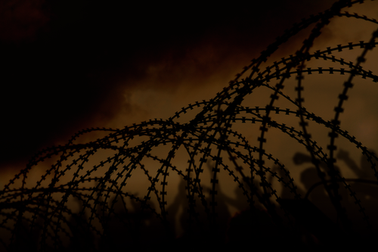
“The Problem of Evil”
Notes:
“The problem of evil” is, perhaps, one of the most well-known of such arguments against Christian faith, where it is argued that God cannot be both all powerful and holy, given the fact that evil exists in the world. One version of the argument goes like this… <NEXT>

Slide 8
“The Problem of Evil”
If God is perfectly good, He would prevent evil.
Notes:
[READ SLIDE]

Slide 9
“The Problem of Evil”
If God is perfectly good, He would prevent evil.
If God is omnipotent, He could prevent evil.
Notes:
[READ SLIDE]
God hates evil and opposes it, and has the ability to prevent evil, as nothing can stop God from doing what He wants to do. <NEXT>

Slide 10
“The Problem of Evil”
If God is perfectly good, He would prevent evil.
If God is omnipotent, He could prevent evil.
Evil exists.
Notes:
[READ SLIDE]
<NEXT>

Slide 11
“The Problem of Evil”
If God is perfectly good, He would prevent evil.
If God is omnipotent, He could prevent evil.
Evil exists.
God is not good and or not omnipotent.
Notes:
Therefore… [READ SLIDE]
Given the existence of evil, God cannot be both good and all-powerful. That, in a nutshell, is the so-called “problem of evil.” And because Scripture says God is both perfectly good and infinitely powerful, Scripture cannot be true and the God that Scripture describes cannot exist. In other words, it is illogical that a God of perfect goodness and power could exist given the existence of evil in the world. Thus, the argument pits God’s goodness or holiness against His power. <NEXT>

Slide 12
Related “Problems”
Notes:
Many arguments against faith in Christ resemble the problem of evil, or restate the argument in a slightly different way or context.
For instance… <NEXT>

Slide 13
Related “Problems”
Predestination (or sovereignty) and moral responsibility
Notes:
[READ SLIDE] …are viewed as incompatible. In other words, how can God predestine everything and people still be held responsible for their sin. Romans 9 addresses this particular argument. Scripture teaches that God predetermines all things and that people are responsible for their own sin. But if God knows all things before they come to pass, and He brings all things into existence and foreordains all things, how can He not be the responsible cause of sin? And if God is the ultimate cause of sin, He is unholy and unable to justly condemn sin. How then could God judge the world?
If, on the other hand, God is unable to control evil, He is not sovereign over all things. Again, given that evil exists, God’s holiness appears incompatible with His sovereignty, in addition to his sovereignty appearing incompatible with human responsibility for sin. We’ll talk of this more when we speak of God’s infinite knowledge. <NEXT>

Slide 14
Related “Problems”
Predestination (or sovereignty) and moral responsibility
Did God create evil?
Notes:
Another related problem is… [READ SLIDE] How can it be that a perfect God, whose acts are perfect, created angels and people that became evil? God is the source of all things, He even created Lucifer, He created all the angels, He created all of us, He created Adam and Eve. How can a perfect God create a being that goes bad? Yes, God created them with free will, but God gave them their free will and knew they would sin when He created them. Or, again, if God predetermines all things, how can He not be responsible for their sin? <NEXT>

Slide 15
Maybe
“God did not know they would sin”
Notes:
<READ SLIDE> One might say that God did not know they would sin to protect God’s holiness. He created them perfect and gave them free will, but did not know when He created them that they would sin. This is a common argument among “Open Theists.” For some it is a way, though a naïve and unbiblical way, to protect God’s holiness. To others, it stems from a low view of God, as God is subject to the limitations of what He created. <NEXT>

Slide 16
Maybe
“God did not know they would sin”
But this cannot be true because it denies God’s perfect knowledge
Notes:
<READ SLIDE>
All such explanations deny God’s perfect knowledge, a truth clearly taught in Scripture. <NEXT>

Slide 17
Maybe
“The choice of evil is needed to have free will”
Notes:
[READ SLIDE]
<NEXT>

Slide 18
Maybe
“The choice of evil is needed to have free will”
But this cannot be true because:
God was free before evil existed and He cannot choose evil.
Notes:
[READ SLIDE]
<NEXT>

Slide 19
Maybe
“The choice of evil is needed to have free will”
But this cannot be true because:
God was free before evil existed and He cannot choose evil.
We will be most free in heaven where no evil will exist.
Notes:
[READ SLIDE]
<NEXT>

Slide 20
Maybe
“The choice of evil is needed to have free will”
But this cannot be true because:
God was free before evil existed and He cannot choose evil.
We will be most free in heaven where no evil will exist.
Christ set us free from evil, not to the option of choosing it.
Notes:
[READ SLIDE]
Human freedom is not improved by having bad options to choose from. <NEXT>

Slide 21
Notes:
[READ SLIDE] Imagine sitting down to dine in a nice restaurant. You open the menu and note the many excellent and tasty choices. At the same time, you notice observe that the menu does not list cat box pizza, rotten eggs, or dirt casserole, or other miserable choices. Now ask the question, were you cheated? <NEXT>

Slide 22
Human freedom is not improved by having bad options to choose from.
Notes:
Would you complain to the waiter that your menu excludes pizza sprinkled with used kitty litter? No. At least, I hope not. Would you be made more free by having the option of cat box pizza on the menu? No. Does the option to choose something that will make you sick or kill you improve your situation, or make you more free? No.
<NEXT>

Slide 23
Biblical freedom is the ability to choose the best thing, not the ability to choose evil.
Notes:
[READ SLIDE] or the ability to choose that which is bad for us and dishonoring to God.
Our situation is not improved one iota by having the option to choose things that destroy us and others.
Scripture tells us that when the Son sets you free, you will be free indeed! He set us free to choose the best things, to choose the things that benefit us the most, to choose the very best thing, God’s glory. He set us free to choose Him, we already had the choice of evil. And again, you will never be more free than you will be in heaven where you will not have the option to choose evil. Heaven would be ruined by the presence of evil and the option to choose it. <NEXT>

Slide 24
Maybe
“God created beings with a propensity to sin”?
Notes:
[READ SLIDE]
Maybe God created Lucifer, Adam, and Eve with evil hearts bent toward sin. <NEXT>

Slide 25
Maybe
“God created beings with a propensity to sin”?
But this cannot be true because it makes God unholy and responsible for their sin by creating them with the defect that is the cause of evil.
Notes:
[READ SLIDE]
God is perfect and everything He does is perfect. <NEXT>

Slide 26
Maybe
“God created evil to display His goodness”?
Notes:
[READ SLIDE]
<NEXT>

Slide 27
Maybe
“God created evil to display His goodness”?
But this cannot be true because it says that God does evil that good may result, a principle strongly condemned in Scripture.
(See Romans 3:8)
Notes:
[READ SLIDE]
Imagine that I want to display to you my goodness and mercy, so I take our cat… <NEXT>

Slide 28
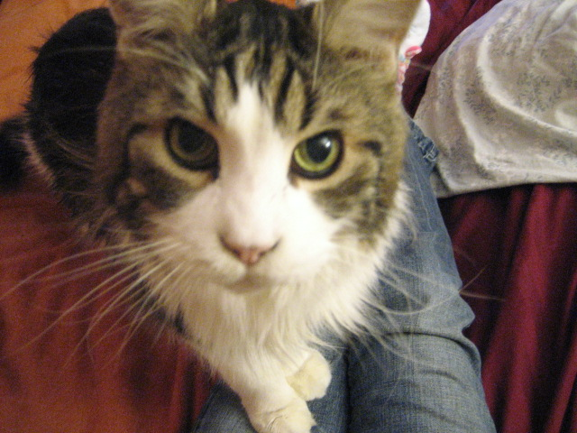
Notes:
… here’s a picture of our cat, and I beat it with a stick and show you how good I am by nursing it back to health. Does that work for you? Are you impressed by such “goodness”? Of course not, it is evil to do such a thing. Can we really attribute that to an infinitely good and holy God? Absolutely not. God does not create evil that good may result… <NEXT>

Slide 29
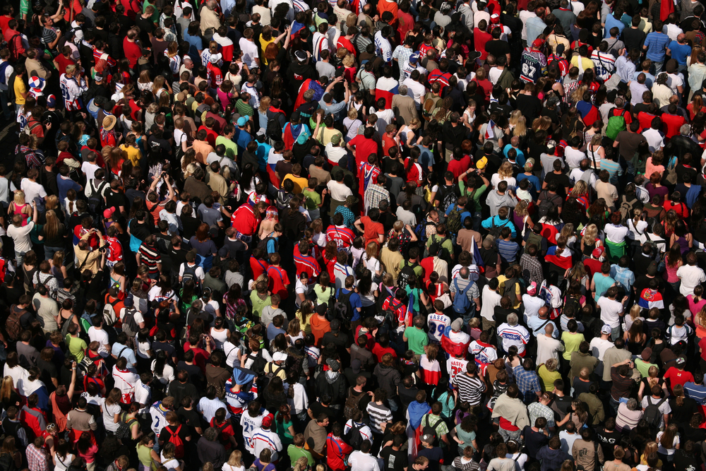
Notes:
He does not create billions of people for hell, apart from consideration of their personal choice to sin, in order to show us how good He is by rescuing a few. He does show us His mercy by rescuing sinners, but He rescues them from the mass of people who are freely responsible for their own sin. <NEXT>

Slide 30
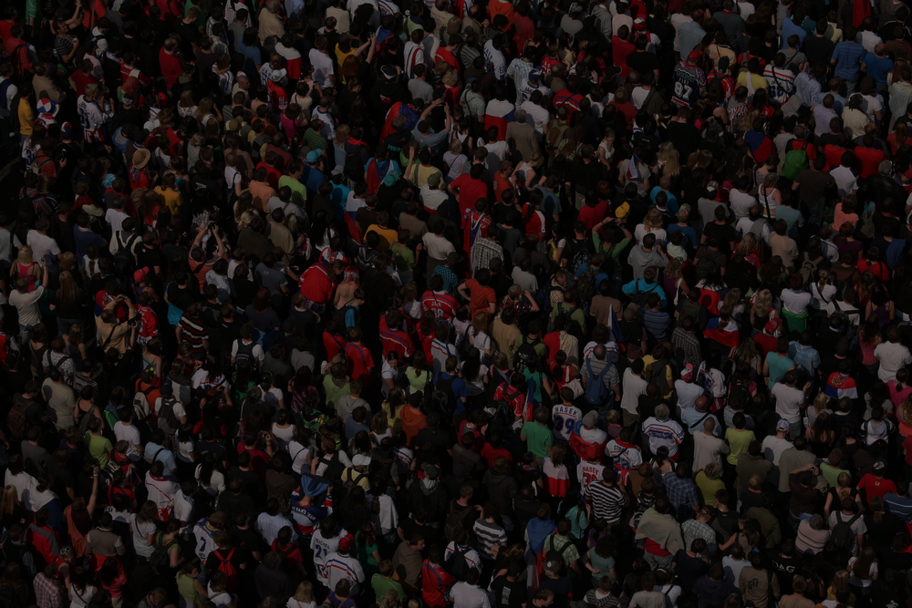
“Does not the potter have a right over the clay, to make from the same lump one vessel for honorable use, and another for common use?”
Romans 9:21
Notes:
In Romans 9, He saves people from an already fallen lump of clay.
Sometimes we need to better think through biblically our attempts to solve difficult theological questions. <NEXT>

Slide 31
Maybe
“Evil is the equal opposite of good”?
Notes:
[READ SLIDE]
<NEXT>

Slide 32
Maybe
“Evil is the equal opposite of good”?
But this cannot be true because:
God alone existed eternally as holy until He created beings with a free will.
Notes:
[READ SLIDE]
<NEXT>

Slide 33
Maybe
“Evil is the equal opposite of good”?
But this cannot be true because:
God alone existed eternally as holy until He created beings with a free will.
Evil began in the will of created beings, and will have an end.
Notes:
[READ SLIDE]
Moral evil does not exist as some abstract thing by itself; it only exists in the will of created beings; it exists no where else. <NEXT>

Slide 34
Maybe
“Evil is the equal opposite of good”?
But this cannot be true because:
God alone existed eternally as holy until He created beings with a free will.
Evil began in the will of created beings, and will have an end.
Good is an eternal perfection of God that will never end.
Notes:
[READ SLIDE]
Evil is temporary and will be abolished forever.
The view that evil is necessary to know good will be discussed further under the implications of God’s goodness. <NEXT>

Slide 35
Maybe
“God cannot be both just and merciful”?
Notes:
[READ SLIDE] …because mercy spares what justice requires.
This is a legitimate question, but easily answered by Scripture. God, indeed, can never allow the guilty to go unpunished or compromise His justice in the smallest degree in order to be merciful to a sinner. <NEXT>

Slide 36
Maybe
“God cannot be both just and merciful”?
But Christ satisfied God’s justice on our behalf so He can be merciful to us without compromising His justice.
Notes:
[READ SLIDE]
<NEXT>

Slide 37
Maybe
“God cannot be both just and merciful”?
Christ perfectly satisfied the unchanging and strict requirements of God’s justice by His perfect obedience and perfect sacrifice to bear the just penalty for sin.
Notes:
[READ SLIDE]
Christ fully satisfied the requirements of God’s justice on behalf of unrighteous sinners. Such is why… <NEXT>

Slide 38
Maybe
“God cannot be both just and merciful”?
God can “justify the ungodly” and “be just and the justifier of the one who has faith in Jesus”
(Romans 4:5; 3:26).
Notes:
[READ SLIDE]
<NEXT>

Slide 39
Maybe
“God cannot be both just and merciful”?
Christ was the propitiation for sin in order “to show God’s righteousness” in saving sinners (Romans 3:25). This is part of the beauty of the Gospel.
Notes:
[READ SLIDE]
<NEXT>

Slide 40
Maybe
“God cannot be both just and merciful”?
God both satisfies His justice and exercises infinite mercy upon unholy sinners through the substitutionary work of Christ.
Notes:
[READ SLIDE]
<NEXT>

Slide 41
Maybe
“God cannot know the future and be free”?
Notes:
Some say God cannot know the future and be free, because a future act that is known before it happens cannot be changed from what it was already known to be. If God knows what His future act will be, it is predetermined and not free. If God changes His choice, the argument goes, His original knowledge was incorrect. In the same way, they argue, if people are truly free, God cannot know their future acts. <NEXT>

Slide 42
Maybe
“God cannot know the future and be free”?
But Scripture clearly teaches that God knows all things, including the future, and remains perfectly free.
Notes:
[READ SLIDE]
We may have difficulty reconciling these two things by a standard of logic or philosophy, but God is not so limited. His ways are infinitely beyond our ways, how could we possibly know otherwise? Our limited perspective and understanding of an infinite God is not the final word as to what God can or cannot do. If I could figure out all such mysteries, I would be God.
Earlier we noted the argument that God cannot be both transcendent and personal, or be outside of time and act within time at the same time. Again, Scripture teaches that God is both transcendent and personal. Many such arguments that pit one attribute of God against another are proposed to argue against the existence of God. But, as we will see later, the biblical principles that answer one of the above arguments will answer all of such arguments. <NEXT>

Slide 43
What We Can Say About Evil
Notes:
Well… [READ SLIDE]
<NEXT>

Slide 44
What We Can Say About Evil
Evil is not the equal opposite of good.
Notes:
<READ SLIDE>
<NEXT>

Slide 45
What We Can Say About Evil
Evil is not the equal opposite of good.
God did not create evil; it began in the will of the creature.
Notes:
<READ SLIDE>
<NEXT>

Slide 46
What We Can Say About Evil
Evil is not the equal opposite of good.
God did not create evil; it began in the will of the creature.
Evil only exists in the will of creatures.
Notes:
<READ SLIDE>
<NEXT>

Slide 47
What We Can Say About Evil
Evil is not the equal opposite of good.
God did not create evil; it began in the will of the creature.
Evil only exists in the will of creatures.
Evil is not eternal; it is a temporary abnormality.
Notes:
<READ SLIDE>
<NEXT>

Slide 48
What We Can Say About Evil
Evil is not the equal opposite of good.
God did not create evil; it began in the will of the creature.
Evil only exists in the will of creatures.
Evil is not eternal; it is a temporary abnormality.
Evil is not necessary.
Notes:
<READ SLIDE>
<NEXT>

Slide 49
God Is a Unity
No attribute of God can be in conflict or opposition with another attribute of God.
Notes:
Remember, the doctrine of God’s unity tells us that… [READ SLIDE]
The being, persons, and attributes of God exist in perfect harmony; no contradictions or incompatibilities in God are possible. God cannot be at war with Himself, He cannot contradict Himself. Nonetheless, apparent incompatibilities or logical difficulties between the attributes, from a fallen, limited, human perspective are often used as arguments against the existence of God. <NEXT>

Slide 50
God
∞
“Gap”
Man
Notes:
Difficulties reconciling God’s revelation of Himself and the world as it exists can be reduced to the infinite difference between God and His people. Limited in perspective and knowledge in the face of an infinite God, we depend on God who determines all truth. We simply cannot fully grasp the infinite. <NEXT>

Slide 51
God
∞
“Gap”
Mystery
Man
Notes:
We have already seen that mystery is right and reasonable in a universe created and sustained by an infinite God, given that we are not infinite. The desire to reconcile every “apparent” tension or incompatibility of God’s revelation with our limited understanding reflects a refusal to accept that we are not God. I say “apparent tension or incompatibility” because that reflects our limited perspective, no tensions or incompatibilities exist in God. <NEXT>

Slide 52
Human Opinion
Man
“god”
Notes:
To reject what God has revealed about Himself and His universe because we do not understand it repeats the sin of Adam and Eve by making our limited understanding the ultimate standard of truth. It says, in effect, “what I cannot understand cannot be true, and only what I can understand can be true.” If truth is only what we can understand, then God is not God. <NEXT>

Slide 53
Notes:
As believers we delve deeply into the Scriptures. But sometimes, from a lack of systematic and comprehensive knowledge of what God has clearly revealed, we create mysteries where no mysteries exist.
“The secret things belong to the Lord our God while the things revealed belong to us,” but sometimes we reverse these, making things revealed into secret things and attempting to make secret things into things revealed by making things up or speculating. The cure for this is growing in our love and knowledge of God through a greater love and knowledge of Scripture. Some tensions are not tensions, but merely a lack of theological understanding. Some mysteries are not mysteries, they just require a little more exegesis of the text, a little more theological study. <NEXT>

Slide 54
Notes:
We cannot fully grasp the origin of evil in a world created, ordered, and sustained by a good and omnipotent God, but our limited understanding is not the final authority of what is possible and impossible with an infinite God. The fact that I cannot understand something does not make it untrue, it just means I can’t understand it. By every means available we should pursue God’s word and learn about God’s universe through scientific study. But when confronted with deep mystery, we rightly admit our limitations and humbly refuse the irreverent debasing of God--we don’t deny one or more attributes of God in order to emphasize or affirm another attribute. We have to be comfortable living within the gap of God’s infinity and our limitations. <NEXT>

Slide 55
“The Problem of Evil”
If God is perfectly good, He would prevent evil.
If God is omnipotent, He could prevent evil.
Evil exists.
God is not good and or not omnipotent.
Notes:
Now, a few more thoughts about the problem of evil: the premise “if God is perfectly good, He would prevent evil” is an unsupportable assumption. How can someone know for sure that God will always prevent evil? We have already seen that human limitations make us incapable of answering ultimate questions about God and His universe apart from His revelation. But God’s revelation clearly states that God has allowed free beings to sin.
Some say this is a contradiction, making Scripture and the God of Scripture untrue. But how can they know that a perfectly good God would always prevent evil? From our limited human perspective, we can understand why a parent might allow a child to do something wrong. Could a God of infinite wisdom allow sinful acts for reasons we cannot understand? Yes. The assumption that He would not is not provable and something we cannot know unless He tells us.
<NEXT>

Slide 56
Notes:
To deny mystery is to deny the infinite “gap” between ourselves and God and presume our limited understanding to be the ultimate standard of truth. Limited people cannot fully understand the ways of an infinite God, and we can only know what He has chosen to reveal to us, and He has revealed that He has allowed free beings to sin.
<NEXT>

Slide 57
Notes:
For limited people to presume to know otherwise, to know what cannot be known apart from God’s revelation, or contrary to God’s revelation, is unreasonable. <NEXT>

Slide 58
Notes:
Most attempts to answer the problem of evil either redefine evil, like calling it merely the absence of good, like a hole in a sock, or give reasons why evil exists. But evil is an active force of the will, not just the absence of good. And the worst and most untenable attempts to answer the problem propose compromising one or more attributes of God, an unacceptable approach, as we will see. We have to be comfortable with the infinite gap between God and our understanding. <NEXT>

Slide 59
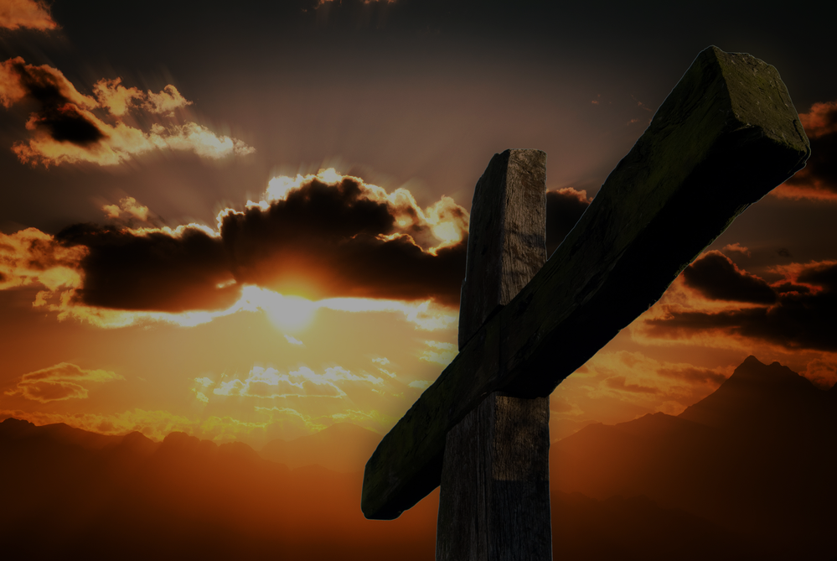
Notes:
Now, we know that in the crucifixion of Christ God has taken the worst evil ever perpetrated in the universe and produced the best possible outcome from it, producing infinite good from infinite evil. God can do that. But saying that God brought infinite good from infinite evil is not to say that God perpetrated infinite evil to bring about infinite good. The former is true, the latter is blasphemy, saying that God did evil that good may result. God can never to evil that good may result. <NEXT>

Slide 60
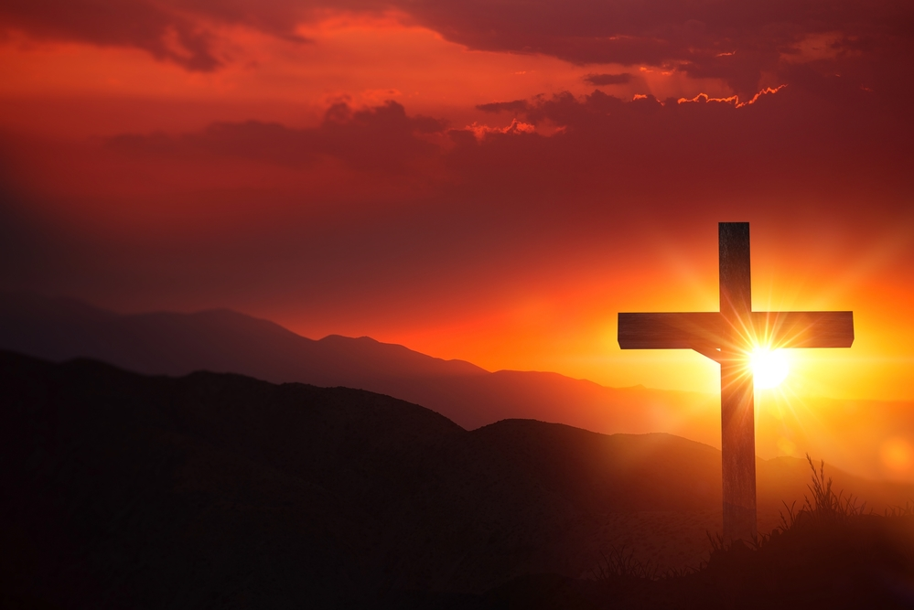
Notes:
We know from the perfection and unity of God, no attribute of God as revealed in Scripture can be compromised and no one attribute of God can be in conflict with another attribute. If a single attribute of God is compromised, God would not be God. We see this most clearly at the cross where God went the infinite extent, at infinite cost to Himself, suffering infinite wrath, to maintain His perfect justice, to avoid compromising His justice to the smallest degree in order to bring people to glory. If the cross tells us anything, it tells us that God cannot compromise any of His perfections. No matter how great God’s love is to His people, He cannot save a single soul by compromising His justice. <NEXT>

Slide 61
Responding to Apparent Contradictions
Notes:
How, then, do we respond to apparent contradictions. From our short survey we can see that attempts by people of limited perspective to logically reconcile certain theological difficulties, including the seemingly incompatible nature of various attributes of God, often create additional problems and the denial of other attributes of God.
How do we answer those who would point to mysteries to deny the existence of the God of Scripture? Can we logically reconcile the apparent contradictions?
While a comprehensive list of answers to each theological problem is beyond the scope of this work, Scripture provides the basic answer to all such problems in the nature of God’s perfections. The “problem of evil,” and all such theological difficulties, are answered in light of the infinite excellence of God.
A God-honoring approach to all such theological problems involves acceptance of the following biblical truths. <NEXT>

Slide 62
Responding to Apparent Contradictions
God’s ways are perfect and infinitely above our ways (mystery is proper).
Notes:
[READ SLIDE]
<NEXT>

Slide 63
“For My thoughts are not your thoughts, neither are your ways My ways, declares the LORD. For as the heavens are higher than the earth, so are My ways higher than your ways and My thoughts than your thoughts.”
Isaiah 55:8-9
Notes:
[READ SLIDE]
An easy text for us to understand, but a difficult Scripture for us to embrace and apply on a daily basis. <NEXT>

Slide 64
“Then the LORD answered Job out of the whirlwind and said: ‘Who is this that darkens counsel by words without knowledge? Now gird up your loins like a man, and I will ask you, and you instruct Me! Where were you when I laid the foundation of the earth? Tell Me, if you have understanding.’”
Job 38:1-4
Notes:
[READ SLIDE]
A great verse that puts us in our place. Job had a good many complaints against God, but he had no idea what was going on behind the scenes. <NEXT>

Slide 65
“Who has measured the waters in the hollow of His hand, and marked off the heavens by the span, and calculated the dust of the earth by the measure, and weighed the mountains in a balance, and the hills in a pair of scales?
Notes:
[READ SLIDE]
<NEXT>

Slide 66
Who has directed the Spirit of the LORD, or as His counselor has informed Him? With whom did He consult and who gave Him understanding? And who taught Him in the path of justice and taught Him knowledge, and informed Him of the way of understanding?”
Isaiah 40:12-14
Notes:
[READ SLIDE]
A rhetorical question, the answer, of course, is no one.
<NEXT>

Slide 67
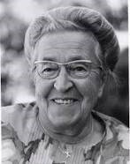
Responding to Apparent Contradictions
Notes:
In reading about the experience of Corrie ten Boom I came across the Corrie ten Boom Museum website. They have created a virtual tour of her house in the Netherlands, recounting some of the events surrounding her family giving safe haven to Jews and their subsequent arrest and imprisonment. Towards the end of the tour the narrator spoke of Corrie’s ministry some years after her release from the Ravensbruck concentration camp. They tell of how the Lord used her to bring reconciliation and forgiveness to some of the very people who participated in the evil of the Holocaust, including some who worked at the concentration camp where she was imprisoned.
<NEXT>

Slide 68
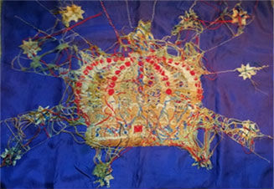
Responding to Apparent Contradictions
Photo courtesy of tenboom.org
Notes:
In her ministry after the war, Corrie would carry with her an embroidered piece of blue cloth to illustrate how Christians should view life’s difficulties. In her conversations she would display the backside of the cloth, a chaotic jumble of different colored threads, giving the impression that she had held up the wrong side of the embroidery. Then she would ask, “Does God always grant us what we ask for in prayer?” After a brief pause she would answer, “Not always. Sometimes He says no. That is because God knows what we do not know. God knows all. Look at this piece of embroidery, the wrong side is chaos. But look at the beautiful picture on the other side, the right side.” <NEXT>

Slide 69
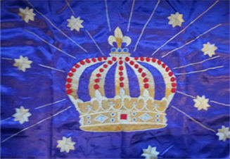
Responding to Apparent Contradictions
Photo courtesy of tenboom.org
Notes:
Corrie would then turn the cloth over to reveal a beautiful image of a crown, made with threads of many different colors and overlaid with pearl, “symbolizing our crown of eternal life.” She would then quote the following poem:
My life is but a weaving, between my God and me, I do not choose the colors, He worketh steadily, Oft times He weaveth sorrow, and I in foolish pride, Forget He sees the upper, and I the underside. Not till the loom is silent, and shuttles cease to fly, Will God unroll the canvas and explain the reason why. The dark threads are as needful in the Weaver's skillful hand, As the threads of gold and silver in the pattern He has planned.
Our past, present and future circumstances are in God’s hands, while Romans 8:18 tells us “that the sufferings of this present time are not worth comparing with the glory that is to be revealed to us.” All suffering must be viewed in light of the brevity of life and endless eternity, the excellence of God displayed in Christ and the extent to which He went to remedy evil, God’s perfect wisdom in His ordering of our life and the world, and our profoundly limited human perspective. We look forward to the day when we will see our skillful Weaver face to face and view the “upper side” of His perfect purpose and plan. Until that marvelous day we see dimly, and trust His perfect wisdom in the ordering of our circumstances. <NEXT>

Slide 70
God
The infinite “gap” means:
Mystery is reasonable
∞
“Gap”
Man
Notes:
God’s ways are perfect and infinitely above our ways. The infinite gap means mystery is both reasonable and to be expected. We only see the backside of the embroidery, some day we will see the other side. <NEXT>

Slide 71
Responding to Apparent Contradictions
God’s ways are perfect and infinitely above our ways (mystery is proper).
As created, finite, and dependent upon God for all knowledge, we can only know what God has revealed to us.
Notes:
[READ SLIDE]
<NEXT>

Slide 72
“The secret things belong to the LORD our God, but the things revealed belong to us and to our sons forever, that we may observe all the words of this law.”
Deuteronomy 29:29
Notes:
[READ SLIDE]
<NEXT>

Slide 73
Creator
Independent
Infinite
The infinite “gap” means:
Mystery is reasonable
Revelation is necessary
∞
Man
Finite
Dependent
Notes:
[READ SLIDE] The gap must be bridged if we are to know anything about God. He bridged the gap in communicating to us everything we need to know about life and godliness, and everything we need to know and love Him, to have eternal life, and to dwell with Him for all eternity.
But He hasn’t told us everything. If He told us everything we couldn’t handle it; and if we could handle it, we would be God. So again, we see the importance of accepting our status as created and limited people. <NEXT>

Slide 74
Responding to Apparent Contradictions
Our limited understanding is not the standard of what God can be or do.
Notes:
[READ SLIDE]
…and, as we have seen, our limited understanding has no effect on what God can be or do. <NEXT>

Slide 75
“Behold, I am the LORD, the God of all flesh; is anything too difficult for Me?”
Jeremiah 32:27
Notes:
[READ SLIDE]
Theologians should not make claims that certain things are too difficult for God.
<NEXT>

Slide 76
“When I gave my heart to know wisdom and to see the task which has been done on the earth (even though one should never sleep day or night), and I saw every work of God, I concluded that man cannot discover the work which has been done under the sun.
Notes:
[READ SLIDE]
<NEXT>

Slide 77
Even though man should seek laboriously, he will not discover; and though the wise man should say, ‘I know,’ he cannot discover.”
Ecclesiastes 8:16-17
Notes:
[READ SLIDE]
<NEXT>

Slide 78
“On the contrary, who are you, O man, who answers back to God? The thing molded will not say to the molder, ‘Why did you make me like this,’ will it?”
Romans 9:20
Notes:
[READ SLIDE]
We need to know our place.
<NEXT>

Slide 79
Creator
Independent
Infinite
The infinite “gap” means:
Mystery is reasonable
Revelation is necessary
Human opinion is not the ultimate authority
∞
Man
Finite
Dependent
Notes:
So… [READ SLIDE]
Human understanding determines nothing. <NEXT>

Slide 80
Responding to Apparent Contradictions
No proposed solution to the “problem of evil” or other theological difficulty can compromise any revealed attribute of God, or any necessary implication of an attribute of God.
Notes:
[READ SLIDE]
We cannot propose things that contradict what God has revealed about Himself. <NEXT>

Slide 81
“Then the LORD said to Job, ‘Will the faultfinder contend with the Almighty? Let him who reproves God answer it.’ Then Job answered the LORD and said, ‘Behold, I am insignificant; what can I reply to Thee? I lay my hand on my mouth. Once I have spoken, and I will not answer; even twice, and I will add no more.’
Notes:
[READ SLIDE]
<NEXT>

Slide 82
Then the LORD answered Job out of the storm, and said, ‘Now gird up your loins like a man; I will ask you, and you instruct Me. Will you really annul My judgment? Will you condemn Me that you may be justified?’”
Job 40:1-8
Notes:
[READ SLIDE]
To people who are hostile toward God, who want to point to seemingly incompatible logical difficulties to argue that the God to whom they owe their life does not exist, God says: will you define me out of existence, will you say that I am in error or say that I am less than God, will you say that I am weak, or evil, or tribal, that I am this or that, “will you condemn me that you might be justified?” In their unbelief, in their hostility, in their denial of the obvious, in their setting themselves up as the ultimate authority, in assuming the very place and prerogative of God Himself, they belittle and condemn God to justify themselves. This is a terrible thing to do. <NEXT>

Slide 83
“What then? If some did not believe, their unbelief will not nullify the faithfulness of God, will it? May it never be! Rather, let God be found true, though every man be found a liar, as it is written, ‘That Thou mightest be justified in Thy words, and mightest prevail when Thou art judged.’
Notes:
[READ SLIDE]
<NEXT>

Slide 84
But if our unrighteousness demonstrates the righteousness of God, what shall we say? The God who inflicts wrath is not unrighteous, is He? (I am speaking in human terms.) May it never be! For otherwise how will God judge the world?”
Romans 3:3-6
Notes:
[READ SLIDE]
God can’t judge the world if He is not perfectly righteous. <NEXT>

Slide 85
Responding to Apparent Contradictions
No proposed solution to the “problem of evil” or other theological difficulty can compromise any revealed attribute of God, or any necessary implication of an attribute of God.
The responsibility and guilt of sin always lies in the will of the sinner.
Notes:
[READ SLIDE]
How can God judge the sinner if God is somehow responsible for what they do? Every sin is the responsibility of the sinner, not God.
In Romans 9 we read that God hardened Pharaoh's heart so that He would not let the people go. <NEXT>

Slide 86
Notes:
In the Old Testament account, it says in several places that God hardened Pharaoh's heart, while several times it says that Pharaoh hardened his own heart. What’s going on here? Well, when God hardened Pharaoh's heart, was Pharaoh already a sinner? Did he already have a heart inclined toward darkness? Did he love darkness and hate the light? Did Pharaoh so love God that he wanted His people to go worship Him in the wilderness that it might bring glory and honor to this God? Was that His attitude? No. <NEXT>

Slide 87
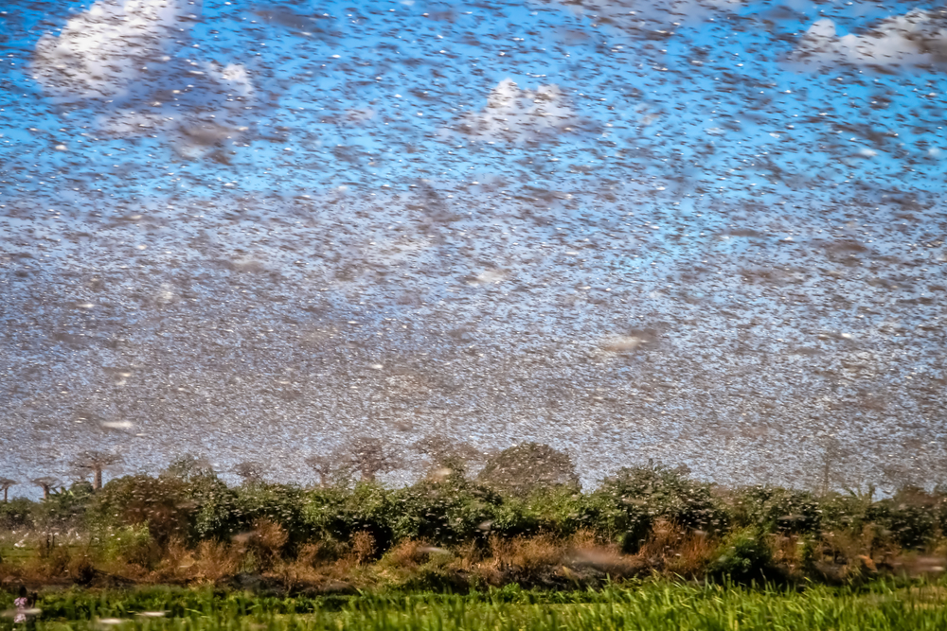
Notes:
Pharaoh, at some point decided, “I am going to let these people go, because if I don’t, I will be destroyed.” At points he wanted to the them go to protect himself and his kingdom. At those times, God hardened Pharaoh’s heart in order to judge Pharaoh for his sin, among other things, and would not let Pharaoh avoid his judgment out of pharaoh’s concern for self protection. <NEXT>

Slide 88
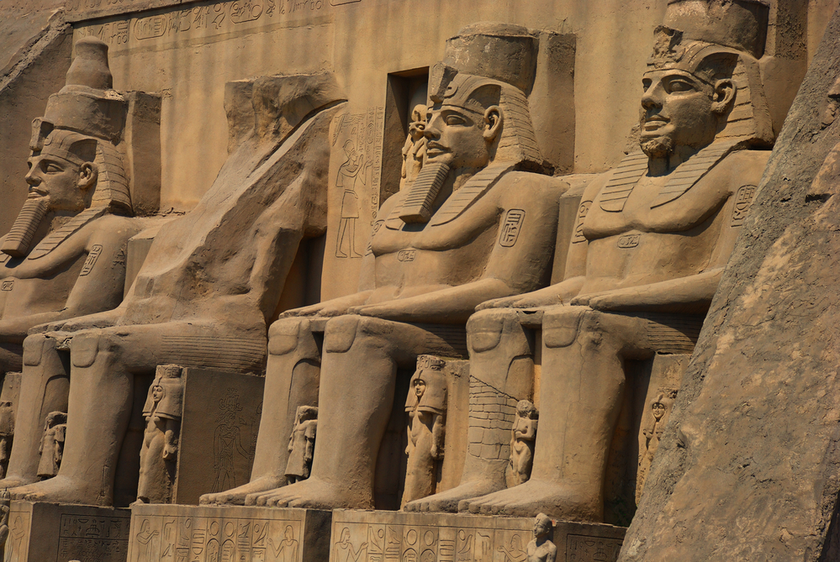
Notes:
Pharaoh was like any sinner looking out for himself. Pharaoh knew enough to know he was no match for the God of Moses, so at times he was happy to see them leave. But God would not let Pharaoh save himself and his kingdom. He hardened Pharaoh's heart so he would not let them go. But even if Pharaoh had let them go, if God did not harden his heart, Pharaoh’s attitude was still sinful, as he would have done it for selfish reasons, not from a love to God. God can choose when and how he judges guilty sinners, and Pharaoh was guilty before Moses arrived on the scene, and was guilty whether or not he let the people go. God did not make Pharaoh a sinner or make Pharaoh sin. God merely prevented Pharaoh from saving his skin, even as Pharaoh remained hostile to God. Again, Pharaoh deserved God’s judgment whether or not he let the people go. <NEXT>

Slide 89
“Behold, I have found only this, that God made men upright, but they have sought out many devices.”
Ecclesiastes 7:29
Notes:
[READ SLIDE]
<NEXT>

Slide 90
“Let no one say when he is tempted, ‘I am being tempted by God’; for God cannot be tempted by evil, and He Himself does not tempt anyone.
Notes:
[READ SLIDE]
<NEXT>

Slide 91
But each one is tempted when he is carried away and enticed by his own lust. Then when lust has conceived, it gives birth to sin; and when sin is accomplished, it brings forth death.”
James 1:13-15
Notes:
[READ SLIDE]
<NEXT>

Slide 92
Responding to Apparent Contradictions
In Christ, God has remedied evil at infinite cost to Himself, upheld His perfect righteousness, and clearly revealed His perfect character such that we can fully trust Him in the face of great mysteries and difficulties.
Notes:
[READ SLIDE]
God has displayed His infinite excellence in the person and saving work of Christ, descending from heaven’s glory to take upon Himself frail human flesh. From an infinite heart of love He suffered infinite wrath on behalf of the infinitely unworthy, that He might purchase for them perfect righteousness and infinite joy in heaven forever. And through it all He maintained the perfection of His attributes. The God who goes the infinite distance for the unlovable, without the slightest compromise of His righteousness, can be fully trusted in the face of great mystery.
Of this we can be sure, God’s character is infinitely excellent and the free will of the creature is responsible for sin. To find fault with such a God speaks only of one’s own wickedness. <NEXT>

Slide 93
“But now apart from the Law the righteousness of God has been manifested, being witnessed by the Law and the Prophets, even the righteousness of God through faith in Jesus Christ for all those who believe; for there is no distinction; for all have sinned and fall short of the glory of God…
Notes:
[READ SLIDE]
<NEXT>

Slide 94
being justified as a gift by His grace through the redemption which is in Christ Jesus; whom God displayed publicly as a propitiation in His blood through faith. This was to demonstrate His righteousness, because in the forbearance of God He passed over the sins previously committed…
Notes:
[READ SLIDE]
<NEXT>

Slide 95
for the demonstration, I say, of His righteousness at the present time, that He might be just and the justifier of the one who has faith in Jesus.”
Romans 3:21-26
Notes:
[READ SLIDE]
When faced with difficult theological issues in Scripture, or things that in our human limitations we cannot logically reconcile, we need to trust God’s character and acknowledge our limitations, we do not re-write what Scripture has clearly revealed about God’s infinite and perfect excellence. We hold fast to the things revealed and leave the secret things to God. <NEXT>

Slide 96
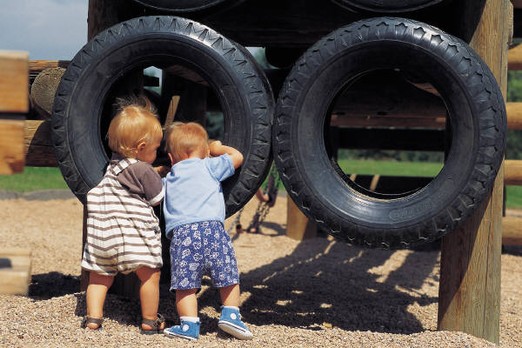
Apparent conflicts in God and Scripture…
reveal our limitations, not problems with God.
Notes:
When all is said and done… [READ SLIDE]
Having said that, nothing said in this course will satisfy a self-appointed authority of what God can be or do in His universe, apart from the Holy Spirit changing their heart. People hostile to God will deny all truth that points to the supremacy and excellence of God (Romans 1:18-22). “To the pure, all things are pure, but to those who are defiled and unbelieving, nothing is pure; but both their minds and their conscience are defiled” (Titus 1:15). No human opinion or sinful suppression and denial of the truth changes God and His truth. <NEXT>

Slide 97
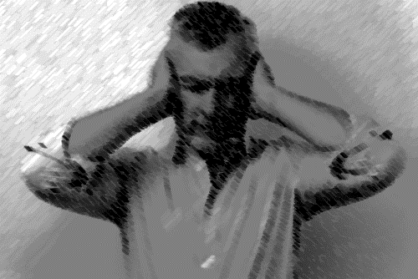
Apparent conflicts in God and Scripture…
reveal our limitations, not problems with God.
Notes:
And while these arguments fall on deaf ears, they nonetheless expose the irrationality of unbelief and prevent believers from being intimidated by sophisticated unbelieving arguments, helping us to persevere and reach out to unbelievers with grace and love. Knowing these things boosts our faith and assurance in Christ and the truth of Scripture. They immunize us against the arguments of unbelief. <NEXT>

Slide 98
Apparent conflicts in God and Scripture…
reveal our limitations, not problems with God.
Notes:
As believers, we sometimes forget to trust God’s perfect character when confronted with great mysteries. We can and should know what God has given us to know, but must leave the secret things to Him.
The best and brightest of created beings are simply unqualified to pass judgment on what God has revealed about Himself and His universe. Our limitations are just too great. <NEXT>

Slide 99
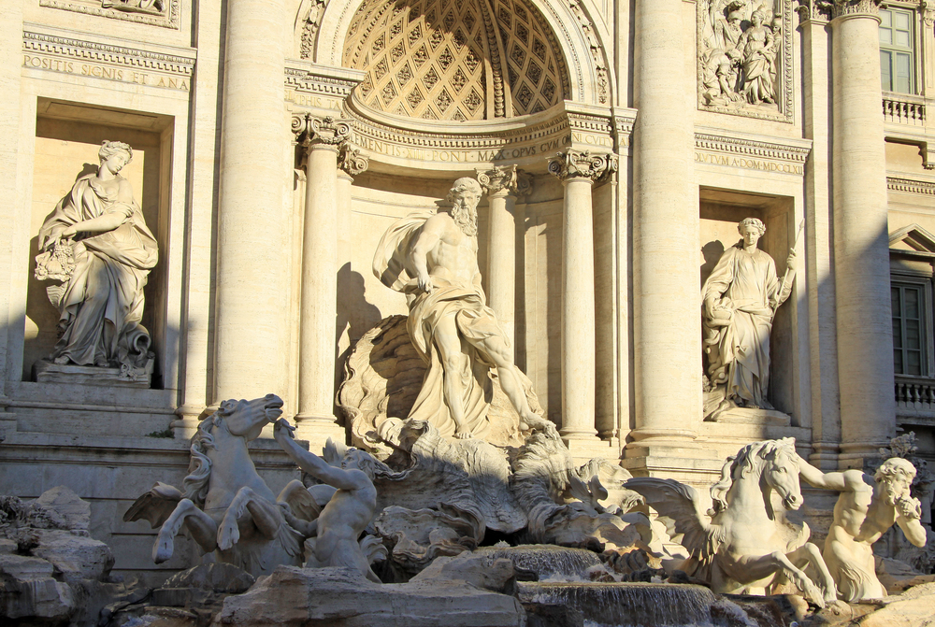
Making God acceptable to unbelief…
…denies the infinite excellence of God.
Notes:
Moreover… [READ SLIDE]
To make God acceptable to unbelief, one must affirm the unreasonable principles of unbelief, contradict what God has revealed to us, and deny the infinite excellence of God. God cannot be made acceptable to unbelief any other way. How do you make an infinitely holy God acceptable to people who love darkness and hate God’s holy character? You must compromise His holiness. How do you make a God of perfect righteousness, who judges all sin without exception, acceptable to people who love their sin and reject any ultimate judgment for it? You would have to redefine God and Christ’s work on the cross. One must, in effect, exchange “the glory of the incorruptible God” for “the image of corruptible man.”
But this dishonors God and poison’s the cure of the unbeliever’s greatest need. This, we should never do. <NEXT>

Slide 100
“You thought that I was just like you; I will reprove you.”
Psalm 50:21
Notes:
[READ SLIDE]
<NEXT>

Slide 101
“For as the heavens are higher than the earth, so are My ways higher than your ways, and My thoughts than your thoughts.”
Isaiah 55:9
Notes:
Again… [READ SLIDE]
In making God acceptable to unbelief, we, in effect, make God’s ways no higher than our ways, and His thoughts no higher than our thoughts. And worse, we make Him no better than our fallen nature. <NEXT>

Slide 102
To deny a single attribute of God…
…denies God as God.
Notes:
Next, concerning the unity of God… [READ SLIDE]
His attributes are mutually interdependent, with each implied by the others. You cannot compromise one attribute of God without compromising other attributes. <NEXT>

Slide 103
“All of his attributes have divine attributes! God’s mercy is eternal, and his creative power is wise.”
Source: John Frame, Doctrine of God, 229.
Notes:
Of this, John Frame said, “all of his attributes have divine attributes! God’s mercy is eternal, and his creative power is wise.”*
<NEXT>
*Frame, Doctrine of God, 229.

Slide 104
“The perfections of God…are attributes, without which He would cease to be God.”
Source: Charles Hodge, Systematic Theology, 1:369.
Notes:
Charles Hodge writes, “The perfections of God…are attributes, without which He would cease to be God.”**
<NEXT>
Hodge, Systematic Theology, 1:369.

Slide 105
To deny a single attribute of God…
…denies God as God.
Notes:
To deny one attribute denies other attributes and thus denies God as God. Yet, this all-important truth is often misunderstood or ignored by theologians attempting to reconcile mysteries beyond what God has revealed to us, or by those who attempt to make God’s nature and acts more amenable to prevailing philosophical and cultural beliefs.
For instance, granting to an unbeliever that God can only act in time denies God as infinite, self-existent, spirit, omniscient, omnipresent, and omnipotent. To deny God’s knowledge of the future to preserve an erroneous view of free will not only denies omniscience, it denies God’s infinite perfection, wisdom, and self-sufficiency. It makes God dependent on events outside of His control to accomplish His will. It denies God as God. <NEXT>

Slide 106
Notes:
For instance, granting to an unbeliever that God can only act in time denies God as infinite, self-existent, spirit, omniscient, omnipresent, and omnipotent. To deny God’s knowledge of the future to preserve an erroneous view of free will not only denies omniscience, it denies God’s infinite perfection, wisdom, and self-sufficiency. It makes God dependent on events outside of His control to accomplish His will. It denies God as God. <NEXT>

Slide 107
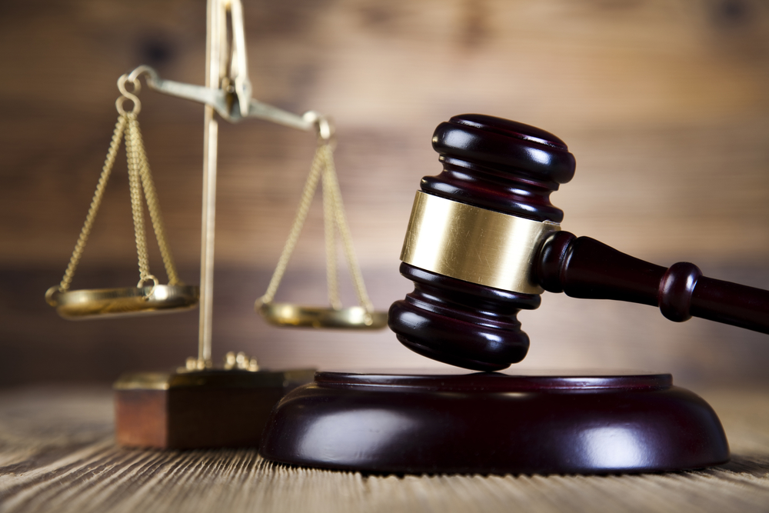
To deny a single attribute of God…
…denies God as God.
Notes:
We see the same principle with respect to God’s justice, as God’s justice is both consistent and necessarily implied in God’s perfections. God created and sustains all things, and knows all things. And as He is infinite and perfect in knowledge, He always knows the best and right judgment to make. His perfect justice and righteousness are intimately related to and dependent upon His perfect knowledge. The fact that He determines all things and knows all things, He can make a right judgment concerning all things. <NEXT>

Slide 108
God’s perfect knowledge keeps Him from ever being deceived, and He cannot be tempted to receive any more than He already has because He lacks nothing, while His happiness and pleasure cannot be increased; they are independent of what He created.
Notes:
To paraphrase Edwards… [READ SLIDE]
<NEXT>
38 “None Are Saved by Their Own Righteousness,” Works 14:334-5.
39 “Deuteronomy 32:4,” WJEO, L. 4r.
40 “Deuteronomy 32:4,” WJEO, L. 4v.
41 “Deuteronomy 32:4,” WJEO, L. 5r.
42 “Deuteronomy 32:4,” WJEO, L. 5r. – 6r.
*From The Infinite Merit of Christ, 99-100

Slide 109
Should He need anything, His infinite power can get whatever He would want while, as holy, He could never be tempted to gain it unjustly.
Source: Craig Biehl, The Infinite Merit of Christ, 99-100.
Notes:
[READ SLIDE]
<NEXT>
38 “None Are Saved by Their Own Righteousness,” Works 14:334-5.
39 “Deuteronomy 32:4,” WJEO, L. 4r.
40 “Deuteronomy 32:4,” WJEO, L. 4v.
41 “Deuteronomy 32:4,” WJEO, L. 5r.
42 “Deuteronomy 32:4,” WJEO, L. 5r. – 6r.
*From The Infinite Merit of Christ, 99-100

Slide 110
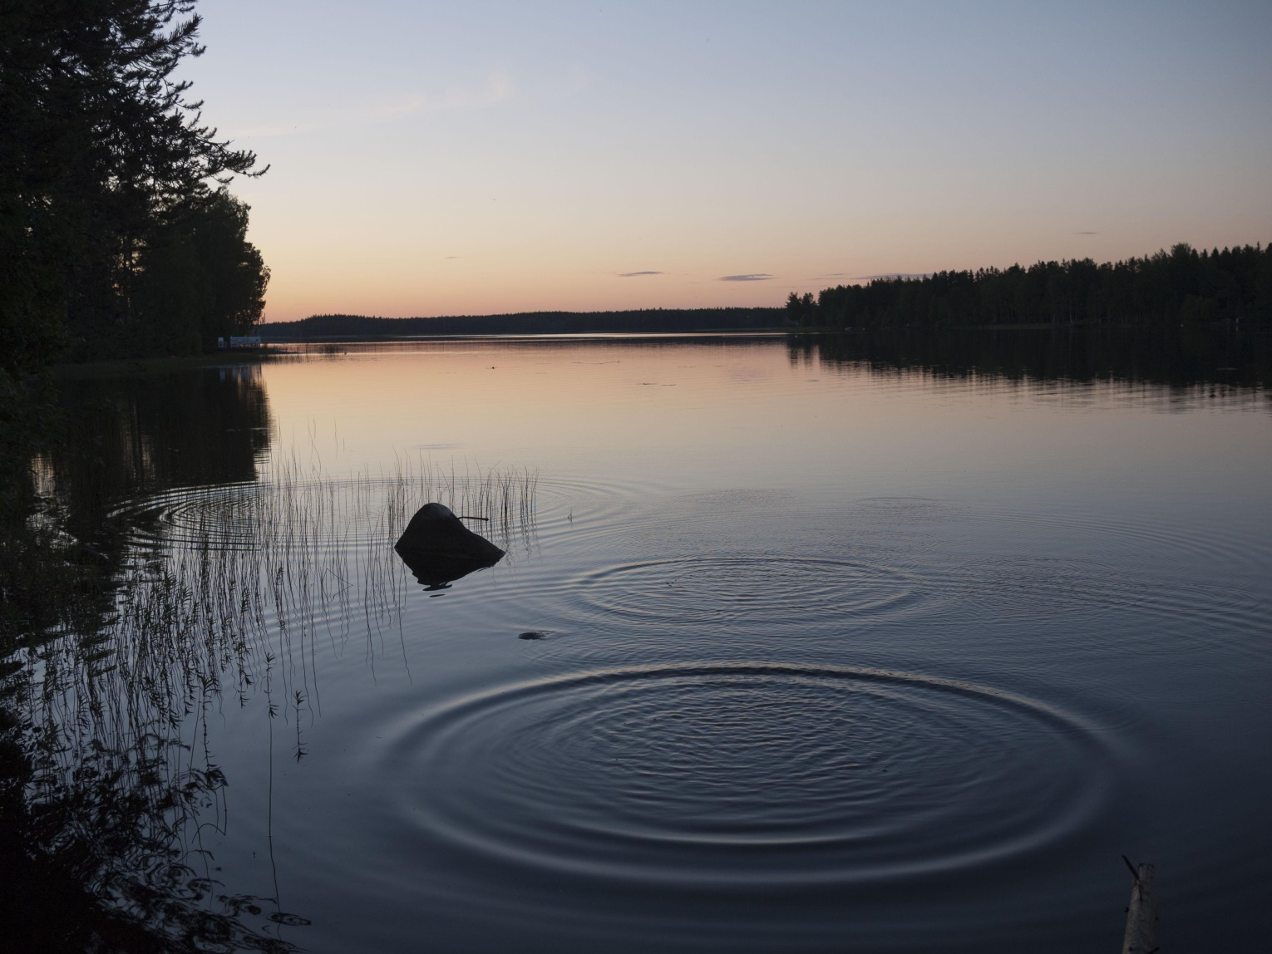
Notes:
Seemingly small compromises of God’s justice, or of any attribute of God, ripple through all of theology and ultimately create huge problems, not the least of which is we deny God as God. <NEXT>

Slide 111
Notes:
And so we see why Christ had to go to the cross if any were to be saved. If God allows a single sinner into heaven by compromising His justice one iota, He is no longer God. That is why false views of justification are so dangerous, and so unnecessary. We have no reason to believe other than God requires perfect obedience, His judgment is perfect and unchanging, Christ satisfied it completely, forever; and, salvation is through faith in Him alone. Very clear, very simple, and it all fits together perfectly. Again, for God to be unjust is to compromise all of His attributes; God would no longer be God.* <NEXT>

Slide 112
Notes:
In the end, we need to accept our limits and dependence on God for what we can and cannot know, and trust what God has revealed about Himself in Scripture. Praise God He hasn’t asked us to be God, a rather heavy weight to bear on our shoulders. We need just trust Him, cast our cares upon Him, and leave the secret things to Him. What a relief that He knows it all, and that His perfect purpose will be accomplished. <NEXT>

Slide 113
God NEEDS NO Defense
Notes:
Lastly, under the Unity of God, and applying to all of God’s attributes… [READ SLIDE]
…and certainly He needs no defense that compromises who He is--that’s surrender. And certainly He needs no defense that elevates human reason over His authority, or subjects Him to the constraints of our understanding of logic or the physical laws of His universe. We certainly do not defend God when we lower God and compromise His message. <NEXT>

Slide 114
Defend and Proclaim
His Excellence
Notes:
Yet, He has called us to defend the faith as we proclaim His excellence in the Gospel. He needs nothing, but He has graciously given us the privilege of participating in His ultimate purpose to display His glory in and through the person and work of Christ. We are to honor Him by reverently participating in His purpose, in a way that exalts His glory. The denial of a single attribute of God is contrary to God’s ultimate purpose to display His glory.
God needs no “defense” that reduces His infinite excellence to suit our limited understanding. He desires a faithful defense that honors Him as Lord of all. <NEXT>

Slide 115
Next Up:
God Is Spirit
Notes:
<NEXT>

Slide 116
Copyright © 2014, Craig Biehl, Pilgrim's Rock, LLC.
Credit is gratefully acknowledged for “My Life is Like a Weaving” by Grant Colfax Tullar
Unless otherwise indicated, Scripture taken from the NEW AMERICAN STANDARD BIBLE, © Copyright The Lockman Foundation 1960, 1962, 1963, 1968, 1971, 1972, 1973, 1975, 1977, 1988, 1995. Used by permission.
Scripture quotations marked (ESV) are from The Holy Bible, English Standard Version® (ESV®), copyright © 2001 by Crossway, a publishing ministry of Good News Publishers. Used by permission. All rights reserved.
Space images courtesy of NASA. Use of NASA images does not constitute an endorsement of the content of this presentation by NASA or any NASA affiliate. Used by permission.

