Slide 2
Unbreakable Faith
How God’s Perfections Give Life, Joy and Thriving Assurance in a World of Unbelief

Slide 3
Section Two
God Is Too Great To Be Known Unless He Makes Himself Known
Notes:
We come now to the perfection of God’s incomprehensibility, or, God is too great to be known unless He makes Himself known. God is infinite and beyond our comprehension unless He condescends, or stoops down, as it were, to reveal Himself to us in a way that we can understand. God can and does make Himself known personally through whatever means He chooses, but we can never know Him completely or exhaustively because God is infinite and we are finite, or limited. We know that God is incomprehensible because He has told us in Scripture. <NEXT>

Slide 4
God Is Incomprehensible
“For My thoughts are not your thoughts, neither are your ways My ways, declares the LORD. For as the heavens are higher than the earth, so are My ways higher than your ways and My thoughts than your thoughts.”
Isaiah 55:8-9
Notes:
[READ SLIDE]
<NEXT>

Slide 5
God Is Incomprehensible
“Oh, the depth of the riches and wisdom and knowledge of God! How unsearchable are His judgments and how inscrutable His ways! For who has known the mind of the Lord, or who has been His counselor?”
Romans 11:33-35
Notes:
[READ SLIDE]
<NEXT>

Slide 6
God Is Incomprehensible
“The LORD is the everlasting God, the Creator of the ends of the earth. He does not faint or grow weary; His understanding is unsearchable.”
Isaiah 40:28b
Notes:
[READ SLIDE]
<NEXT>

Slide 7
God Is Incomprehensible
“No one has ever seen God; the only God, who is at the Father's side, He has made him known.”
John 1:18 ESV
Notes:
[READ SLIDE]
<NEXT>

Slide 8
God
∞
Man
Notes:
In this course we’ll call the infinite distance between the infinite creator of all things and the finite creatures God has created… <NEXT>

Slide 9
God
∞
“Gap”
Man
Notes:
…the “gap.” This gap has nothing to do with the so-called “gap theory” proposed by some people concerning Genesis 1. For the purposes of this course, the gap will always refer to the infinite distance between God and those He created. Understanding this “gap” is critical for proper thinking about everything, as we shall see later.
The gap is so great… <NEXT>

Slide 10
God
∞
Man
Notes:
…that God could never be known unless He gave us the ability to know Him, and then communicated with us in a way that we could know Him. This is a critical starting point for all theology, apologetics, philosophy, and all right thinking about God and His universe. And note well that the “gap” existed before Adam and Eve sinned and will exist forever.
Even as Christians grow in their love and knowledge of God for eternity, an infinite Gap will always remain, since 1 or 1 trillion are still an infinite distance from infinity.
And as we saw earlier, we are both blessed and fully accountable before God since He has clearly and comprehensively bridged the gap and revealed Himself to us in all the world around us, in our conscience and consciousness within us, and most importantly in Christ and Scripture. Every aspect of the universe displays God’s power and excellence.
In light of God’s incomprehensibility… <NEXT>

Slide 11
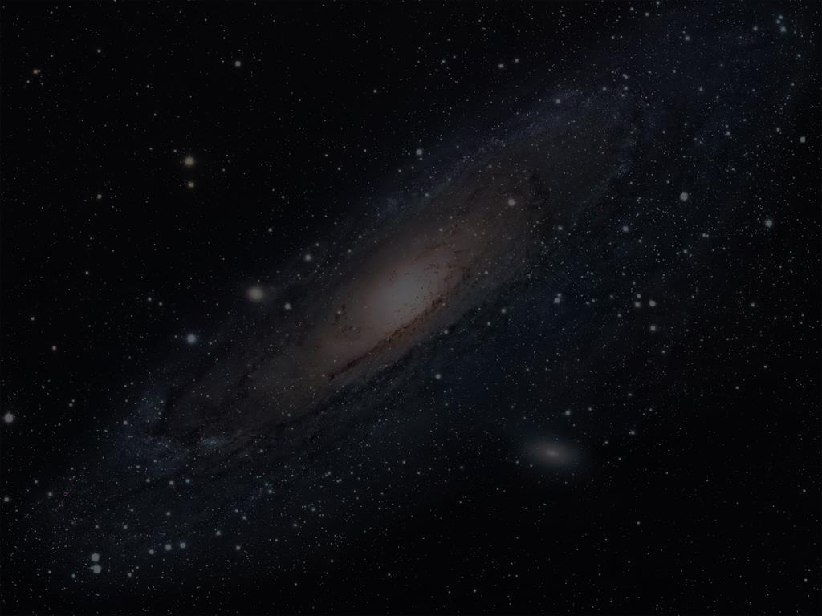
Speculation without revelation…
…cannot explain God.
Notes:
[READ SLIDE]
We depend completely on God’s revelation to know Him, thus we are helpless and hopeless in trying to know Him apart from His revelation. We are locked out, as it were, from the knowledge of God if He has not and does not make Himself known. <NEXT>

Slide 12
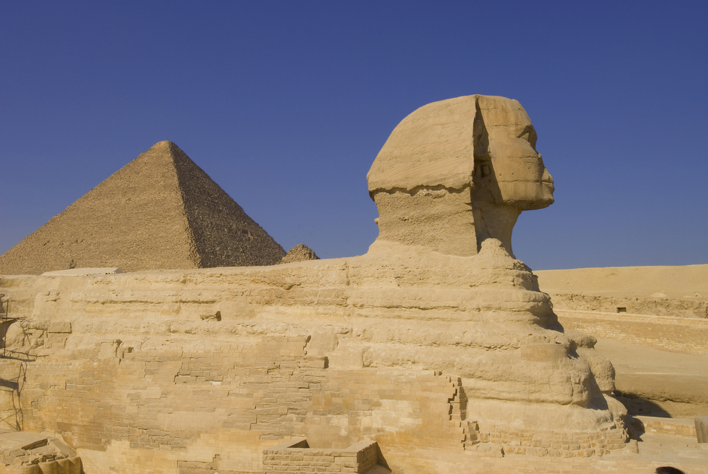
Speculation without revelation…
…cannot explain God.
Notes:
For this reason God tells us, “’You shall not make for yourself an idol, or any likeness of what is in heaven above or on the earth beneath or in the water under the earth.’” (Ex. 20:4). The world is full of such attempts, however. <NEXT>

Slide 13
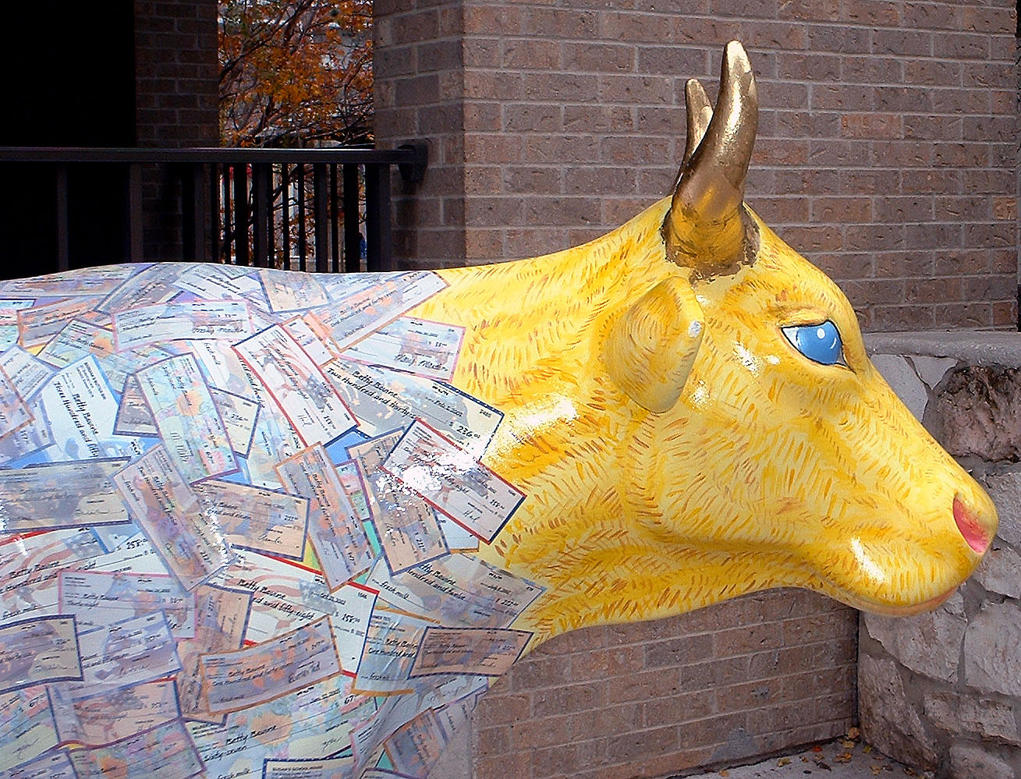
Speculation without revelation…
…cannot explain God.
Notes:
Perhaps the most familiar attempt is the golden calf of the Exodus, and the results were disastrous.
Speculation about God beyond what He has chosen to reveal to us about Himself is a foolish and dangerous business, with potentially terrible consequences. Further… <NEXT>

Slide 14
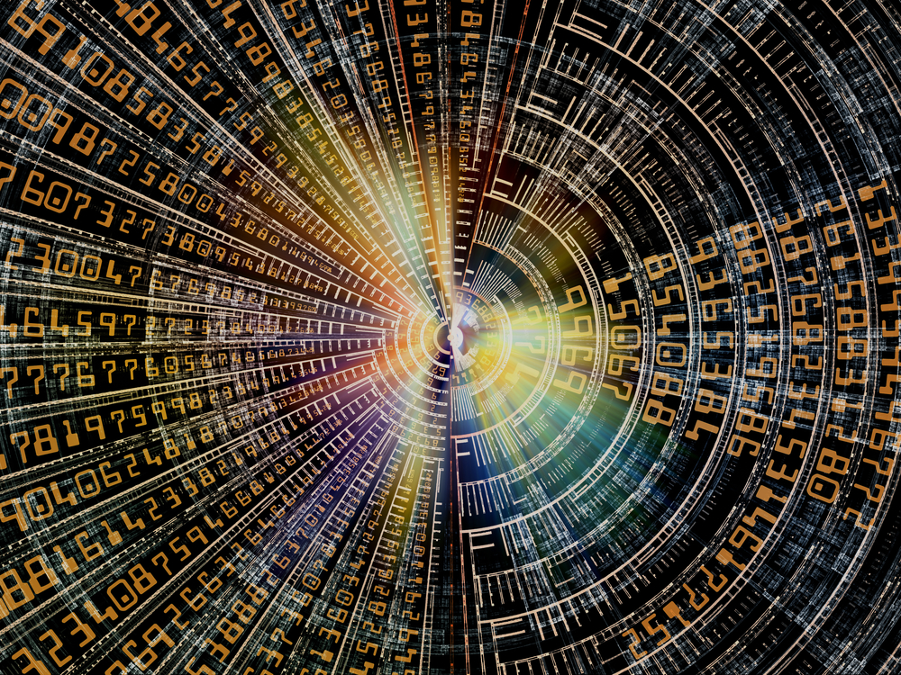
Logic alone…
…is insufficient to know God.
Notes:
[READ SLIDE] Created as dependent upon God for all things, God gave us reason and logic to understand, order, and reverently submit to His revelation. And as the entire universe bears the fingerprints of God’s power and genius, so logic reflects the mind of God as He is infinitely rational and coherent in His thinking and knowledge of all things. God does not contradict Himself and in Him are no contradictions. <NEXT>

Slide 15
Logic alone…
…is insufficient to know God.
Notes:
And while we may not understand all that God has revealed to us about Himself and His world, our human limitations do not imply contradictions in God. Logic reflects the coherent mind of God, but is limited as used by created, finite, and fallible people. <NEXT>

Slide 16
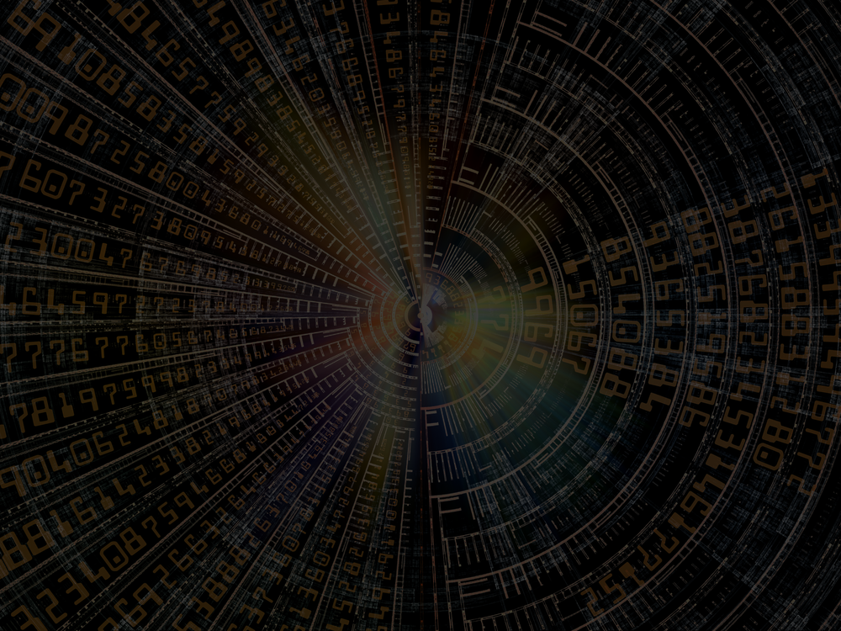
Logic
Logic
Notes:
For instance, logic is never used in a neutral manner, but is always used according to the perspective and purpose of the person using it. Believers use logic to affirm God’s existence and attributes while unbelievers use it to deny them. One’s relationship to God determines how one interprets God and His creation according to the rules of logic.
Also, logic alone is inadequate to know the attributes of God. <NEXT>

Slide 17
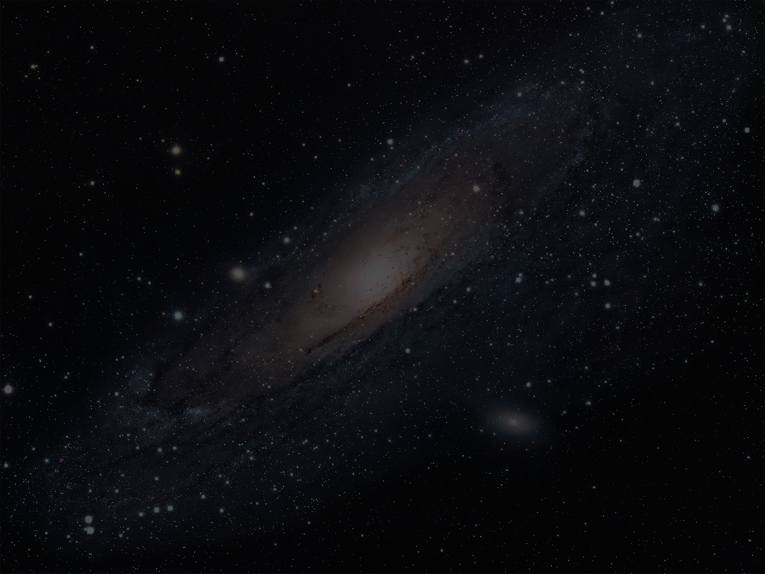
We know God by what He has revealed to us in creation and Scripture. God’s revelation is the ultimate determiner of truth.
Notes:
[READ SLIDE]
We know the person, works, and words of Jesus Christ, and the ultimate interpretation of God’s universe by Scripture. Logic, as vitally important as it is to order our thinking, does not tell us these things. God’s revelation is the ultimate determiner of truth. <NEXT>

Slide 18
The Cosmological Argument
Notes:
Consider the well-known “cosmological” argument for the existence of God. One simple version says that every effect has a cause, and as an infinite chain of causes and effects is impossible, a first cause, or God, must exist. In one sense, the entire universe does give clear and comprehensive evidence of God as its creator. The effect of creation proclaims God as the cause. <NEXT>

Slide 19
The Cosmological Argument
Notes:
Yet, logic alone cannot tell us that an infinite chain of causes and effects is impossible. On the contrary, it logically follows that if “every effect must have a cause,” then an infinite chain of causes and effects must exist, for the “first cause” must have a cause. Only God’s revelation tells us that God is the uncaused cause of all things. <NEXT>

Slide 20
Logic alone…
…is insufficient to know God.
Notes:
“In the beginning God” limits the authority of logic by itself to determine ultimate truth about God and His existence. In the same way, logic alone cannot tell us that God is a Trinity, or that Christ is both 100% God and 100% man, etc. Logic, apart from revelation, could be used to argue against such Christian doctrines. <NEXT>

Slide 21
Logic itself…
…reveals God’s existence.
Notes:
At the same time… [READ SLIDE]
Logic is not contrary to Christian doctrine. God gave logic to be used by people created in His image in the context of a world that clearly and comprehensively reveals God in all things. <NEXT>

Slide 22
Logic itself…
…reveals God’s existence.
Notes:
And while logic depends on God’s revelation as the ultimate source of truth concerning God’s existence and attributes, the existence and use of logic itself gives clear evidence of the existence of God. <NEXT>

Slide 23
Logic itself…
?
?
?
?
?
?
?
?
?
?
?
?
?
?
?
?
?
?
?
?
…reveals God’s existence.
Notes:
Consider again a universe of random chance without God. <NEXT>

Slide 24
?
?
?
?
?
Truth
Science
?
?
?
Language
?
?
?
?
Meaning & Purpose
?
?
Knowledge
?
?
?
?
Interpretation
?
?
?
?
Notes:
As we have seen, meaning and purpose, interpretation, language, knowledge, truth, and science would be impossible in a random chance universe. <NEXT>

Slide 25
?
?
?
?
?
Truth
Science
?
?
?
Language
?
?
?
?
Logic
Meaning & Purpose
?
?
Knowledge
?
?
?
?
Interpretation
?
?
?
?
Notes:
What, then, accounts for the uniformity and universality of the laws of logic? <NEXT>

Slide 26
?
?
?
?
?
Truth
Science
?
?
?
Language
?
?
?
?
Logic
Meaning & Purpose
?
?
Knowledge
?
?
?
?
Interpretation
?
?
?
?
Notes:
Uniform and universal laws could not exist in a universe founded on random chance. That our reasoning functions according to uniform and universal laws of logic gives clear evidence of God’s existence. As with physical laws, logic would be impossible apart from God. <NEXT>

Slide 27
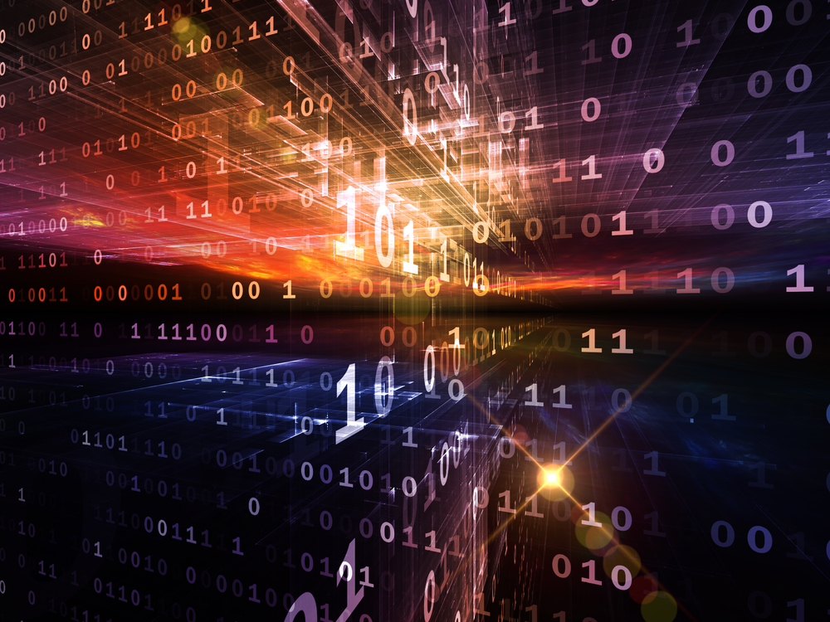
Notes:
Random chance does not produce uniform and universal laws, God does.
Moreover, knowledge of God is not primarily the result of a process of logical deduction, rather… <NEXT>

Slide 28
The beauty of God’s excellence…
…is known immediately and intuitively.
Notes:
[READ SLIDE]
This is not to say that the knowledge of God is illogical. God as the source and sustainer of all things is entirely logical and the only reasonable and logical explanation of reality as we know it. Yet, no amount of logical reasoning will convince a sinful heart of the existence and excellence of God.
Edwards likens the knowledge of God to our recognition of the harmony of music, the beauty of a rainbow, or the tasting of honey* <NEXT>
* Religious Affections, Banner of Truth, 224.

Slide 29
Notes:
For instance, when you listen to someone singing, no scientific analysis of the sound waves or pitch is needed to determine whether or not the the music is beautiful or harsh, or in or out of tune. <NEXT>

Slide 30
!
Notes:
Hearing is evidence enough. <NEXT>

Slide 31
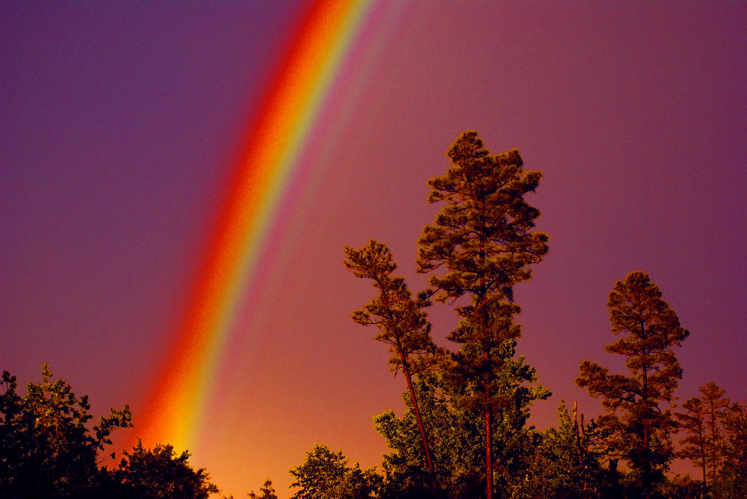
Notes:
Scientific explanations of the color scale to describe the beauty of a rainbow can’t substitute for actually seeing the rainbow; its beauty is known immediately and intuitively, no amount of logical reasoning is undertaken or needed. <NEXT>

Slide 32
The beauty of God’s excellence…
…is known immediately and intuitively.
Notes:
And all of the verbal descriptions of honey to someone without taste buds are nothing compared to actually tasting it. So it is with the knowledge of God. Edwards writes, <NEXT>

Slide 33
“The divine glory and beauty of divine things is in itself a real evidence of their divinity, and the most direct and strong evidence. He that truly sees the divine, transcendent, supreme glory of those things which are divine, does, as it were, know their divinity intuitively.”
Source: Religious Affections, Banner of Truth, 224.
Notes:
[READ SLIDE]
While helpful, no amount of logical reasoning will convince unbelievers of the excellence of God if they lack the spiritual sense to see His beauty. <NEXT>

Slide 34
“The gospel of the blessed God does not go abroad a-begging for its evidence, so much as some think; it has its highest and most proper evidence in itself.”
Source: Religious Affections, Banner of Truth, 223.
Notes:
Edwards, again, writes… [READ SLIDE]
The evidence is clear and convincing. <NEXT>

Slide 35
The beauty of God’s excellence…
…is known immediately and intuitively.
Notes:
The marks of God’s excellence are so clear in creation that all people are without excuse for not worshipping and giving God thanks (Romans 1:18-22). They are equally clear in Scripture, but those hostile to God view the excellence of the Gospel as “foolishness” (1Corinthians 1:18-31). They see and know the truth, but their love of sin, the desire for independence from God, blindness to the beauty of His holiness, and rejection of God as creator and Lord drives them to wrong views of God’s world and Scripture, and the rejection of Scripture’s authority.
<NEXT>
[In Camtasia, gradually dim this to black for the first paragraph]

Slide 36
Notes:
Therefore, the ultimate issue of unbelief is not logic (though true belief is logical)… <NEXT>

Slide 37
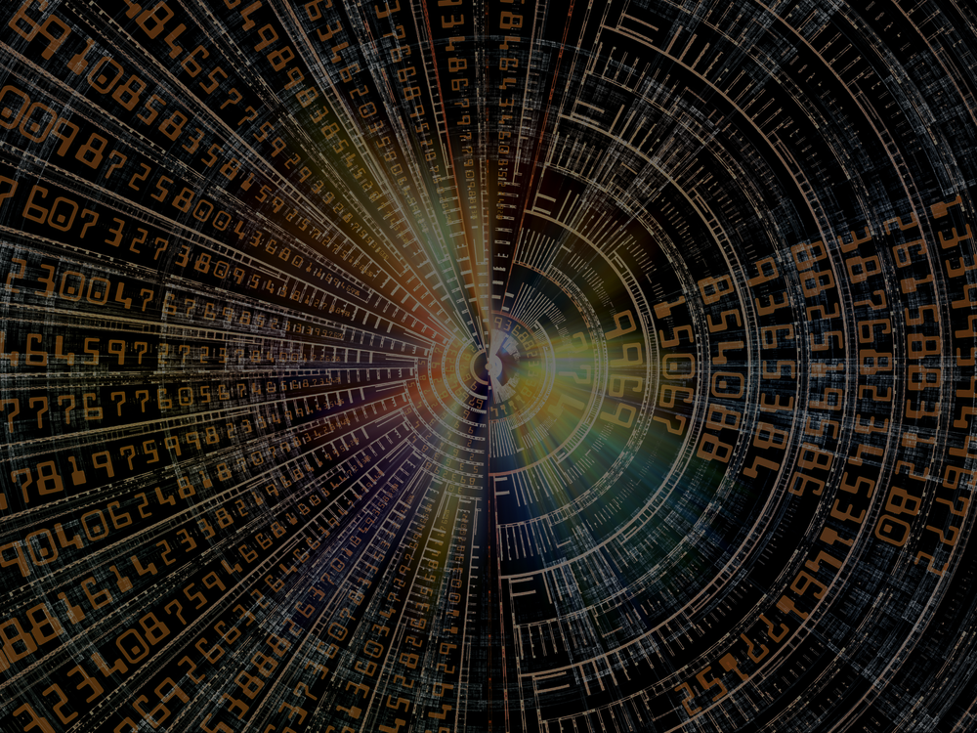
Love
God
Hate
Notes:
but the nature of the heart toward God. The heart hostile to God will not see the beauty of God’s excellence and will deny the knowledge of God, regardless of logical arguments for faith. <NEXT>

Slide 38
“The whole earth is full of His Glory”
Notes:
But when the Holy Spirit removes the hostility and blindness to the beauty of God’s excellence, the excellence of God will be known immediately and intuitively; truth will then be seen for what it truly is. <NEXT>
[In Camtasia, gradually lighten this from dark]

Slide 39
“For God, who said, ‘Light shall shine out of darkness,’ is the One who has shone in our hearts to give the light of the knowledge of the glory of God in the face of Christ.”
2 Corinthians 4:6
Notes:
2 Corinthians 4:6 tells us… [READ SLIDE]
When the spiritual eyes are opened, logical arguments for the existence of God will also begin to be seen correctly. <NEXT>

Slide 40
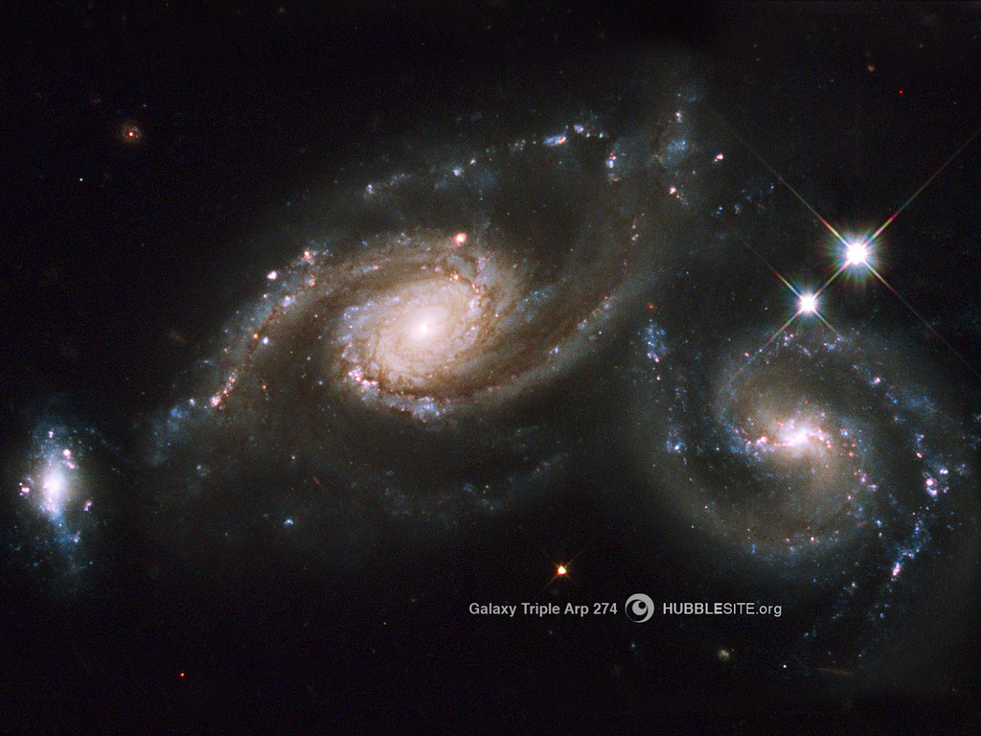
God is infinite and incomprehensible…
…thus mystery is proper and reasonable.
Notes:
Next… [READ SLIDE]
And while we can know God personally, God is too great for us to know Him and His ways exhaustively. If we could know Him completely, He would not be God. <NEXT>

Slide 41
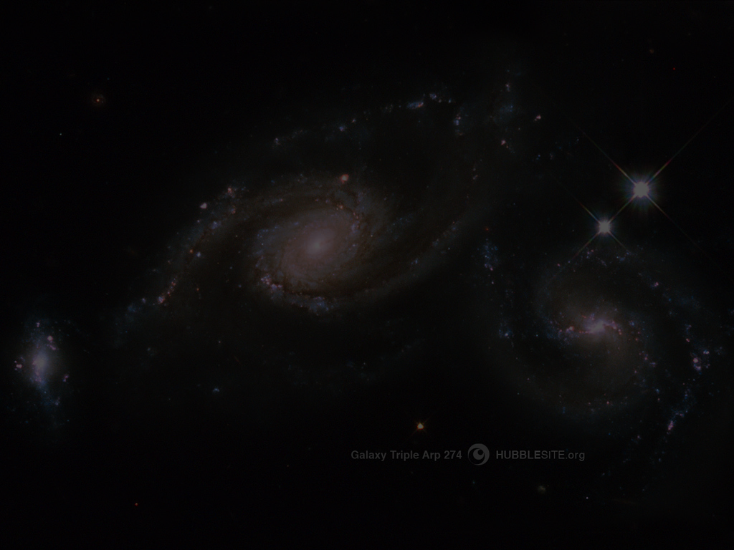
“‘For my thoughts are not your thoughts, neither are your ways My ways,’ declares the LORD. ‘For as the heavens are higher than the earth, so are My ways higher than your ways and My thoughts than your thoughts.’”
Isaiah 55:8-9
Notes:
Again, [READ SLIDE]
<NEXT>

Slide 42
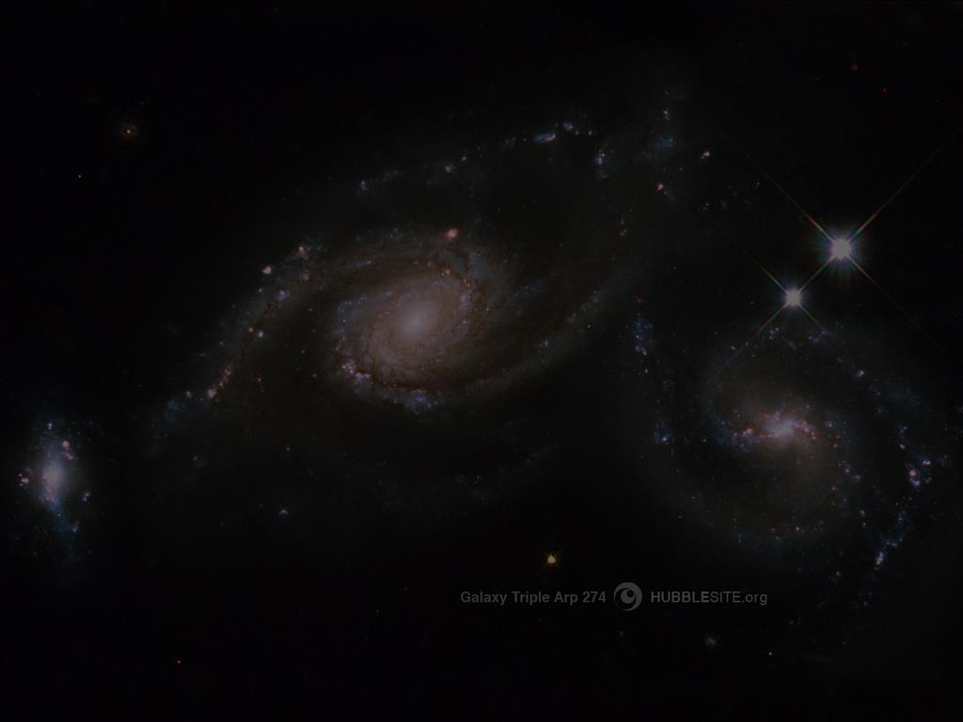
God is infinite and incomprehensible…
…thus mystery is proper and reasonable.
Notes:
Arguments against faith in Christ often claim that certain Christian doctrines and biblical events are impossible, such as the Trinity, a universal flood, six-day creation, Noah and the Ark, the sun standing still, etc. But… <NEXT>

Slide 43
Because we can’t see or understand something does not make it untrue.
Notes:
[READ SLIDE] We are limited and lack the knowledge and vantage point to deny God’s explanation of Himself or the universe He created and sustains.
As we have seen, human perception and understanding have no effect on God’s nature and the reality He created and upholds. Because limited people don’t believe something can happen or exist determines nothing.
To deny mystery, or to deny what God has revealed because we cannot understand it… <NEXT>

Slide 44
God
∞
“Gap”
Man
Notes:
…denies the infinite gap between God and His creation. It denies our human limitations, and denies God as infinitely beyond us and able to do anything. It denies our dependence on God alone for knowledge of what He can and cannot do. It denies God’s incomprehensibility. <NEXT>

Slide 45
God
∞
“Gap”
Mystery
Man
Notes:
Mystery must always exist, reflecting the infinite gap between God and His creatures, not any irrationality or contradictions in God.
This is critical to understand because it restrains us from wrongly saying something can’t be true because we don’t understand it, or that extraordinary events in Scripture are impossible because of “natural laws.” Given our limited knowledge compared to God’s infinite knowledge, there is much we cannot know.
Mystery, then, is not a copout in the face of difficult questions, but a necessity in the face of an infinite God. We can know what God has revealed in creation and Scripture--and no more. To acknowledge mystery is to accept the nature of God and reality as He created and upholds it, including our limitations as created and dependent people.
To deny mystery is to deny our limitations while claiming to know what we cannot possibly know, that God is not infinite or does not exist. More about this later. <NEXT>

Slide 46
Man
Notes:
In the end, saying, “If I cannot understand something, it cannot be true” makes one’s limited understanding the ultimate standard of truth. It assumes the ability to determine what can or cannot be true of God and His universe, despite our limited senses, three or four dimensions, and a few years upon the earth. Finite human understanding can never be the final standard of truth. <NEXT>

Slide 47
God is infinite and incomprehensible…
…thus mystery is proper and reasonable.
Notes:
It makes perfect, logical sense, then, that limited people cannot fully understand or logically reconcile many things God has revealed to us. We should expect it. If we could understand everything, we would be God.
Behind the many difficulties unbelievers have with how God describes Himself and His world in Scripture lies a refusal to humbly accept our human limitations before an infinite and incomprehensible God.
<NEXT>
About 400 million light years away, per NASA.
Light 186,000 miles per second, around the earth at equator 7.5 times per second.

Slide 48
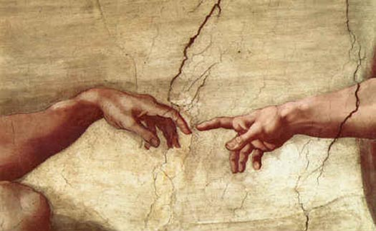
Earthly analogies…
…cannot fully explain God.
Notes:
It follows, then, that… [READ SLIDE] Why? Because God is infinitely higher than all earthly analogies: We read in Isaiah 40… <NEXT>

Slide 49
“‘To whom will you liken God? Or what likeness compare with Him….To whom then will you compare me, that I should be like him?’ says the Holy One.
Notes:
[READ SLIDE]
<NEXT>

Slide 50
‘Lift up your eyes on high and see: who created these? He who brings out their host by number, calling them all by name, by the greatness of His might, and because He is strong in power not one is missing.’”
Isaiah 40:18, 25-26 ESV
Notes:
[READ SLIDE]
<NEXT>

Slide 51
Earthly analogies…
…cannot fully explain God.
Notes:
As the genius of the Potter is seen in the clay, all things bear the finger prints of God. At the same time, the Potter forever remains distinct from the clay and the clay cannot fully explain the Potter. The same applies to God’s image in us. We bear aspects of God’s image but are not divine. Through faith in Christ we “become partakers of the divine nature” (2 Peter 1:4), as we reflect aspects of Christ’s character by His Spirit within us, but we never become Christ. <NEXT>

Slide 52
Earthly analogies…
…cannot fully explain God.
Notes:
At the same time, Scripture teaches us many things about God through earthly analogies. When earthly fathers love their children and give them good things, they picture the love and goodness of God giving good things to His children (Luke 11:10-13). <NEXT>

Slide 53
Earthly analogies…
…cannot fully explain God.
Notes:
Ephesians 5:22-33 tells us that the relationship of a husband and wife pictures the relationship between Christ and the church. Scripture uses many earthly analogies to help us know God better, but no earthly analogy can sufficiently represent an incomprehensible God. If they could, God would be no higher than earthly things.
In any event, Scripture is needed to see and interpret earthly analogies correctly, as our fallen will and understanding tend to pervert and suppress earthly analogies of God. <NEXT>

Slide 54
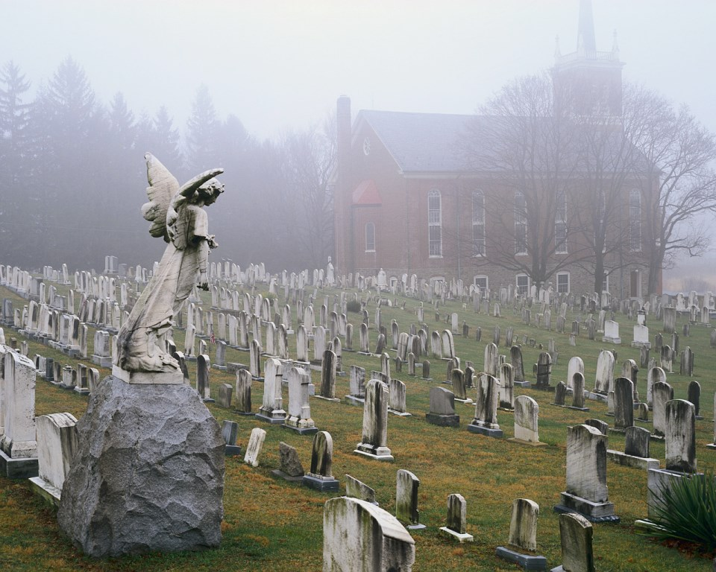
Finite people are unqualified…
…to deny the truth of Scripture.
Notes:
Lastly… [READ SLIDE]
As created and sustained by our eternal and incomprehensible God, we humbly depend on Scripture to know and proclaim His excellence and rightly understand His universe. God alone created all things, knows all things, and possesses ultimate authority to properly explain all things.
To what higher authority can one appeal to deny the truth of Scripture? Science? But scientists are just as limited as everyone else.
This raises the question: <NEXT>

Slide 55
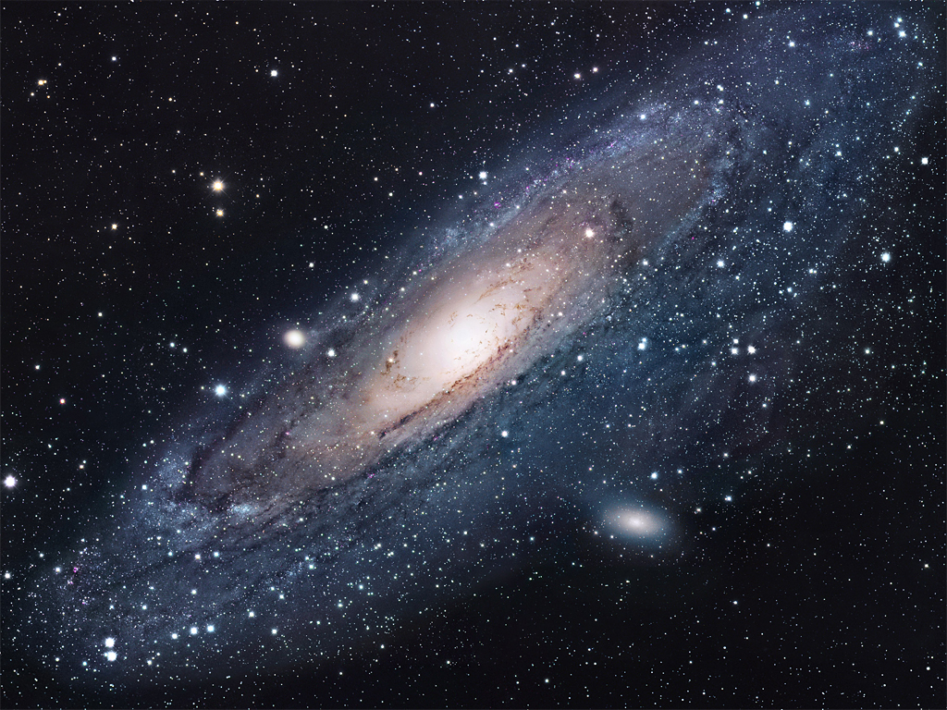
What must an unbeliever know to know what Scripture says about
God is not
true?
Notes:
[READ SLIDE]
<NEXT>

Slide 56
What must an unbeliever know to know what Scripture says about
God is not
true?
That God does not exist.
Notes:
Answer… [READ SLIDE]
If God exists, He can easily do what Scripture says He has done. Since the God of Scripture exists, nothing is impossible with Him. This raises the next question: <NEXT>

Slide 57
What must an unbeliever
know to know that the
God of Scripture does
not exist?
Notes:
[READ SLIDE]
<NEXT>

Slide 58
What must an unbeliever
know to know that the
God of Scripture does
not exist?
Everything about
everything and beyond!
Notes:
[READ SLIDE]
We’ll discuss this at length later, but note well that unbelievers would need to know everything about the universe and beyond to know that God does not exist, and would need to know that God does not exist to know that He could not do what Scripture says He did.
As limited to five senses, three or four dimensions, and a few years on earth, we do not possess the knowledge and outside perspective to deny God’s explanation of Himself or the universe He created and sustains. For good reason God tells us that “whoever trusts in his own mind is a fool” (Proverbs 28:26).
<NEXT>

Slide 59
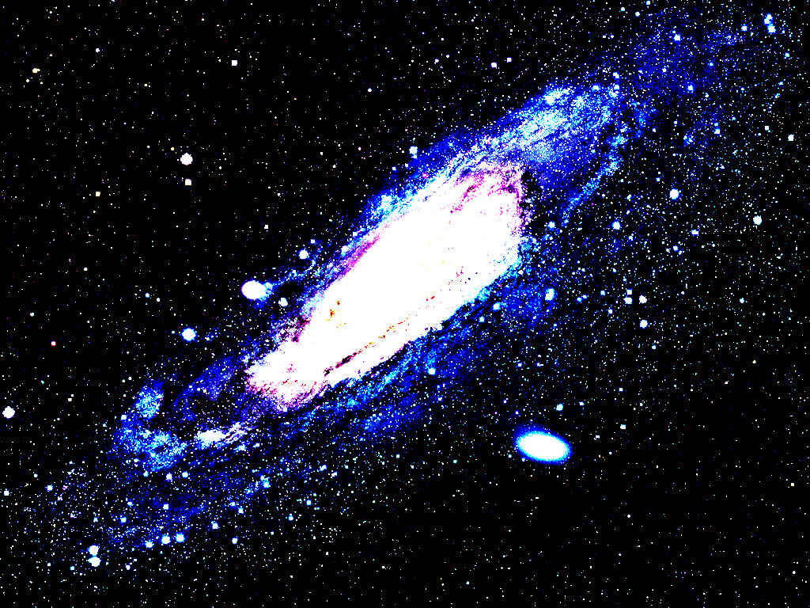
What must an unbeliever know
to claim what Scripture
says about God is
not true?
Everything about
everything and beyond!
Notes:
Lastly, why do we have such a hard time seeing such clear and simple truths?
Briefly, because just as we struggle with living a God-honoring life, so we struggle with seeing God and His world correctly. Just as we imperfectly love and obey God in our struggle against the remains of our fallen nature, as we swim in a world of messages feeding our ungodly desires, as we progress from babes in Christ to mature adults by learning and applying what we learn, so we also struggle to view God and His world rightly.
How we live and how we view God and His world are inseparable moral issues. Idolatry always has its beginning in wrong views of God, while a God-honoring life is founded on right views of God. Wrong views of God and His world are as dishonoring to God as disobedience. <NEXT>

Slide 60
Next Up:
God Is Limitless

Slide 61
Copyright © 2014 Craig Biehl, Pilgrim’s Rock, LLC
Unless otherwise indicated, Scripture taken from the NEW AMERICAN STANDARD BIBLE, © Copyright The Lockman Foundation 1960, 1962, 1963, 1968, 1971, 1972, 1973, 1975, 1977, 1988, 1995. Used by permission.
Scripture quotations marked (ESV) are from The Holy Bible, English Standard Version® (ESV®), copyright © 2001 by Crossway, a publishing ministry of Good News Publishers. Used by permission. All rights reserved.
Space images courtesy of NASA. Use of NASA images does not constitute an endorsement of the content of this presentation by NASA or any NASA affiliate. Used by permission.

