Slide 2
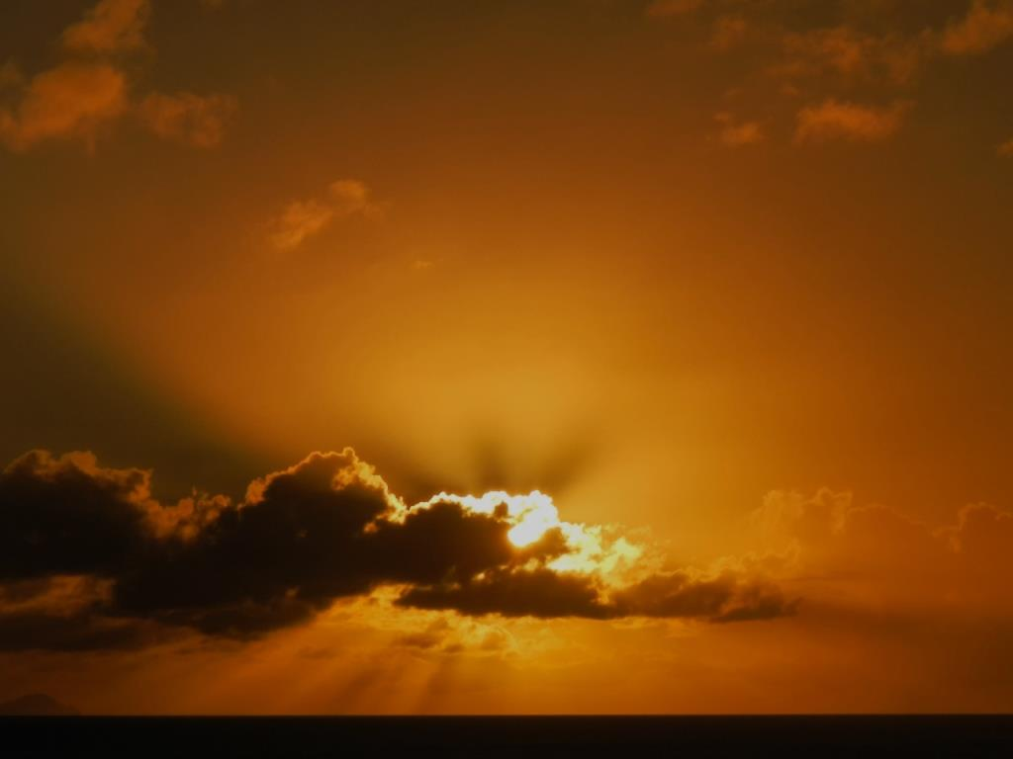
Unbreakable Faith
How God’s Perfections Give Life, Joy and Thriving Assurance in a World of Unbelief

Slide 3
Perfection Eleven
God Is Holy
Notes:
God is holy. Separate and exalted above all things in infinite majesty and moral purity, every aspect of God’s nature is perfect in moral uprightness and excellence, untainted by any evil. Edwards notes that God’s holiness is that which constitutes God’s beauty and “renders all His other attributes glorious and lovely.”*
<NEXT>
*Religious Affections, Banner of Truth, 183; Yale University Press, 257.

Slide 4
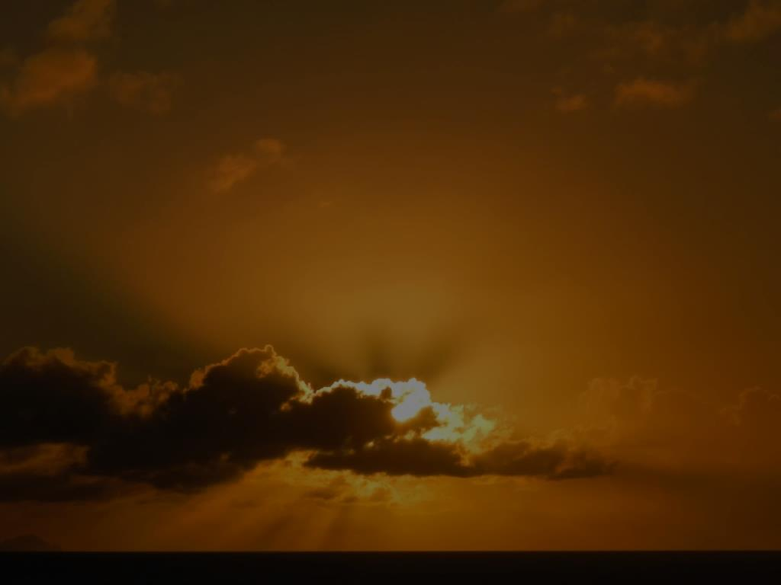
God is Holy
“Who is like Thee among the gods, O LORD? Who is like Thee, majestic in holiness, awesome in praises, working wonders?”
Exodus 15:11
Notes:
[READ SLIDE]
<NEXT>

Slide 5
God is Holy
“Thy way, O God, is holy; What god is great like our God?”
Psalm 77:13
Notes:
[READ SLIDE]
<NEXT>

Slide 6
God is Holy
“Holy, holy, holy, is the LORD of hosts, the whole earth is full of His glory.”
Isaiah 6:3
Notes:
[READ SLIDE]
<NEXT>

Slide 7
God is Holy
“Who will not fear You, Lord, and bring glory to Your name? For You alone are holy. All nations will come and worship before You, for Your righteous acts have been revealed.”
Revelation 15:4
Notes:
[READ SLIDE]
God is holy, separate, exalted above all creation, perfect in moral purity. Therefore…
<NEXT>

Slide 8
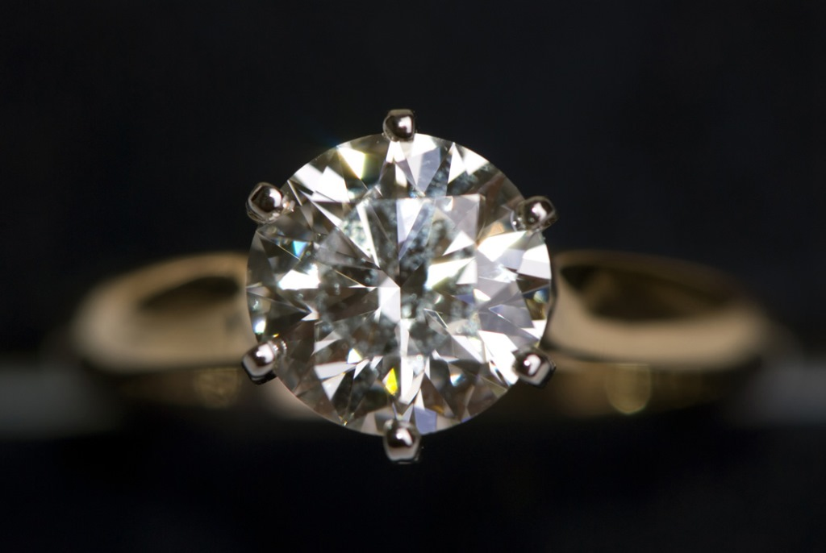
The beauty of God and His works…
…is holiness.
Notes:
[READ SLIDE]
Like the pure light that is the splendor of the many facets of a perfect diamond, so God’s holiness is the splendor of His attributes. In Religious Affections, Edwards argues that the beauty of God consists in His holiness, the chief object of the saints’ love for God. In distinguishing between God’s “natural” attributes, like His power and infinite knowledge, and His “moral” attributes, such as His goodness, holiness, and righteousness, Edwards argues that the beauty of God’s natural attributes is their holiness. <NEXT>

Slide 9
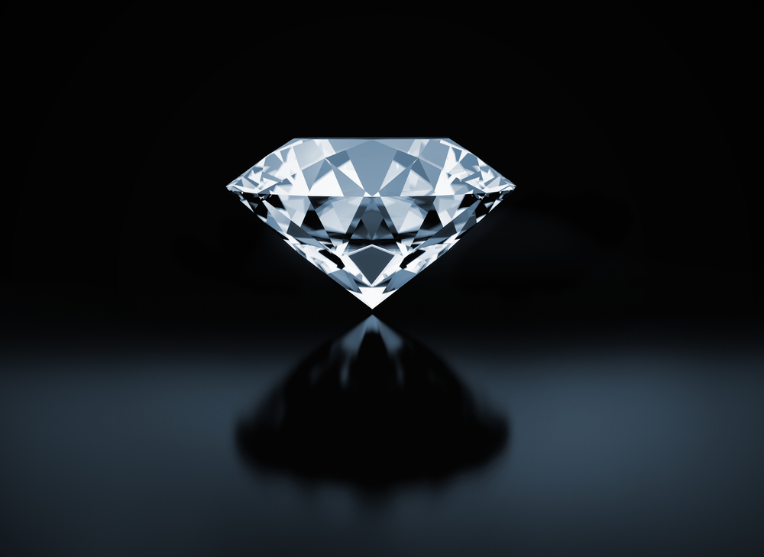
The beauty of God and His works…
…is holiness.
Notes:
For instance, God’s power is a beautiful power because it is holy, whereas the power of Satan and demons is an ugly power because it is unholy. Both angels and demons possess great power, but angels are beautiful because they are holy, while demons are ugly because they are unholy. The same applies to the rule of kings. Think of King David versus Antiochus Epiphanes. Both had great power and kingdoms, but David’s reign was glorious because it was holy, while the reign of Antiochus Epiphanes was evil and unholy. Edwards writes: <NEXT>

Slide 10
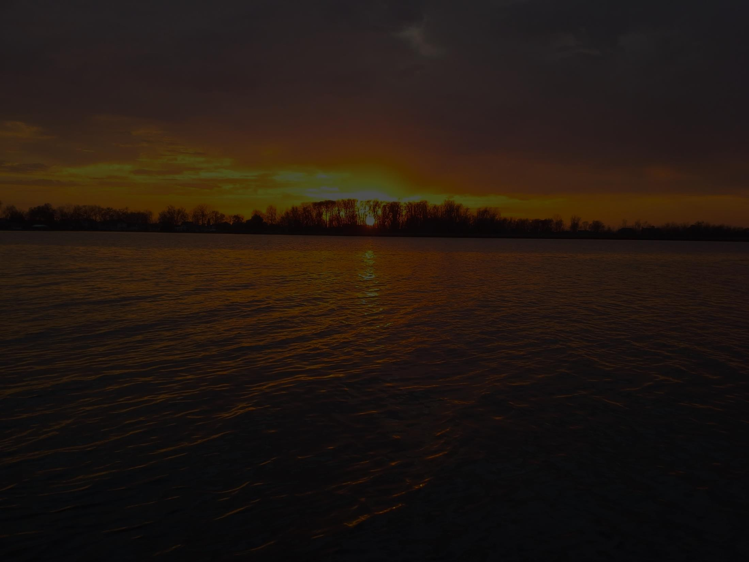
“A true love to God must begin with a delight in His holiness, and not with a delight in any other attribute; for no other attribute is truly lovely without this, and no otherwise than as…it derives its loveliness from this;
Notes:
[READ SLIDE]
<NEXT>

Slide 11
and therefore it is impossible that other attributes should appear lovely, in their true loveliness, until this is seen; and it is impossible that any perfection of the divine nature should be loved with true love until this is loved.”
Religious Affections, Banner of Truth, 183.
Notes:
[READ SLIDE]
<NEXT>
*Religious Affections, Banner of Truth, 183; Yale University Press, 257-258.

Slide 12
The beauty of God and His works…
…is holiness.
Notes:
This gives us an insight into the state of professing believers when their desires and actions take no delight in the holiness of God or in things that reflect God’s holiness, but are continually hankering after things that are contrary to the beauty of God’s holiness. <NEXT>

Slide 13
The beauty of God and His works…
…is holiness.
Notes:
When people disdain or have no love for holiness, it is difficult to take their professed love of God seriously when holiness is that which makes Him lovely. How can you love God when you do not love that which defines His character, that which constitutes His beauty? Loving God’s benefits is not the same thing as loving God for who He is.
You can see how this affects how we deal with the problem of evil. <NEXT>

Slide 14
“It is the glory of God’s wisdom that it is a holy wisdom, and not a wicked subtlety and craftiness. This makes His majesty lovely, and not merely dreadful and horrible, that it is a holy majesty. It is the glory of God’s immutability that it is a holy immutability, and not an inflexible obstinacy in wickedness.”
Religious Affections, Banner of Truth, 183.
Notes:
Edwards continues… [READ SLIDE]
<NEXT>
*Religious Affections, Banner of Truth, 183; Yale University Press, 257-258.

Slide 15
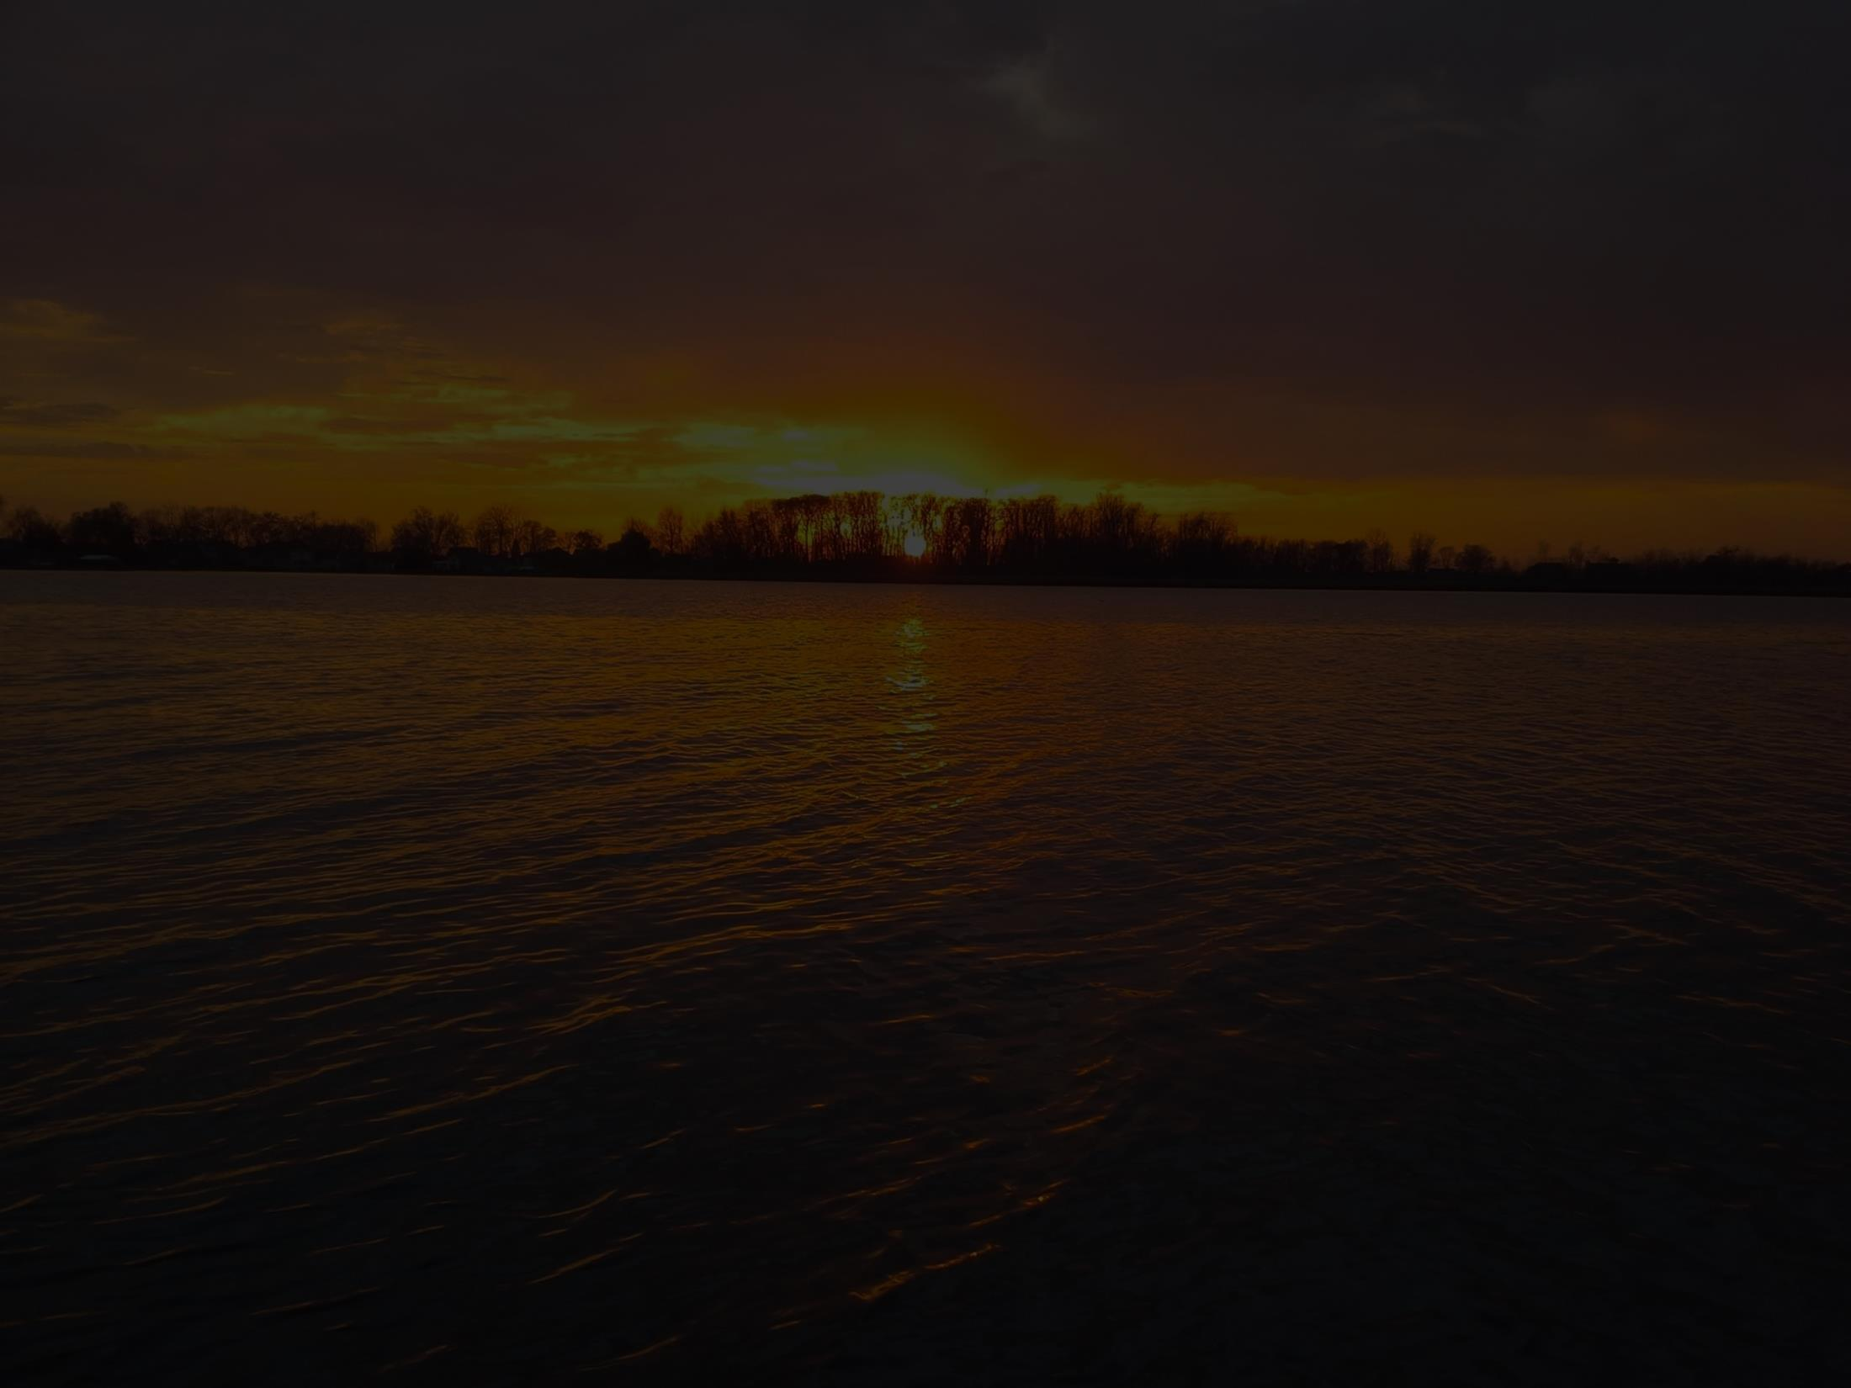
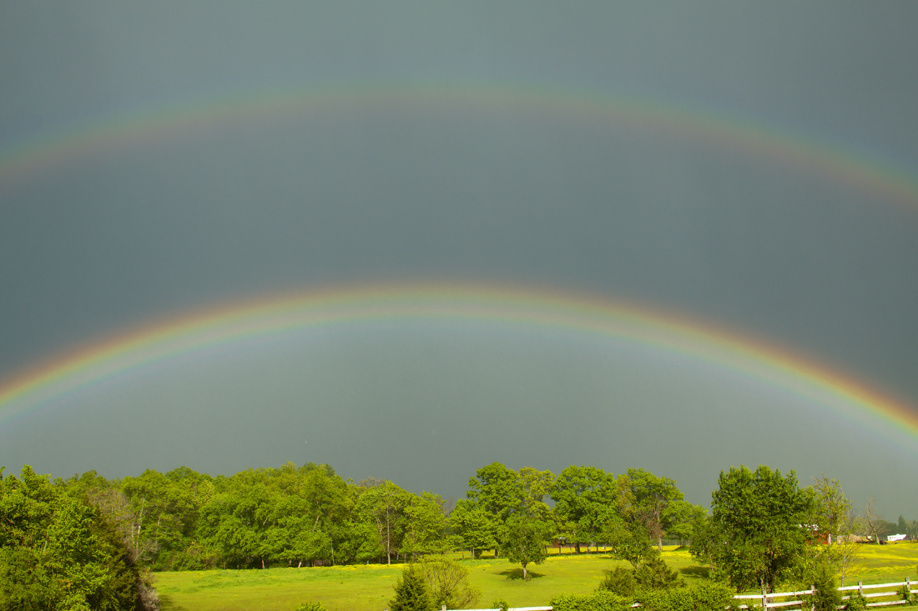
The beauty of God and His works…
…is holiness.
Notes:
The beauty of all things related to God is their holiness. Paraphrasing Edwards, the beauty of Christ is His holiness, while the beauty of “saints or holy ones” is holiness. It is a terrible thing when we profess a love for the Holy One and we ourselves practice evil, it contradicts our testimony. The Gospel is beautiful as it reflects “the holy beauty of God and Jesus Christ,” while its doctrines are spiritually beautiful as “holy doctrines.” Salvation through Christ is a beautiful truth as it is a salvation that magnifies and reflects God’s perfect holiness.**
<NEXT>
**Religious Affections, Banner of Truth, 184-5; Yale University Press, 258-9.

Slide 16
God is Holy
Notes:
And the glory of heaven is that it is a holy place, where the glory of God’s holiness dwells. It would not be heaven if evil were there.**
All of God’s acts are holy acts, including His foreordination of all things. God’s sovereign rule over all things is a holy rule. <NEXT>
**Religious Affections, Banner of Truth, 184-5; Yale University Press, 258-9.

Slide 17
“Sing praises to Him; speak of all His wonders. Glory in His holy name.”
1 Chronicles 16:9-10
Notes:
[READ SLIDE]
<NEXT>

Slide 18
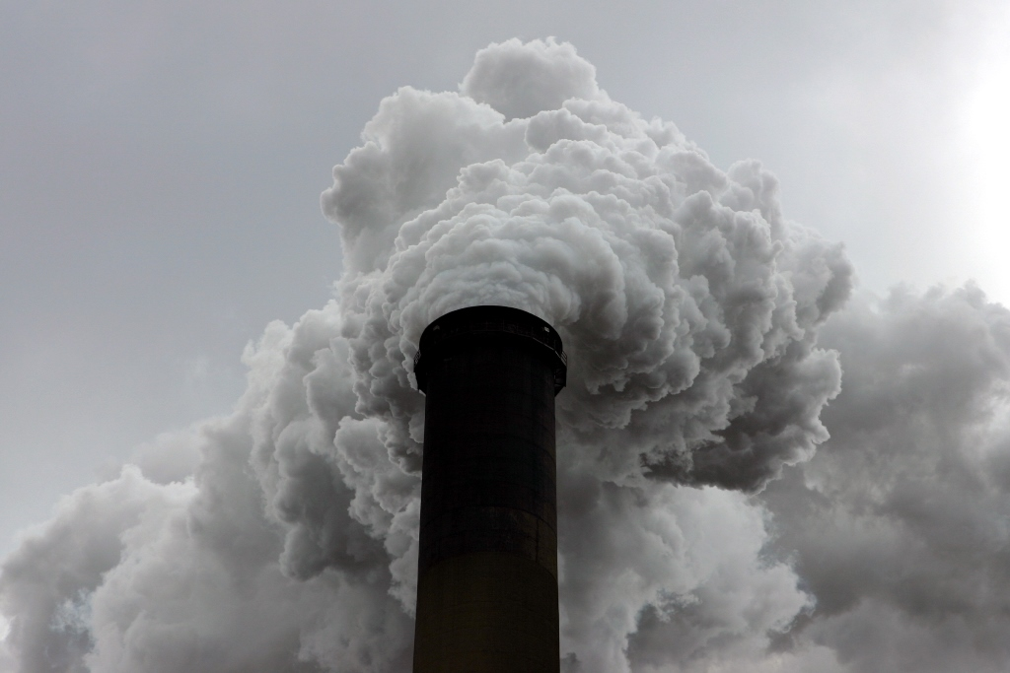
God is not and cannot be…
…the author of sin.
Notes:
Therefore… [READ SLIDE]
Apart from holiness, God’s sovereign rule would be no better than that of a wicked despot. All moral evil in the universe is from the will of the creature and not God. <NEXT>

Slide 19
God brought great good from great evil
God did evil that good may result
True
Blasphemy
Notes:
As we noted earlier, God does not do evil that good may result. Any proposed “solution” to the “problem of evil” that implies that God authored evil to bring about a greater good corrupts God’s holiness. God brought the best from the worst by redeeming sinners by His death at the hands of wicked people, but He cannot do evil that good may result. <NEXT>

Slide 20
Sovereignty
Free Agency
Notes:
Again, all attempts to reconcile God as the sovereign and omniscient creator of all things with the entrance of sin in the world by the free agency of Lucifer, Adam, and Eve, must reject all explanations that compromise God’s perfect holiness. God cannot be the author of that which is contrary to His holy character, and His holiness cannot be subordinated to His sovereignty, because holiness comprises the beauty of God’s sovereignty. At the same time, God’s sovereignty cannot be denied to protect God’s holiness. God’s rule is holy. Here again, we bow our limited understanding before an infinite God. <NEXT>

Slide 21
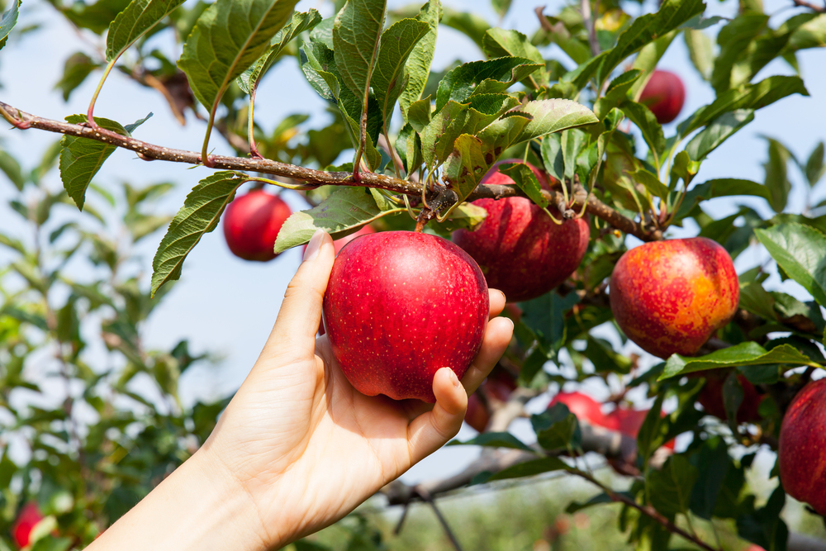
Notes:
Sin entered the world by the will of beings created without moral defect. They freely chose sin, without constraint or coercion, for which God is not responsible or blamable. Yet, God was not surprised, and we take comfort that evil isn’t running wild outside of God’s sovereign control. Satan and sinners can do nothing that does not ultimately accomplish God’s perfect will, but they act according to their own wicked desires, not because God somehow causes them to sin. <NEXT>

Slide 22
God
∞
Man
Notes:
Here again, we need to accept mystery and bow our limited understanding before an infinite God. We can know truly what God has chosen to reveal to us… <NEXT>

Slide 23
God
∞
“Gap”
Man
Notes:
We live in the gap between our smallness and a God who ways are higher than our ways as the heavens are higher than the earth.
This is no copout, but an acknowledgement of our status as created and limited before an infinite God, while the denial of the gap is a refusal to acknowledge reality as seen by everyone but suppressed in unrighteousness, a refusal to acknowledge reality as God has explained it to us in Scripture, a refusal to accept our dependence upon God for truth, knowledge, life, and all things, and a repeat of the sin of Adam and Eve in the Garden when they placed their will and understanding over that of their Creator. <NEXT>

Slide 24
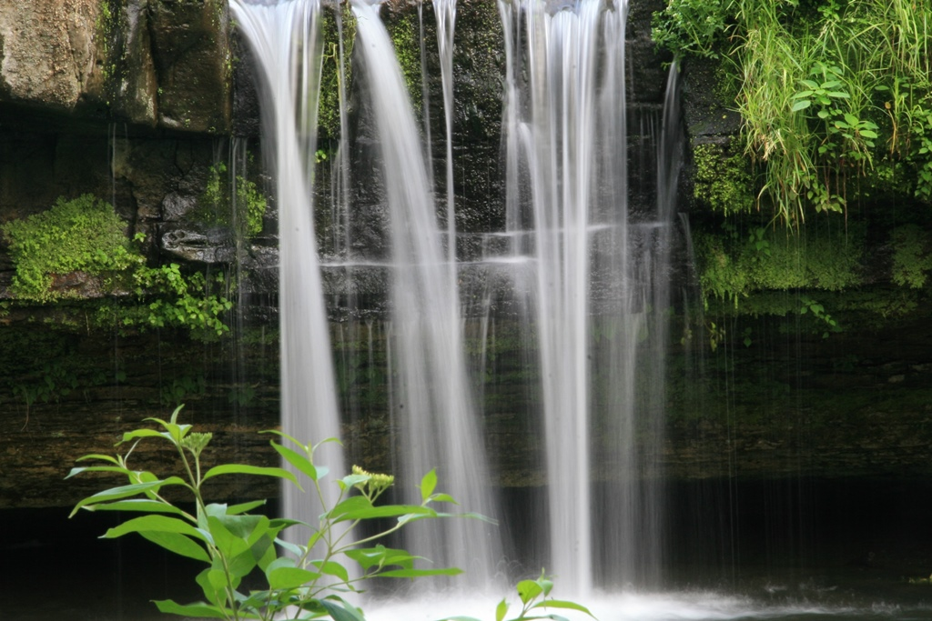
God is not and cannot be…
…the author of sin.
Notes:
To deny an element of mystery in the origin of evil in the universe will result in explanations that debase God’s holiness or sovereignty. God, who does all things perfectly, made Lucifer, Adam and Eve holy. Where, then, did the desire to choose evil come from? Eve was deceived, but why would she or Adam, with holy hearts that knew the excellence of God, accept an evil offer? How did Lucifer, created holy, come to have evil desires and think he could overcome an infinite God? Created with free wills, they all freely chose to sin. But, how do sinless beings that love holiness dismiss God’s authority, wisdom, goodness, and holiness to choose evil? <NEXT>

Slide 25
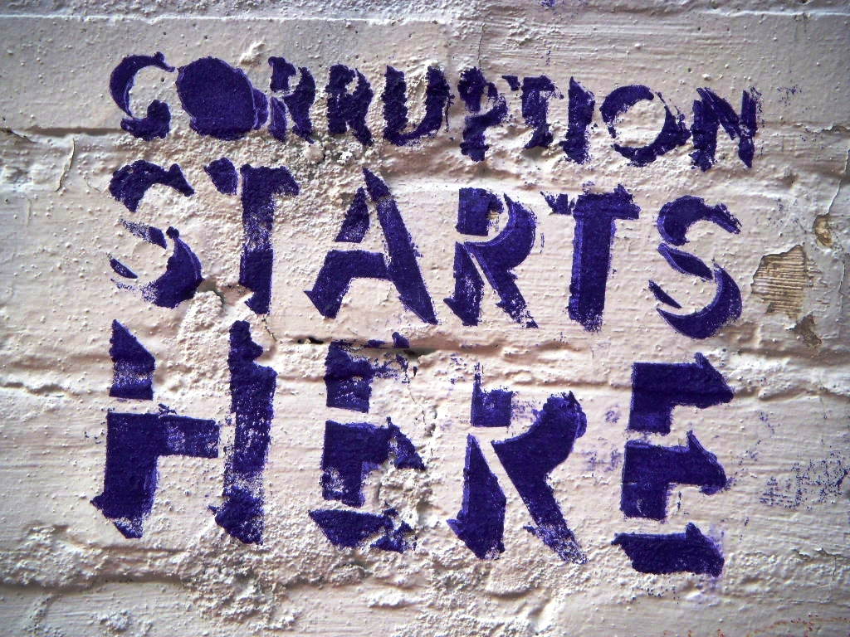
Notes:
In its very essence, evil is irrational. Evil was found in Lucifer, for which he alone was responsible and blamable, and they all chose, by desires contrary to the hearts God gave them, that which was evil, stupid, and self-destructive. What we can say for certain is evil came from the free will of created beings, not God. But beyond what Scripture tells us, the origin of evil in holy beings is inexplicable.
Yet, people still blame God… <NEXT>

Slide 26
“The foolishness of man subverts his way, and his heart rages against the LORD.”
Proverbs 19:3
Notes:
Proverbs 19:3 tells us… [READ SLIDE]
But rather than imitate this, we trust God’s perfect holiness and leave the blame for evil where it belongs, with those who commit it. <NEXT>

Slide 27
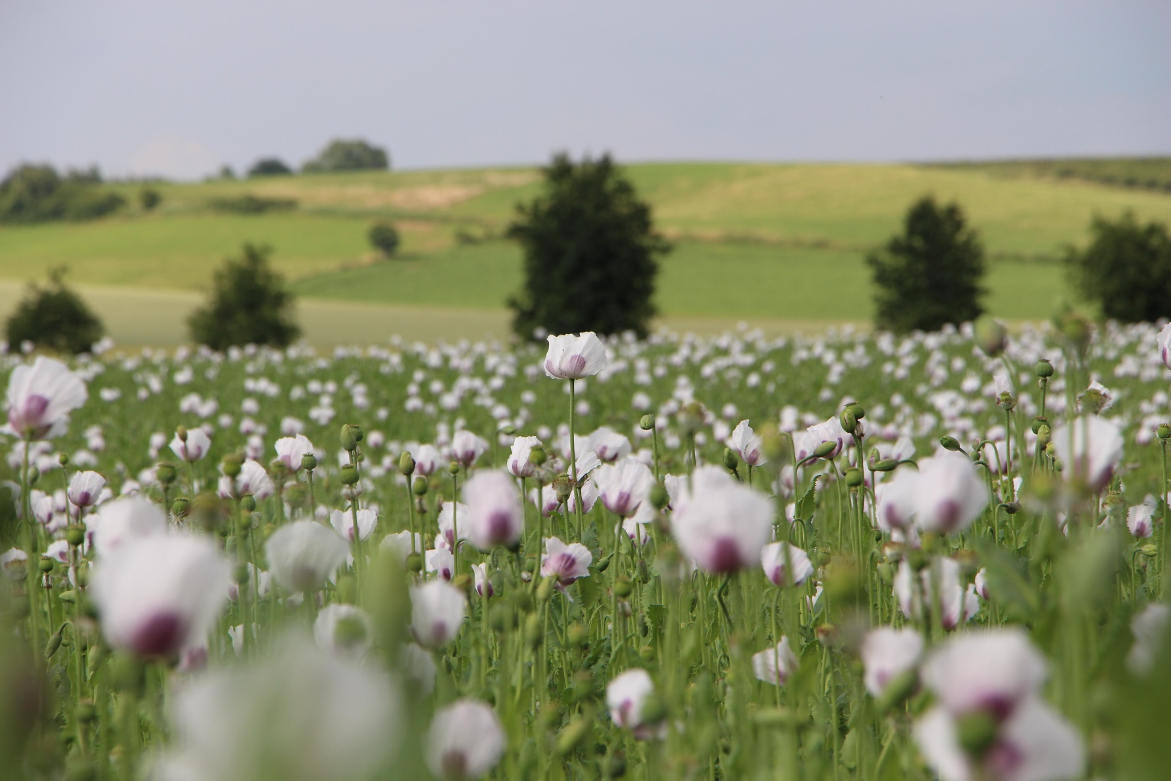
God is not and cannot be…
…the author of sin.
Notes:
And since holiness makes all of God’s attributes lovely, we can’t even indirectly attribute evil to God. Those who love God cannot delight in that which degrades His loveliness and destroys our comfort in difficult struggles--that God always does what is right. We trust His perfect holiness and sovereignty and rest in His unfailing and perfect character, accepting our limitations before an infinite God. Beyond this, we cannot go. <NEXT>

Slide 28
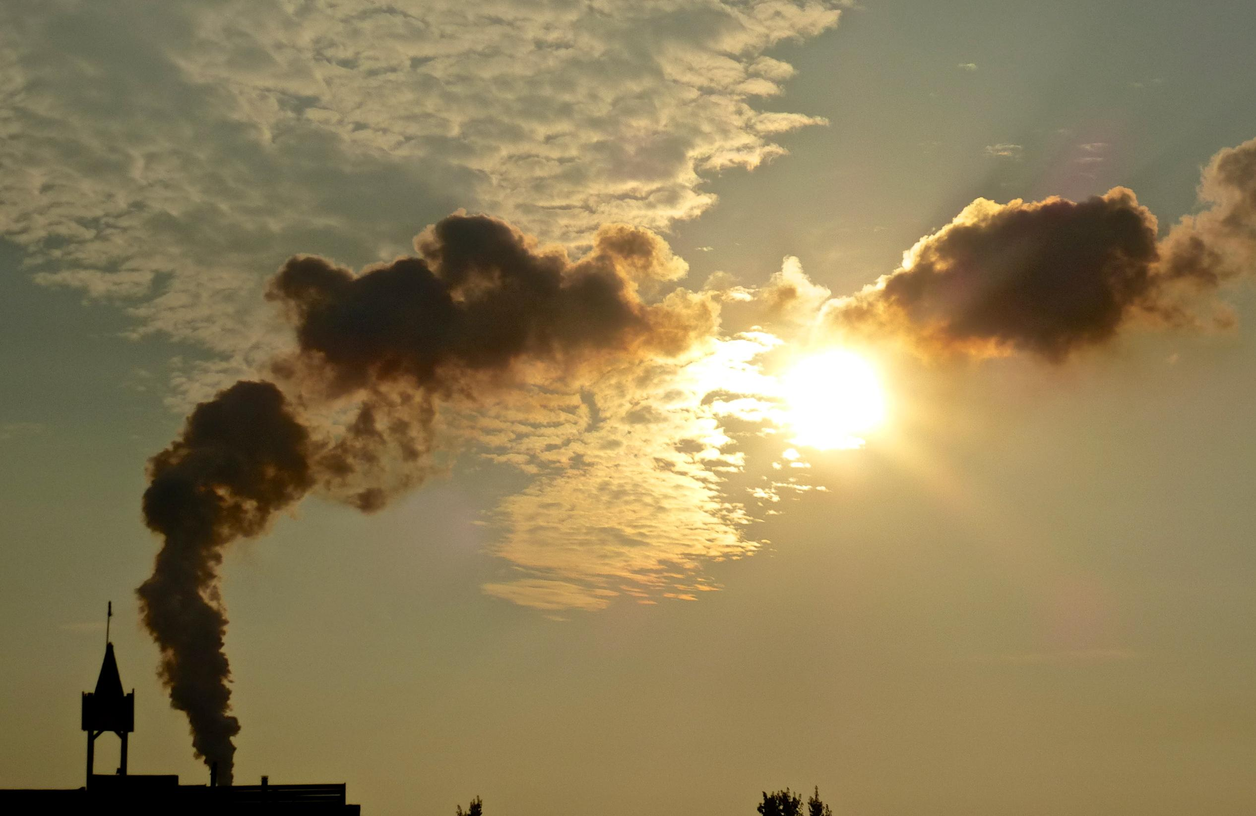
Attempts to defend God and answer unbelief…
…must always honor God as holy.
Notes:
Next… [READ SLIDE]
We can treat God as unholy many ways, including how we respond to unbelief.
For instance, to say that God probably or possibly exists treats God as unholy. Given the universe as it is, it is impossible that God could not exist. God is the creator and sustainer of all things, apart from whom nothing can possibly exist. To argue for the mere probability of God’s existence debases God and, as we have seen, partially justifies unbelief. <NEXT>

Slide 29
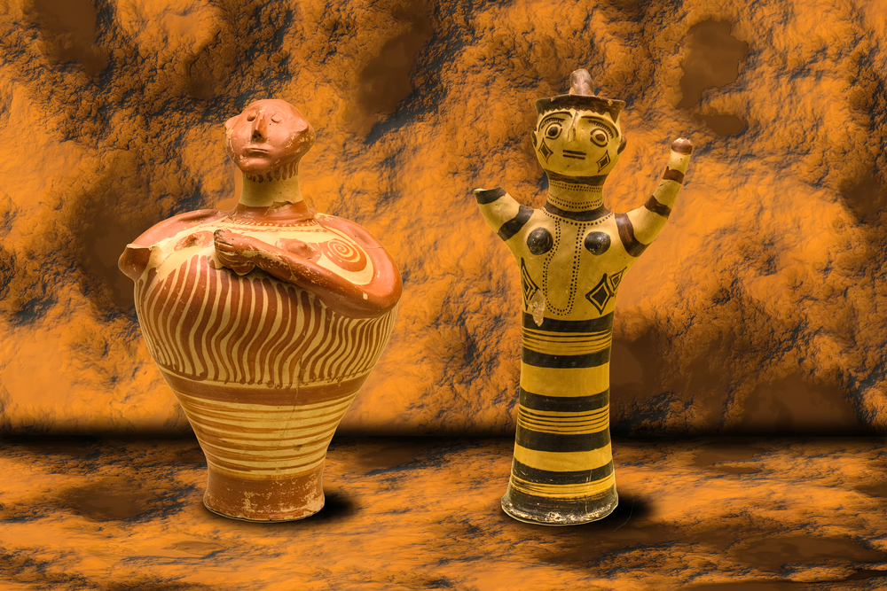
Notes:
Additionally, God is treated as unholy when sinful clay is given legitimacy to sit as judge of the Potter, or when unbelievers are given the place of God as the ultimate determiner of truth, like Adam and Eve in the garden. <NEXT>

Slide 30
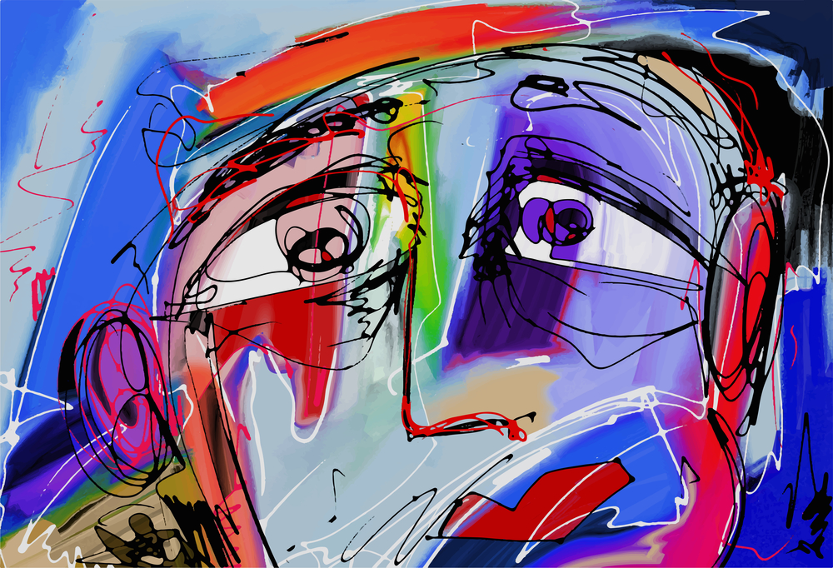
Gospel
Notes:
God is treated as unholy when the Gospel is altered to make it fit with an unbelieving culture. God knows best and we depend upon Him to know what is best. Christ is Lord over how we defend and proclaim Christ, and over the content of the message. <NEXT>

Slide 31
“By those who come near Me I will be treated as holy, and before all the people I will be honored.”
Leviticus 10:3
Notes:
[READ SLIDE]
We must be careful to honor God as holy in all that we think and do. <NEXT>

Slide 32
Sinners have no claims…
…on a holy God.
Notes:
Next… [READ SLIDE]
God despises sin. In fact, were it not for Christ satisfying the penalty for sin, God would have nothing to do with anyone. <NEXT>

Slide 33
Notes:
Not only do we have no claims on God and owe Him all things as our creator, we owe Him all thanks, love and honor for salvation in Christ. Every breath we breathe is mercy and every blessing grace. Apart from Christ we are hopeless and hateful in God’s holy eyes.
From creation to redemption, we have no claims on a holy God. <NEXT>

Slide 34
Notes:
Our approach to unbelief must acknowledge this, denying the validity of complaints against God while keeping the supremacy and holiness of God in proper perspective.
Again, finite and fallen people are unqualified to judge God, the source and standard of righteousness. <NEXT>

Slide 35
Notes:
Yet, unbelievers often criticize and condemn the God of Scripture, while believers sometimes even imitate this irreverence, even if we are not always aware of it. <NEXT>

Slide 36
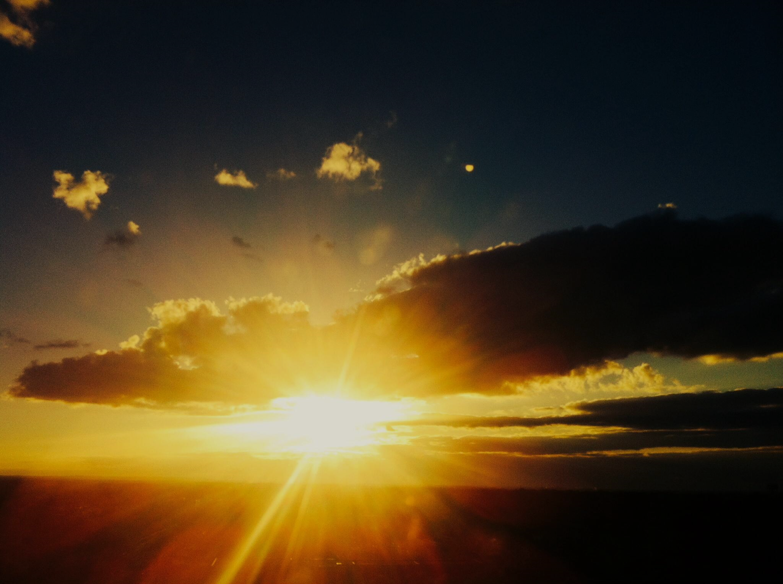
The brighter God’s holiness shines…
…the more lovers of darkness hate it.
Notes:
Next… [READ SLIDE]
…and suppress it wherever it shines. Christ came into the world, but the world “loved the darkness rather than the light” (John 3:19). Opposition to Christ is greatest when His excellence is most clearly displayed. A world blind to the beauty of God’s holiness will be blind to the beauty of Christ, the Gospel, the church, and saints to the extent they reflect His holiness. <NEXT>

Slide 37
The brighter God’s holiness shines…
…the more lovers of darkness hate it.
Notes:
The more spiritually dark a culture, and the more we reflect God’s holiness and present a God-honoring method and message, the more the world will oppose us. Our acceptance or popularity in a fallen culture might indicate a lack of faithfulness to God in our ministry.
Opposition should never be the result of a lack of grace, kindness, compassion, patience, and respect on our part. Sometimes we are opposed because we are unloving and obnoxious. Truth should always be presented with grace and love, but presented, nonetheless. So, when we are gracious and faithful to the message, we should not to be alarmed by opposition. In Philippians 1:27-8 we read… <NEXT>

Slide 38
“Conduct yourselves in a manner worthy of the gospel of Christ; so that whether I come and see you or remain absent, I may hear of you that you are standing firm in one spirit…
Notes:
[READ SLIDE]
<NEXT>

Slide 39
with one mind striving together for the faith of the gospel; in no way alarmed by your opponents—which is a sign of destruction for them, but of salvation for you, and that too, from God.”
Philippians 1:27-28
Notes:
[READ SLIDE]
<NEXT>

Slide 40
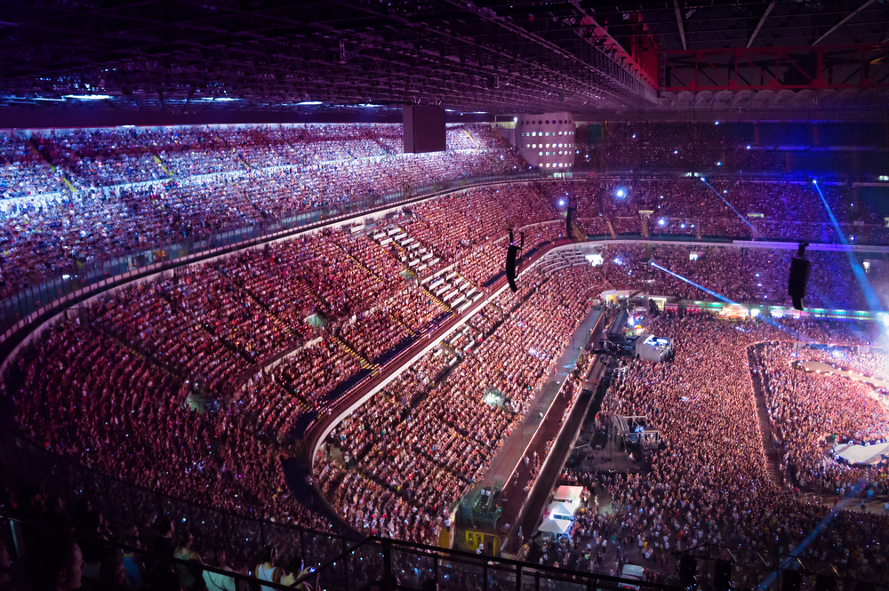
The brighter God’s holiness shines…
…the more lovers of darkness hate it.
Notes:
Therefore, because the methods and message that least honor God’s holiness will be the most acceptable to unbelievers, the message and the way we defend and proclaim it should be judged by their faithfulness to God and His Word and not their acceptance by unbelievers. Perhaps some churches are small in number because they are the most faithful. <NEXT>

Slide 41
Notes:
A church shrinking or growing is not, of itself, an indicator of success. Spiritual success involves growing in holiness, trust in Christ, love and knowledge of God, faithfulness to proclaim and teach the truth as God has revealed it, outreach to the lost, and other things to which God has called us. We are called to be faithful; God grows or shrinks the church. <NEXT>

Slide 42
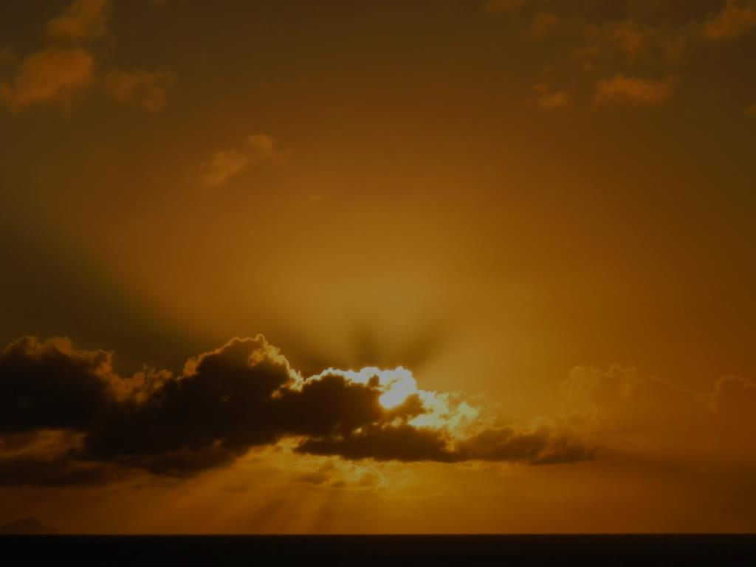
Next Up:
God Is righteous
Notes:
[READ SLIDE]
<NEXT>

Slide 43
Copyright © 2014 Craig Biehl, Pilgrim’s Rock, LLC
Unless otherwise indicated, Scripture taken from the NEW AMERICAN STANDARD BIBLE, © Copyright The Lockman Foundation 1960, 1962, 1963, 1968, 1971, 1972, 1973, 1975, 1977, 1988, 1995. Used by permission.
Scripture quotations marked (ESV) are from The Holy Bible, English Standard Version® (ESV®), copyright © 2001 by Crossway, a publishing ministry of Good News Publishers. Used by permission. All rights reserved.

