Slide 1
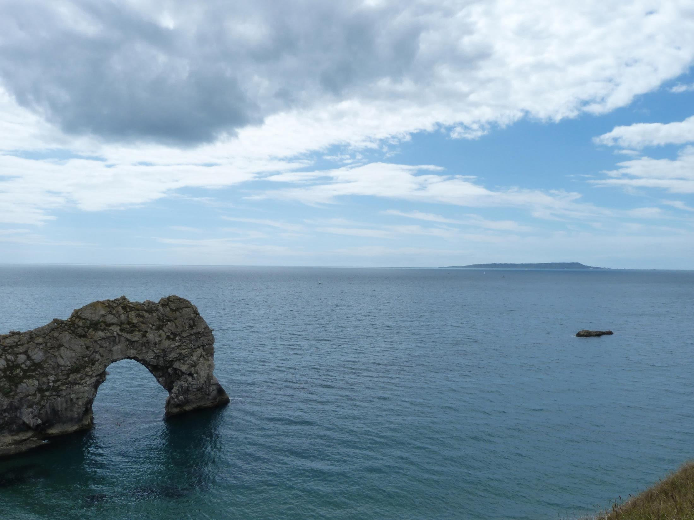

Slide 2
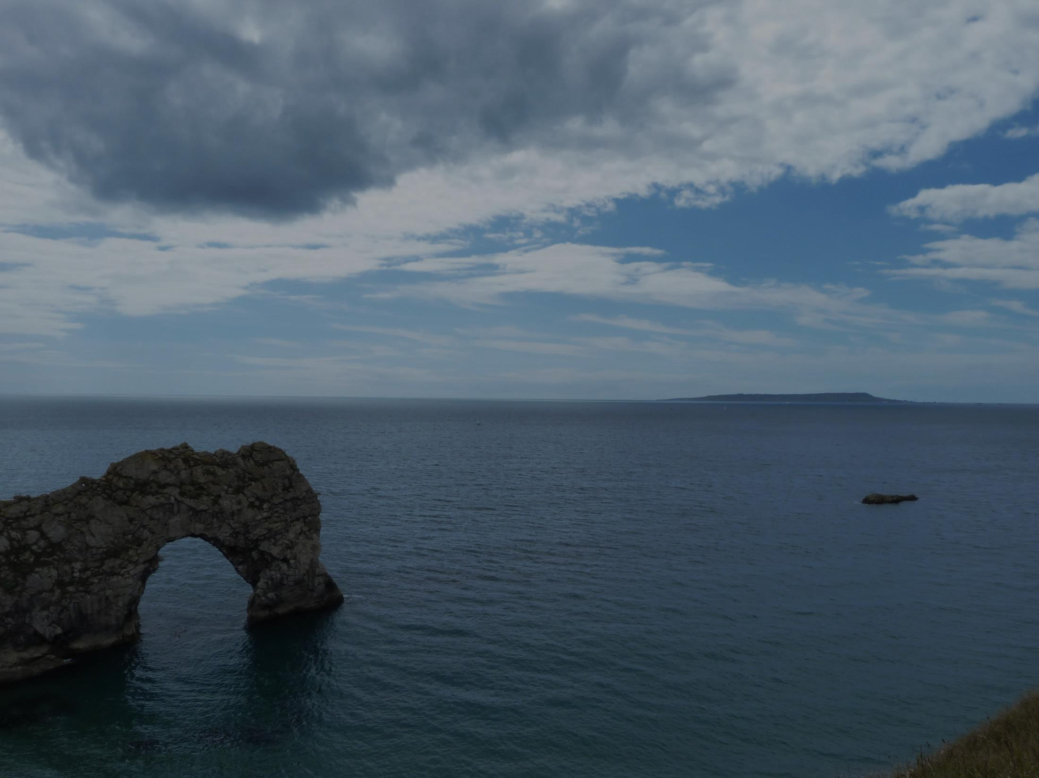
Unbreakable Faith
How God’s Perfections Give Life, Joy, and Thriving Assurance in a World of Unbelief
Notes:
<READ SLIDE> <NEXT>

Slide 3
Section One
God Has No
Beginning or Needs
Notes:
<READ SLIDE> God has always existed and will always exist. Never has there been a time when God did not exist and there will never be a time when God does not exist. He is uncreated and has no cause, beginning, or end. As infinite, perfect, and unchanging, God exists eternally. Moreover…
God needs nothing, has never needed anything, and will never need anything. Nothing can improve Him or His circumstances. He needs no help. He is independent of everything, including the universe and everything in it. He is independent of angels, people, and what many call the laws of nature. He depends on nothing or anyone to accomplish whatever He desires to do. And as the creator and sustainer of all things, God owes nothing to anyone. He is independent and self-sufficient in every conceivable way. <NEXT>

Slide 4
God has always existed and will always exist.
Notes:
[READ SLIDE]
<NEXT>

Slide 5
Never has there been a time when God did not exist and there will never be a time when God does not exist.
Notes:
[READ SLIDE]
<NEXT>

Slide 6
He is uncreated and has no cause, beginning, or end.
Notes:
[READ SLIDE]
<NEXT>

Slide 7
As infinite, perfect, and unchanging, God exists eternally.
Notes:
[READ SLIDE]
<NEXT>

Slide 8
God needs nothing, has never needed anything, and will never need anything.
Notes:
Moreover… [READ SLIDE]
<NEXT>

Slide 9
Nothing can improve Him or His circumstances. He needs no help.
Notes:
[READ SLIDE]
<NEXT>

Slide 10
He is independent of everything, including the universe and everything in it.
Notes:
[READ SLIDE]
<NEXT>

Slide 11
He is independent of angels, people, and what many call the laws of nature.
Notes:
[READ SLIDE]
<NEXT>

Slide 12
He depends on nothing or anyone to accomplish whatever He desires to do.
Notes:
[READ SLIDE]
<NEXT>

Slide 13
As the creator and sustainer of all things, God owes nothing to anyone.
Notes:
And…[READ SLIDE]
<NEXT>

Slide 14
He is independent and self-sufficient in every conceivable way.
Notes:
[READ SLIDE]
<NEXT>

Slide 15
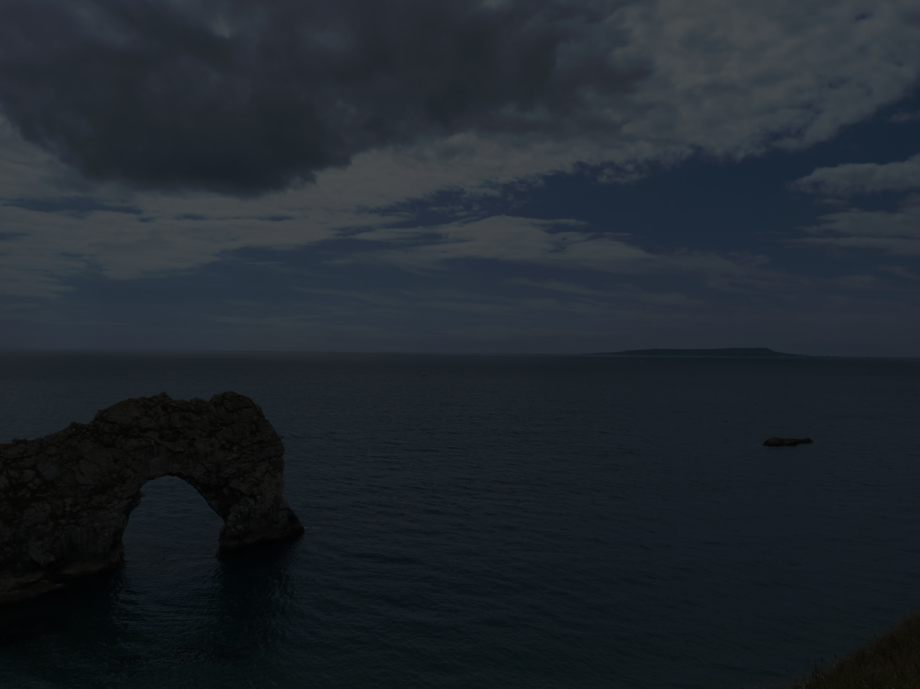
God Has No Beginning or Needs
“Before the mountains were brought forth, or ever You had formed the earth and the world, from everlasting to everlasting You are God.”
Psalm 90:2
Notes:
<READ SLIDE> Uncreated, no beginning. <NEXT>

Slide 16
God Has No Beginning or Needs
“Or who has given a gift to Him that He might be repaid? For from Him and through Him and to Him are all things.”
Romans 11:35-36
Notes:
<READ SLIDE> Does God need anything? No, nothing at all. <NEXT>

Slide 17
God Has No Beginning or Needs
“The God who made the world and everything in it, being Lord of heaven and earth, does not live in temples made by man, nor is He served by human hands, as though He needed anything, since He himself gives to all mankind life and breath and everything.”
Acts 17:24-25
Notes:
<READ SLIDE> God needs absolutely nothing.
The implications of these perfections are profound and far-reaching. First… <NEXT>

Slide 18
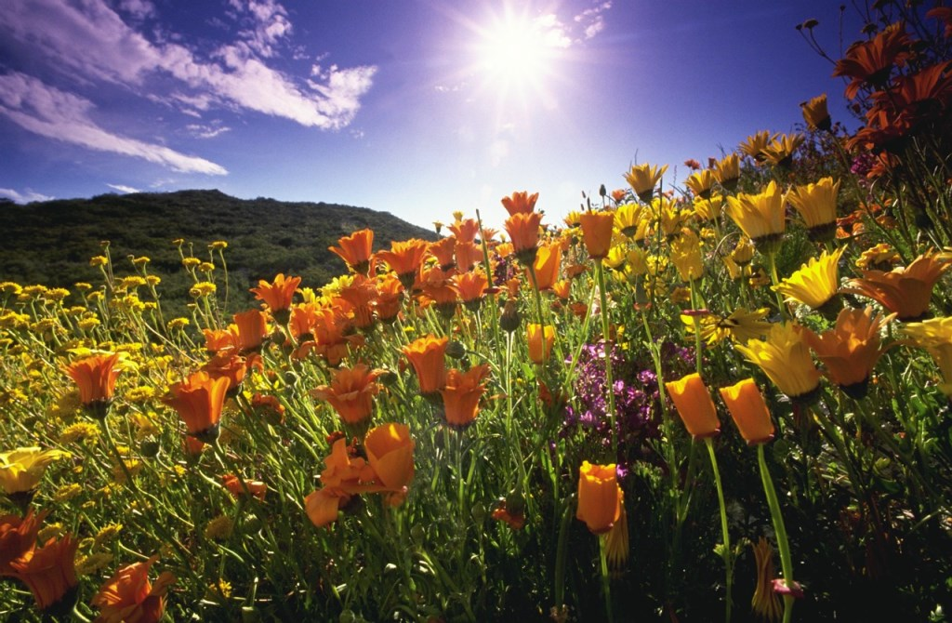
God created and sustains…
…all things.
Notes:
[READ SLIDE] God, alone existed for all eternity until He spoke and made the universe, which continues to exist by God’s ongoing power to order and sustain it. He did not create the universe and then let it to run on its own. The second God stops sustaining the universe it will cease to exist, including everything in it.
God created, sustains, and determines all things, so we depend on Him for all things. Simple and obvious, right? But we’ll soon see how simple principles are not always applied properly and consistently in our Christian life. Thus, we seek a deeper and more complete biblical worldview to better love God as we apply a growing knowledge of the excellence of His perfections and promises to every facet of life.
But mark it… <NEXT>

Slide 19
Apart from God…
…nothing exists.
Notes:
[READ SLIDE]
Nothing at all. Nothing would or could exist apart from God speaking it into existence and sustaining it, including all time, matter, space and energy. The universe has a beginning and is not eternal. <NEXT>

Slide 20
“All things were made through Him, and without Him was not any thing made that was made.”
John 1:3
Notes:
Speaking of God the Son, John 1:3 tells us… [READ SLIDE]
<NEXT>

Slide 21
“He is the radiance of the glory of God and the exact imprint of His nature, and He upholds the universe by the word of His power.”
Hebrews 1:3 ESV
Notes:
In Hebrews 1:3 we read… [READ SLIDE]
He spoke it into existence, and by His word He upholds it, orders it, and determines all things. <NEXT>

Slide 22
“For by Him all things were created, both in the heavens and on earth, visible and invisible, whether thrones or dominions or rulers or authorities…
Notes:
Colossians 1:16-17 tells us… [READ SLIDE]
<NEXT>

Slide 23
all things have been created by Him and for Him. And He is before all things, and in Him all things hold together.”
Colossians 1:16-17
Notes:
[READ SLIDE]
Therefore…
<NEXT>

Slide 24
God created and upholds…
…all “natural laws.”
Notes:
[READ SLIDE]
By laws we mean the laws of physics, biology, etc., how the universe operates. <NEXT>

Slide 25
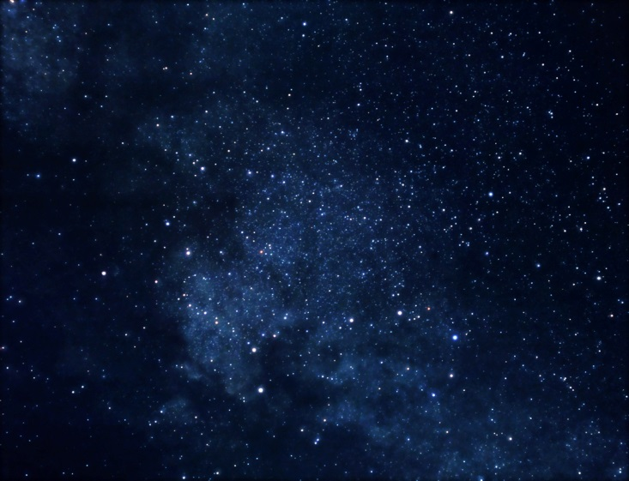
“Natural Laws” = Divine Laws
Notes:
But such laws are really “divine laws” because they would not exist apart from God’s ongoing ordering of all matter and energy. In fact, they are not really laws if by “laws” we mean they exist and operate apart from God’s ongoing power. <NEXT>

Slide 26
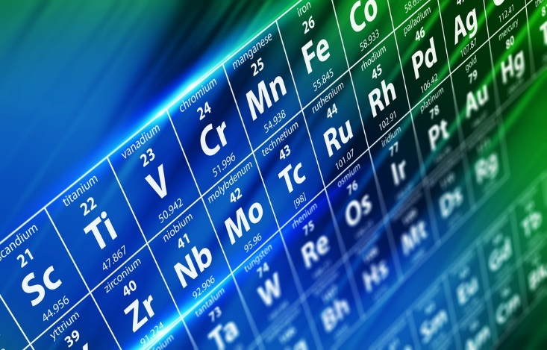
Notes:
The constancy of the “laws of nature” reflects God ordering the elements of the universe for a particular time.
Therefore, God determines what is possible in the universe, not those who observe and discover how God orders and sustains it. Miracles, then, are not God intervening into a self-sustaining system, but God doing something differently for a particular purpose at a point in time. It’s a small thing to stop the sun in the sky, walk on water, or raise the dead, compared to ordering and upholding every quark and atom in the universe every moment of every day. That’s power.
God alone determines what is possible and impossible in the universe He created and upholds. <NEXT>

Slide 27
Notes:
We don’t determine the laws of physics or biology, etc., we merely discover, document, and use how God orders His world. <NEXT>

Slide 28
Notes:
When we make things, we merely arrange what God has made. <NEXT>

Slide 29
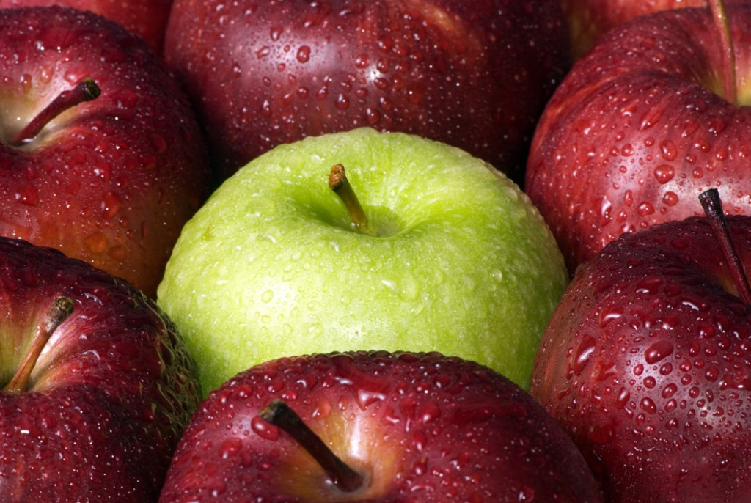
Fixed and universal “laws” are inexplicable…
apart from God creating and sustaining them.
Notes:
Further… [READ SLIDE]
Without God, no reasonable explanation for fixed and universal “laws” is possible. Deny God and… <NEXT>

Slide 30
Notes:
random chance becomes the explanation for a universe of uniform and universal laws, an irrational contradiction.
Uniform and universal laws of logic are also inexplicable apart from God. Again, random chance produces no laws. Rather… <NEXT>

Slide 31
Notes:
laws of logic reflect the order and coherence of God’s thought and are easily explained on that basis. <NEXT>

Slide 32
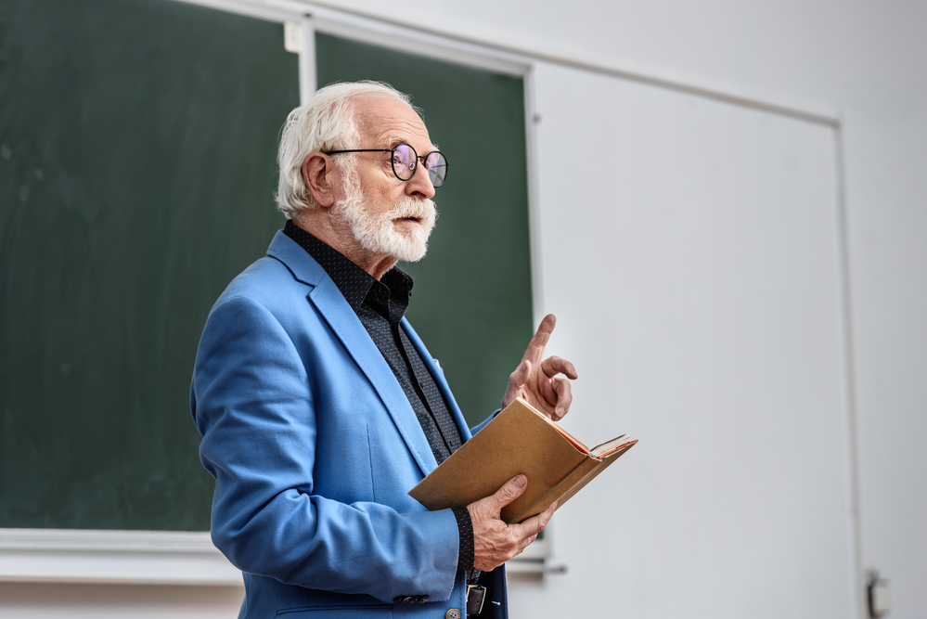
Notes:
And while unbelievers use logic to deny the existence of God, their use of logic presumes God’s existence even as they deny Him (more about this later). <NEXT>

Slide 33
Notes:
We sometimes fail to appreciate this point. We are so used to God’ ordering and sustaining the universe that we take it all for granted, as if the universe orders itself and operates on its own. <NEXT>

Slide 34
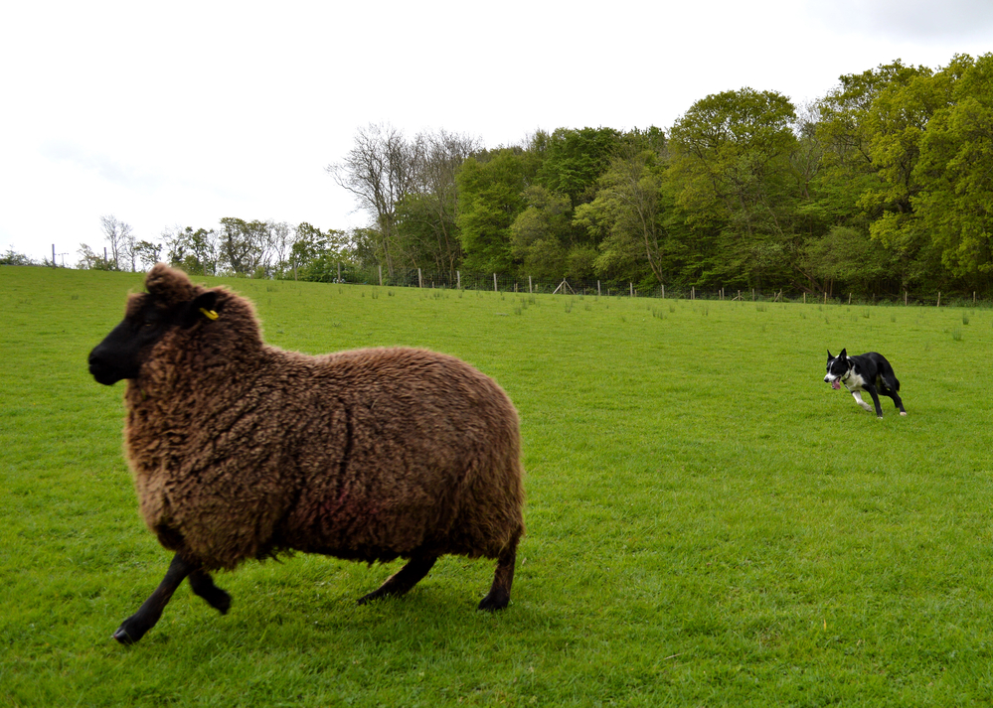
Notes:
And while we know well how we often stray from Christ in our actions, we sometimes miss that loving God includes how we view God and His world. <NEXT>

Slide 35
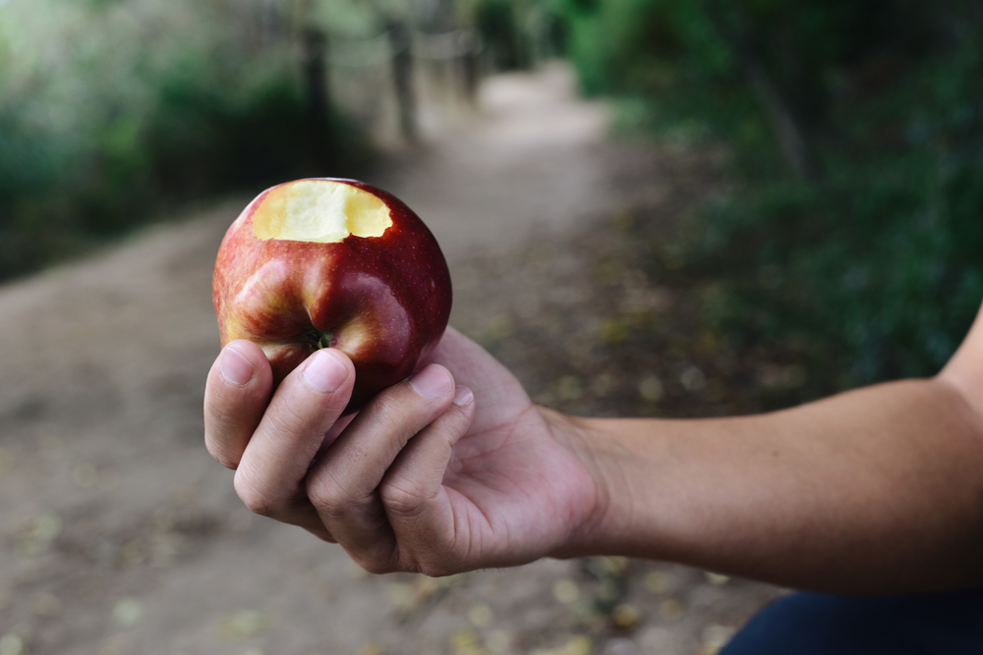
When we sin…
…we are practical atheists.
Notes:
[READ SLIDE]
…at least for the moment we exalt our will over God’s will. <NEXT>

Slide 36
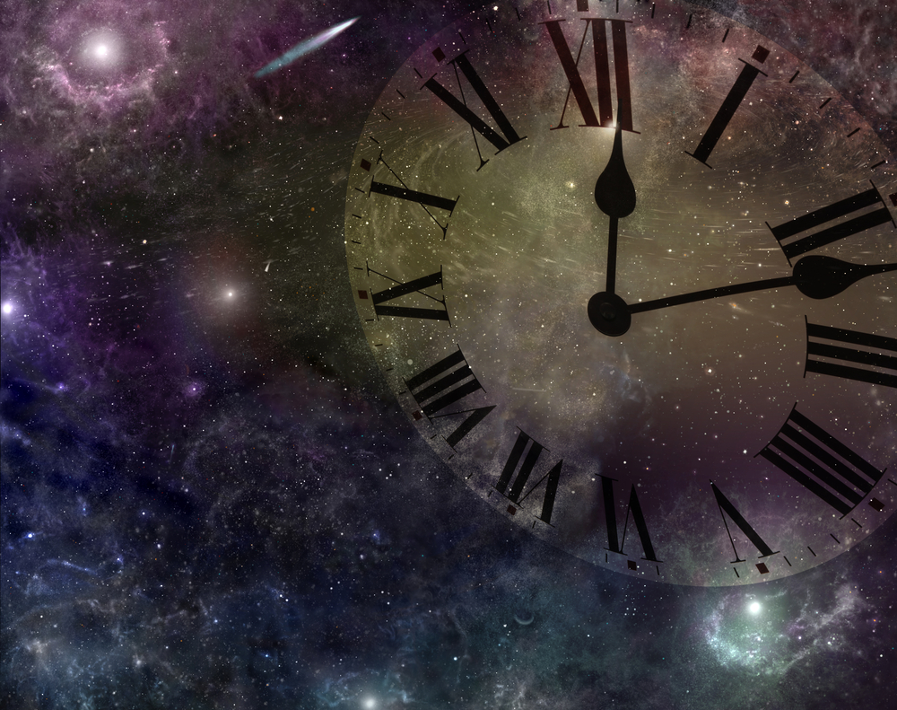
When we view the universe as operating on its own…
…we are practical deists.
Notes:
And… [READ SLIDE]
…insofar as we view the universe as begun by God, but operating according to independent physical laws. <NEXT>

Slide 37
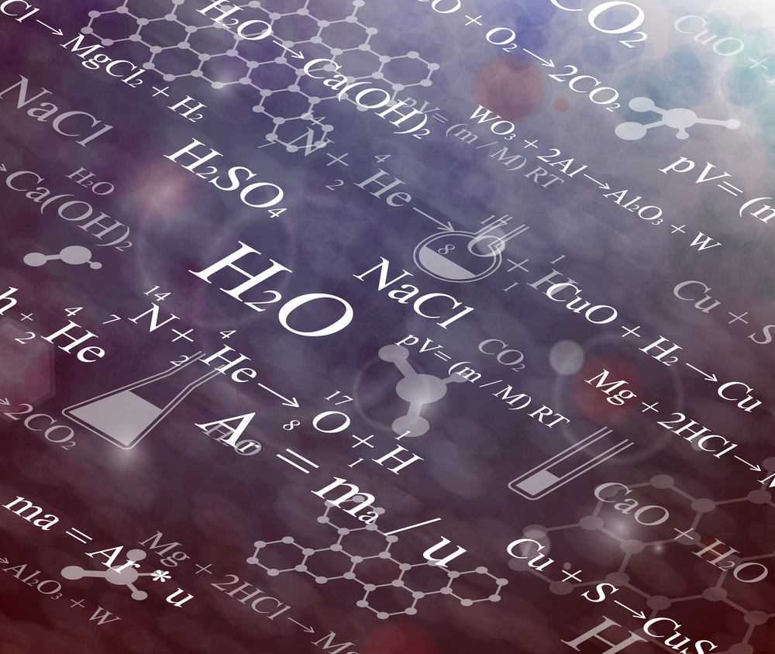
Notes:
As Christians, we study physical laws but rightly see them as the display of God’s ongoing ordering and sustaining of the universe, not operating independent of God or as the product of random chance. <NEXT>

Slide 38
Created and sustained by God…
…we depend upon God for all things.
Notes:
Moreover… [READ SLIDE] Apart from God we have nothing, and everything we have we have received from Him. God alone is independent, while we depend on God for everything. <NEXT>

Slide 39
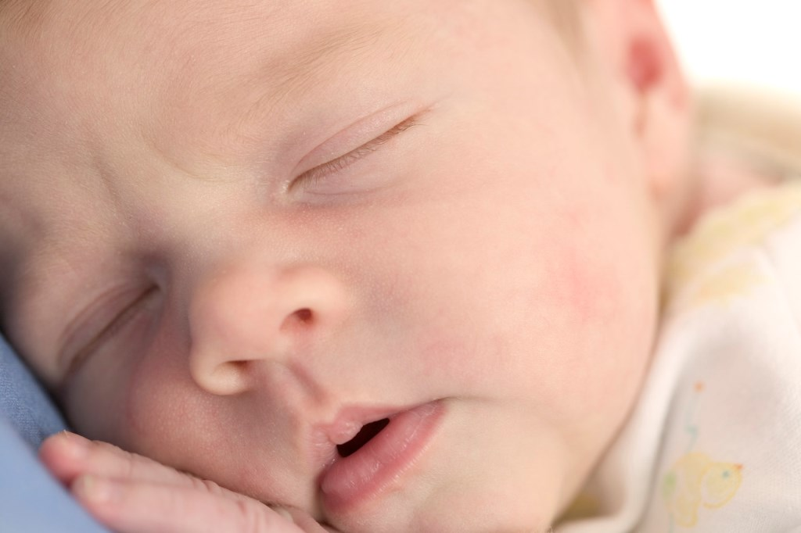
We depend upon God…
…for life.
Notes:
[READ SLIDE]
This is usually the first thing we think of when we think of dependence on God, including physical and eternal life. <NEXT>

Slide 40
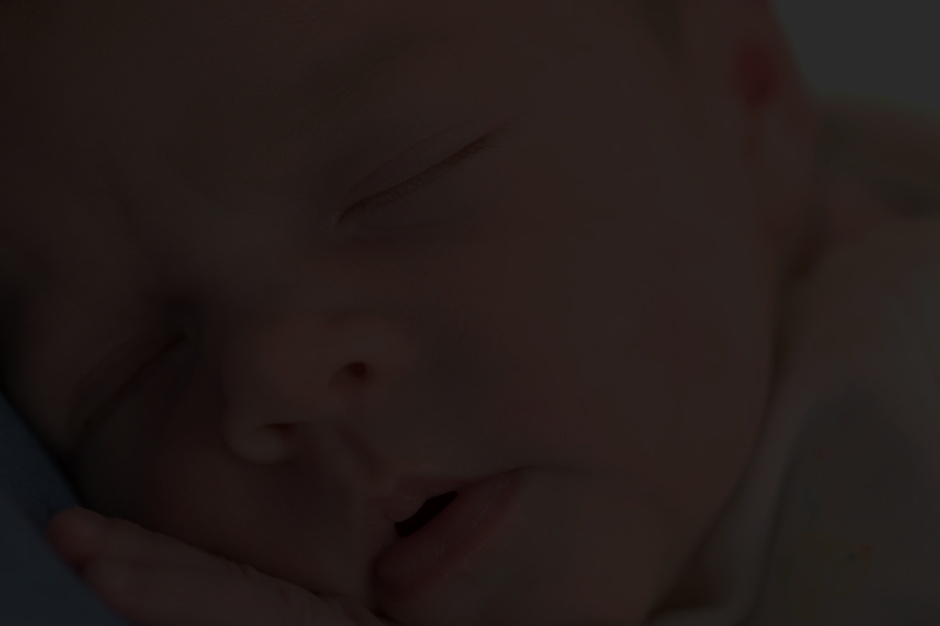
We depend upon God…
“For You formed my inward parts; You knitted me together in my mother’s womb. I praise You, for I am fearfully and wonderfully made. Wonderful are Your works; my soul knows it very well…
…for life.
Notes:
[READ SLIDE]
<NEXT>

Slide 41
We depend upon God…
My frame was not hidden from You, when I was being made in secret, intricately woven in the depths of the earth. Your eyes saw my unformed substance; in Your book were written, every one of them…
…for life.
Notes:
[READ SLIDE]
<NEXT>

Slide 42
We depend upon God…
the days that were formed for me, when as yet there was none of them.”
Psalm 139:13-16 ESV
…for life.
Notes:
[READ SLIDE]
<NEXT>

Slide 43
Notes:
The hairs of our head are numbered (Matthew 10:30)… <NEXT>

Slide 44
Notes:
and the food on our table displays God’s goodness (Acts 14:17). <NEXT>

Slide 45
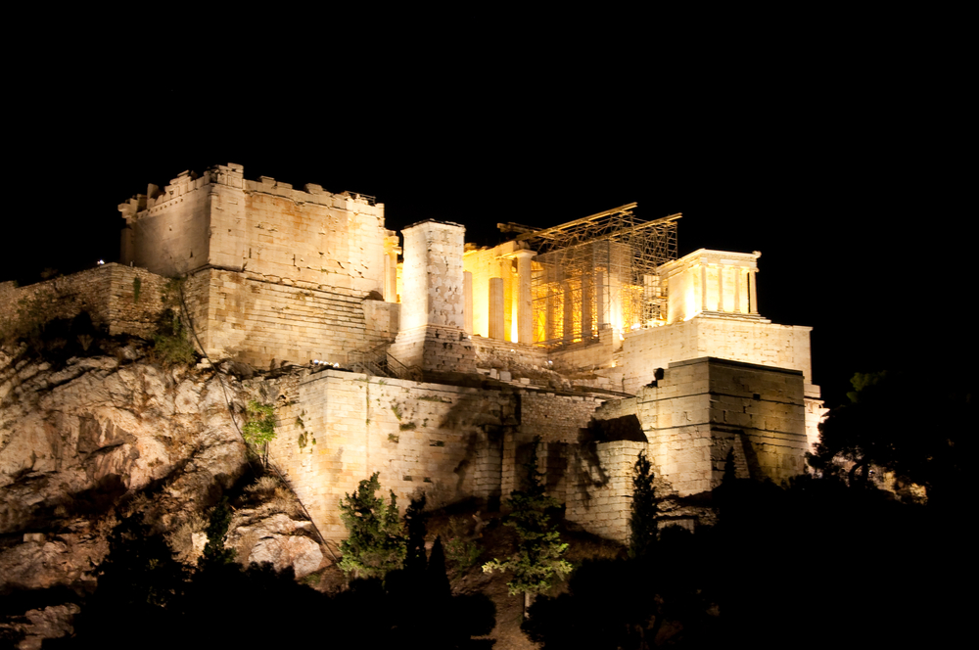
Notes:
And as Paul preached at Mars Hill, even some unbelievers acknowledge dependence on “God” for life, for “in Him we live and move and have our being, as even some of your own poets have said, ‘For we are His offspring’” (Acts 17:28). <NEXT>

Slide 46
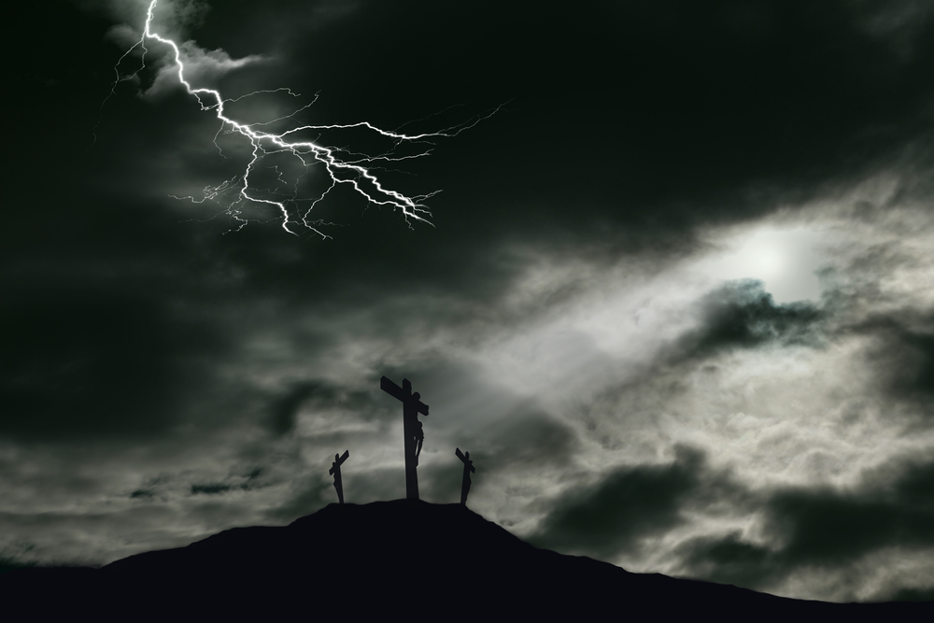
Notes:
Moreover, our dependence upon Christ for salvation is the central doctrine of our faith.
Less understood and appreciated, however, but no less important, is… <NEXT>

Slide 47
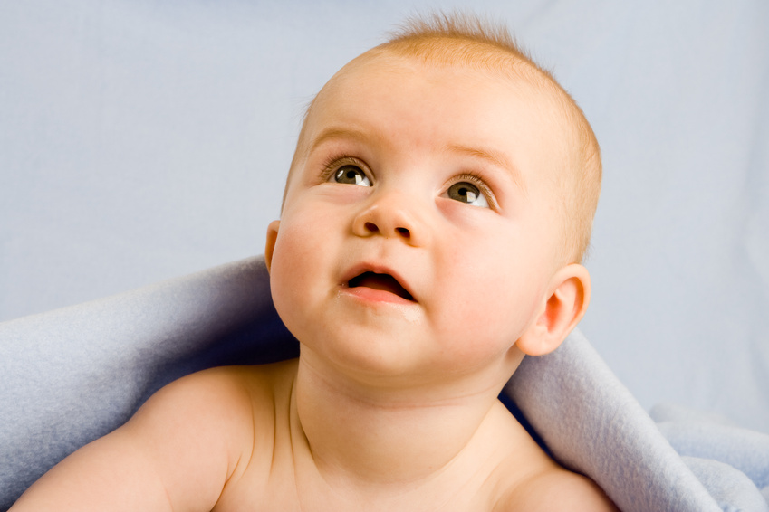
We depend upon God…
…for truth, knowledge, and authority.
Notes:
<READ SLIDE>
As God created, sustains, and rules over all, no higher authority and standard of truth exists. He alone knows everything perfectly and comprehensively, and He alone has a perfect objective perspective as outside and distinct from the universe (we’ll talk more about this later).
<NEXT>

Slide 48
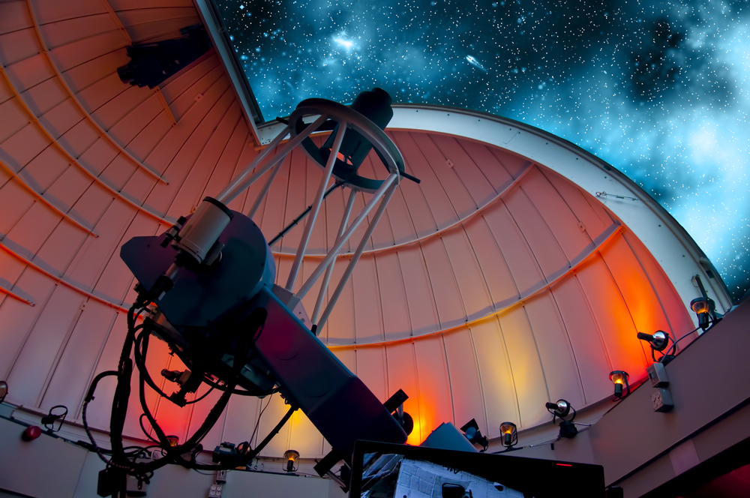
Notes:
We depend on God for the ability to know Him and His world. Created in His image, in personal relationship with Him, He gave us that ability. Without it, we could know nothing. <NEXT>

Slide 49
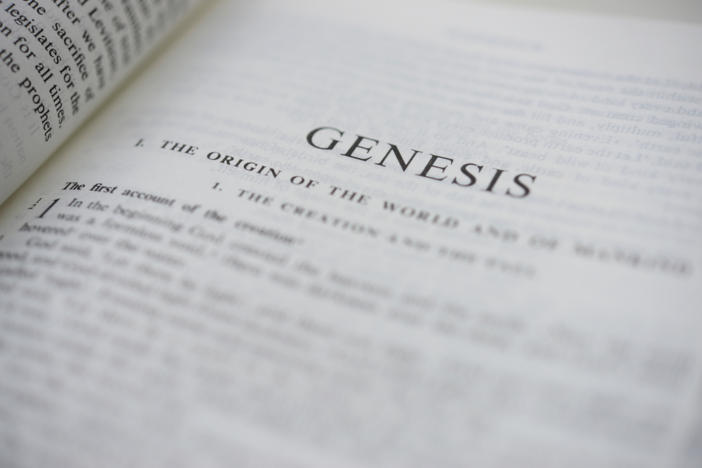
Notes:
God spoke directly to Adam and Eve because He made them able to know Him through human language. They needed God’s revelation in language to relate to God and know His will, to know to cultivate the garden and abstain from the forbidden fruit. <NEXT>

Slide 50
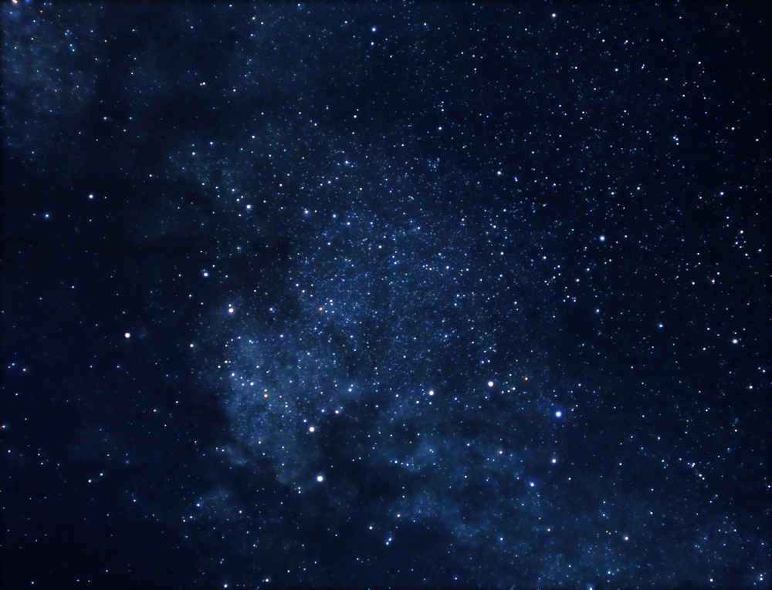
Thus, our dependence on God for truth, knowledge, and authority preceded Adam’s sin.
Notes:
[READ SLIDE]
<NEXT>

Slide 51
Adam’s sin only made our need greater, for left to our sinful selves, we would distort the truth.
Notes:
[READ SLIDE]
<NEXT>

Slide 52
As Adam avoided God in the garden after his sin…
Notes:
[READ SLIDE]
<NEXT>

Slide 53
so fallen people avoid God by rejecting and perverting the clear and comprehensive knowledge of God (Romans 1:18-22).
Notes:
[READ SLIDE]
<NEXT>

Slide 54
Therefore, our speculations about God, apart from revelation, cannot be trusted.
Notes:
[READ SLIDE]
<NEXT>

Slide 55
We depend upon God…
“He gives wisdom to the wise and knowledge to those who have understanding; He reveals deep and hidden things; He knows what is in the darkness, and the light dwells with Him.”
Daniel 2:21-22 ESV
…for truth, knowledge, and authority.
Notes:
[READ SLIDE]
<NEXT>

Slide 56
We depend upon God…
“He who trusts in his own mind is a fool.” Proverbs 28:26
…for truth, knowledge, and authority.
Notes:
Indeed… [READ SLIDE]
We lack proper and unbiased objectivity. Apart from God’s explanation of Himself and His world, we would interpret all things to suit our own desires. <NEXT>

Slide 57
We depend upon God…
“The heart is deceitful above all things, and desperately sick; who can understand it?”
Jeremiah 17:9
…for truth, knowledge, and authority.
Notes:
[READ SLIDE] God can, He searches the hearts.
Additionally… <NEXT>

Slide 58
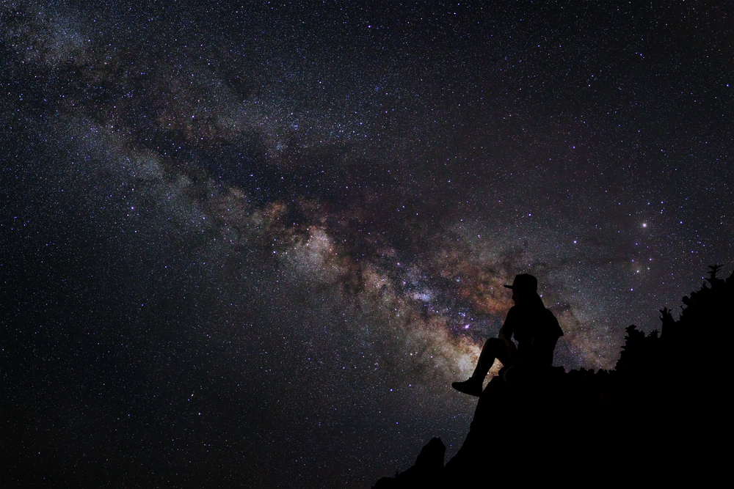
We depend upon God…
…for truth, knowledge, and authority.
Notes:
We are limited. Indeed, we are quite limited. God is infinite and unlimited, while we are limited to 3 to 4 dimensions, five senses, and seventy or so years on earth. How, then, can we make true statements about the ultimate nature of God and reality apart from God’s explanation? The universe is a big place, and some of us have never been out of the country, let alone to the end of the universe and beyond. As God is infinitely greater than the universe He created, we could never describe or know Him accurately without His revelation. God’s admonition to Job is instructive: <NEXT>

Slide 59
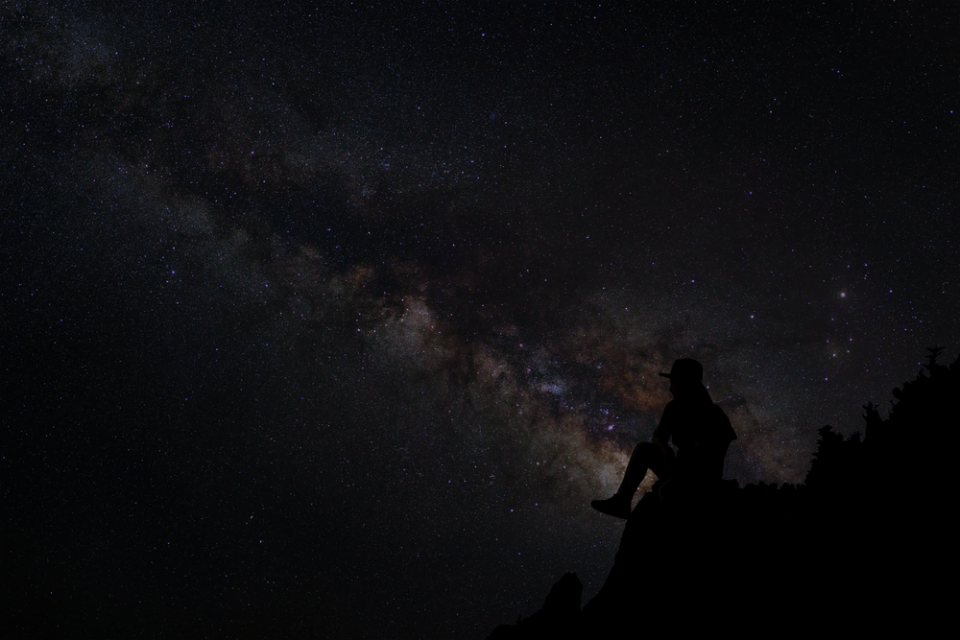
We depend upon God…
“Where were you when I laid the foundation of the earth? Tell me, if you have understanding. Who determined its measurements – surely you know!”
Job 38:4-5
…for truth, knowledge, and authority.
Notes:
<READ SLIDE>
Created, dependent, and finite people, cannot make authoritative statements about the ultimate nature of God and the universe without God’s explanation. From this we can see how silly it is when someone says, “well I think God is this, or I think God would or would not do this or that,” apart from God’s revelation of Himself. Our human limitations make such statements worthless.
And as for the other 7 billion people on the earth, they are all just as limited and dependent on God for specific revelation about Himself and ultimate realities as we are. Apart from Him telling us, what can anyone possibly know about an infinite God who upholds all things by the word of His power, on whom we depend for knowledge and everything else? Our speculations are futile, to put it mildly. We are incapable of knowing ultimate truth apart from what God reveals to us. <NEXT>

Slide 60
“Thy Word Is Truth”
John 17:17
Notes:
Truth, then, is what God says it is, and true knowledge reflects God’s explanation.
So, if someone asks you to define truth, truth is whatever God says it is. Knowledge and truth are derived from God and not original to ourselves. We may discover truth, as in doing science, but God is the source, ultimate authority, and standard of truth, and the giver of our ability to see and know truth.
Of course, our knowledge differs from God’s knowledge since ours is derived from God’s knowledge and subject to human limitations, while God’s knowledge is independent, original, eternal, and infinite. Nonetheless, God created us in His image and made us to know truth as He wants us to know it, both accurately and in agreement with His knowledge (more about this later). <NEXT>

Slide 61
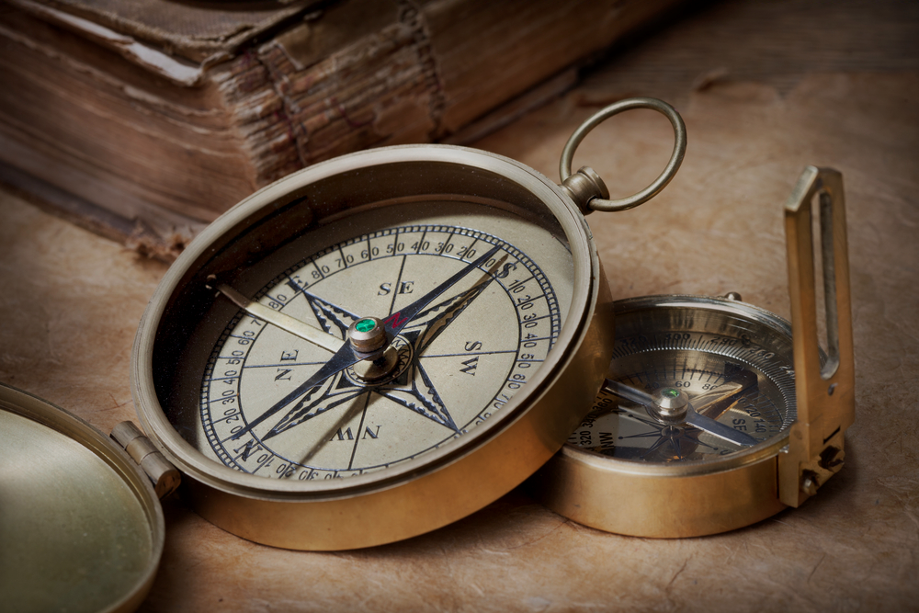
We depend upon God for…
…meaning, purpose, and a moral compass.
Notes:
Moreover… [READ SLIDE] God created us, owns us, and we owe Him all things, therefore He determines our ultimate purpose, meaning, and the moral standards by which we are to live. God alone determines right and wrong, and our purpose is derived from God’s purpose.
No ultimate basis for purpose, meaning, and moral standards exist apart from God. Now, atheists do have moral standards (and well will talk about this more later), but their worldview gives no basis for them. Random chance not only does not produce fixed material laws, it produces no moral laws. <NEXT>

Slide 62
Opinion
Opinion
Opinion
Opinion
Opinion
Opinion
Opinion
Opinion
Opinion
Opinion
Opinion
Opinion
Opinion
Opinion
Opinion
Opinion
Opinion
Opinion
Opinion
Opinion
Opinion
Opinion
Opinion
Opinion
Opinion
Opinion
Opinion
Opinion
Opinion
Opinion
Opinion
Opinion
Opinion
Opinion
Opinion
Opinion
Opinion
Opinion
Opinion
Opinion
Opinion
Opinion
Opinion
Opinion
Opinion
Opinion
Opinion
Opinion
Opinion
Opinion
Opinion
Opinion
Opinion
Opinion
Opinion
Opinion
Opinion
Opinion
Opinion
Opinion
Opinion
Opinion
Opinion
Opinion
Opinion
Opinion
Opinion
Opinion
Opinion
Opinion
Opinion
Opinion
Opinion
Opinion
Opinion
Opinion
Opinion
Opinion
Opinion
Opinion
Opinion
Opinion
Opinion
Opinion
Opinion
Opinion
Opinion
Opinion
Opinion
Opinion
Opinion
Opinion
Opinion
Opinion
Opinion
Opinion
Opinion
Opinion
Opinion
Opinion
Opinion
Opinion
Opinion
Opinion
Opinion
Opinion
Opinion
Opinion
Opinion
Opinion
Opinion
Opinion
Opinion
Opinion
Opinion
Opinion
Opinion
Opinion
Opinion
Notes:
Assuming we could exist without God, human opinion would be elevated to the highest moral authority, with all morality reduced to relativism with no ultimate right or wrong. Again, with 7 billion people on the earth with 7 billion opinions, each as limited and unqualified to stand as the ultimate standard of truth and morality as any other, no ultimate standard of right or wrong would exist. <NEXT>

Slide 63
Notes:
Of course, atheists and agnostics often live by well-developed moral principles, but only because they do not live according to the implications of their denial of God; because they do not live consistently with their worldview, or their view of evolution.
And we can thank God that evolutionists do not generally live according to their principles. Of the many causes of the Nazi reign of terror we can identify, the application of the evolutionary principle of natural selection and survival of the fittest is certainly one of them. <NEXT>

Slide 64
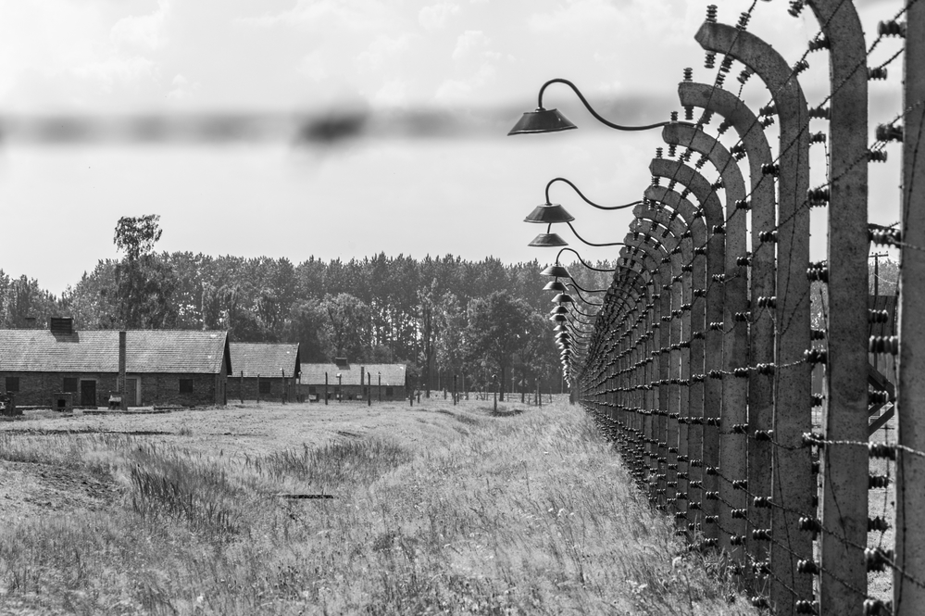
Notes:
In the philosophy of Friedrich Nietzsche we can easily see the atheistic and evolutionary principles that tilled the soil in which the evils of eugenics, Aryanism, and the Holocaust took root.
In his work, The Anti-Christ, he wrote: “Good” is “everything that enhances people’s feeling of power, will to power, power itself,” while the “bad” is “everything stemming from weakness.” “Happiness” is “the feeling that power is growing, that some resistance has been overcome. Not contentedness, but more power; not peace, but war; not virtue, but prowess….The weak and failures should perish: first principle of our love of humanity. And they should be helped to do this. What is more harmful than any vice?—Active pity for all failures and weakness—Christianity” (4, §2). For Nietzsche, getting rid of the weak builds up humanity. <NEXT>
*Friedrich Nietzsche, The Anti-Christ: A Curse on Christianity, in The Anti-Christ, Ecce Homo, Twilight of the Idols, and Other Writings. Ed. Aaron Ridley and Judith Norman, trans. Judith Norman. Cambridge Texts in the History of Philosophy (Cambridge: Cambridge University Press, 2005), 9-10, §11.

Slide 65
Notes:
“The Christian idea of God—God as a god of the sick…is one of the most corrupt conceptions of God the world has ever seen” (15, §18).* Mark it, if God does not supply your moral compass, someone else will. And if you are considered no more than an accident from a pond of muck, don’t be surprised when people who believe such things treat you that way. <NEXT>
*Friedrich Nietzsche, The Anti-Christ: A Curse on Christianity, in The Anti-Christ, Ecce Homo, Twilight of the Idols, and Other Writings. Ed. Aaron Ridley and Judith Norman, trans. Judith Norman. Cambridge Texts in the History of Philosophy (Cambridge: Cambridge University Press, 2005), 9-10, §11.

Slide 66
Infinite
God
Man
Finite
Notes:
To review, created, ordered, and sustained by God, we depend on God for everything. <NEXT>

Slide 67
Independent Creator of all:
Existence and reality
Truth, knowledge, authority
Ethics
Infinite
God
Man
Finite
Notes:
God is the… [READ SLIDE]
<NEXT>

Slide 68
Independent Creator of all:
Existence and reality
Truth, knowledge, authority
Ethics
Infinite
God
Dependent upon God for:
Existence and reality
Truth, knowledge, authority
Ethics
Man
Finite
Notes:
Mankind, however, is… [READ SLIDE]
A proper understanding of this simple truth, or the true nature of reality in God’s universe, is crucial for right thinking about everything. Moreover… <NEXT>

Slide 69
Created and sustained by God…
…we owe God everything.
Notes:
[READ SLIDE] Every day for believers is Thanksgiving. And God owes us nothing. Did he need to create us? No. Did He need to redeem us? No. As perfect, does He gain anything from us? No. And as the Father, Son, and Holy Spirit have existed eternally in perfect mutual love, did He need somebody to love? No. Nothing can increase God’s infinite greatness or happiness. <NEXT>

Slide 70
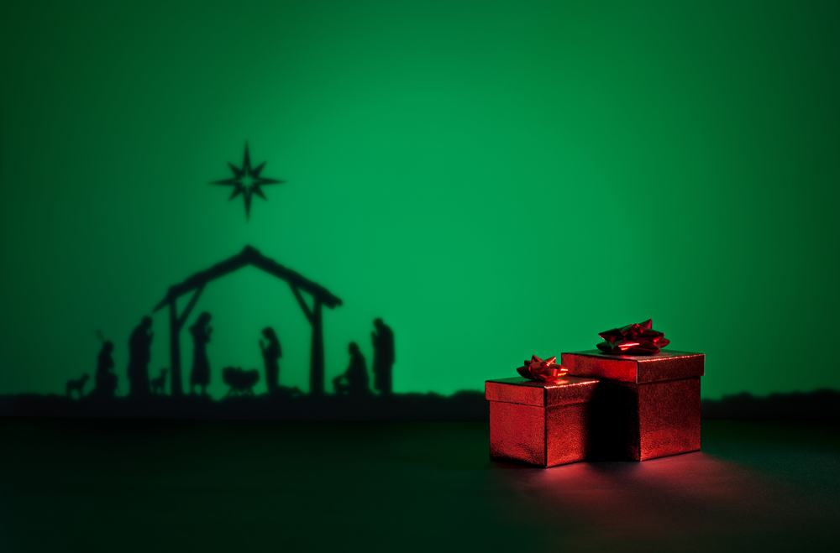
Created and sustained by God…
…we owe God everything.
Notes:
Every day for believers is Christmas. We have nothing we did not receive, and we can merit nothing from God, for the minimum we owe to a God of infinite excellence is perfect love, honor, and obedience. Even if Adam had obeyed, He would have received eternal life by God’s gracious arrangement only, which God was not obligated to initiate or bestow. And as the potter has the right to do as he pleases with the clay (Romans 9:20-21), so God can do as He pleases with us “according to the counsel of His will” (Ephesians 1:11).
This puts arguments that smear God for His judgments and the calamities in the world in proper perspective. <NEXT>

Slide 71
Notes:
In light of our sin against God, every breath we breathe is mercy (God not giving us what we deserve), and every good we receive is grace (God giving us a gift we do not deserve).
And while mysteries will always remain, we have a proper starting point to engage difficult questions: God owes us nothing and we owe God everything. <NEXT>

Slide 72
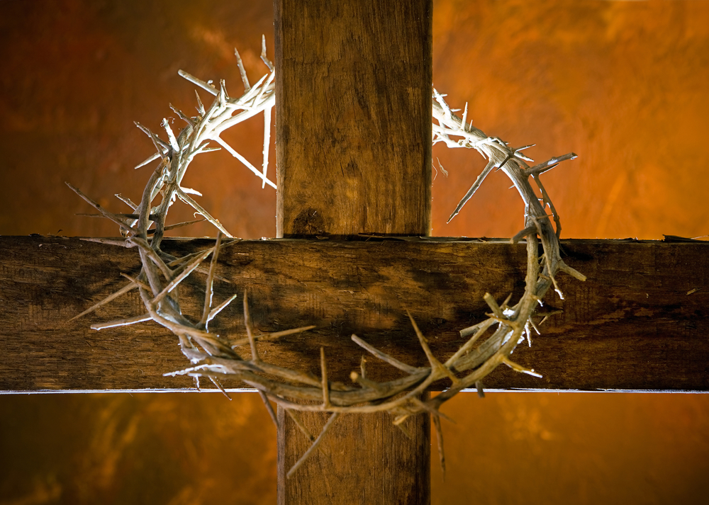
Created and sustained by God…
…we owe God everything.
Notes:
When we think of the profound difficulties and evils of this life, we sometimes ask, why do bad things happen to good people? But, the more appropriate question is why do good things happen to people who ignore the One to whom they owe everything, to those who treat their good and gracious Creator with contempt. Or, why does God love those who hate Him, even while He offers them eternal life, purchased at infinite cost to Himself? Since our every sin cries “crucify Him!” and our indifference cries for Barabbas over the God of infinite love, mercy, and grace, why should anything good happen to us? <NEXT>

Slide 73
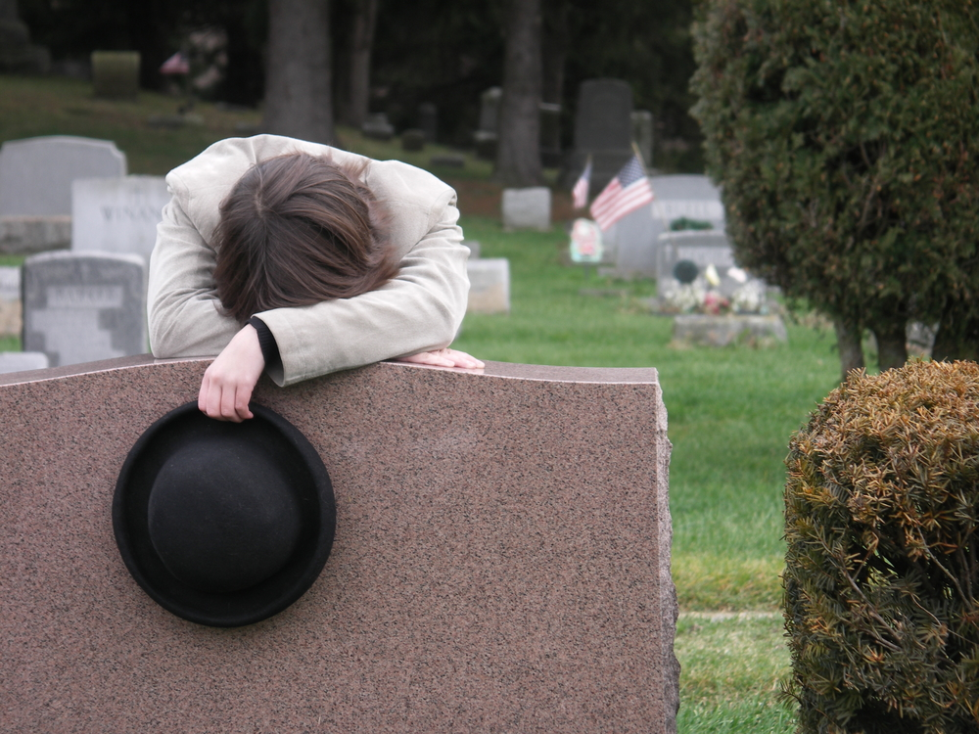
Created and sustained by God…
…we owe God everything.
Notes:
This is reality, the ways things are. So, when we come to painful and difficult things we don’t understand, in history and providence, we should view them in light of who God is and who we are in His universe. Many dark questions are answered or disappear when we begin with God as our creator, and that He owes us nothing and we owe Him everything. Right thinking prevents us from saying foolish things about God. <NEXT>

Slide 74
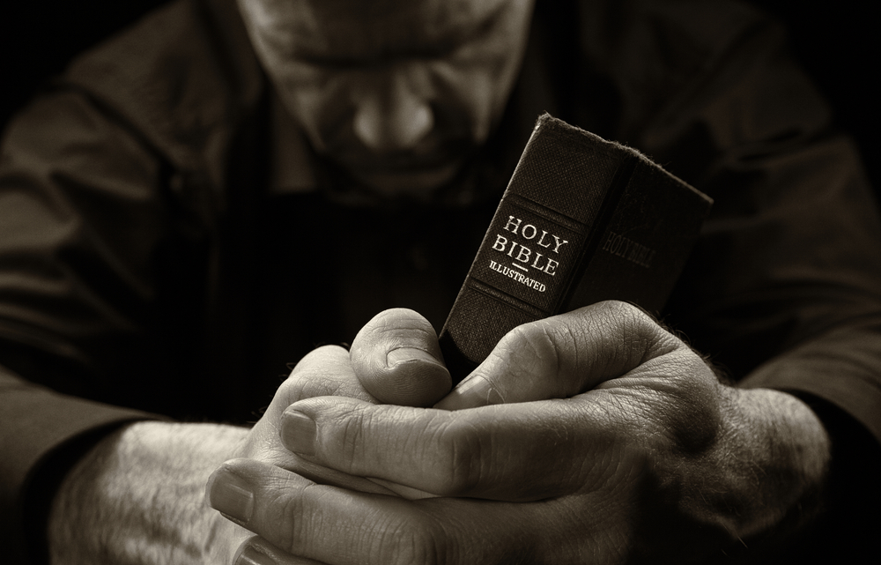
Created and sustained by God…
…we owe God everything.
Notes:
As His children, we can ask of Him our deepest questions without fear. But, given the infinite excellence, love, and mercy of Christ, that He would suffer infinite wrath for wicked people, and given our limited perspective before His infinite wisdom and goodness, who are we to question His perfect character? <NEXT>

Slide 75
God is entirely separate and independent…
…from His creation.
Notes:
[READ SLIDE] Created in God’s image, we share in aspects of God’s nature, though not in the same quality or degree as God. And while the clay displays the genius of the Potter, the Potter is not the clay. As perfect and without any need, God is never constrained by the limitations of His creatures. And though God created all things from nothing, and sustains all things by the ongoing exertion of His power, all created things remain distinct from God forever. <NEXT>

Slide 76
Notes:
As saints, we are married into the family of God as the bride of Christ, and shall be made like Christ, “for when he appears we shall be like Him” (1 John 3:2), but we will not be Christ. And while the redeemed in Christ have “become partakers of the divine nature” (2 Peter 1:4), and will display that nature to an increasingly greater extent forever in heaven, we will never be God. Even as glorified, we will forever remain creatures of God, dependent upon God for all things. And while our holiness will shine like the sun forever, we will only be reflecting God’s own glory. <NEXT>

Slide 77
All things…
…display God’s power and genius.
Notes:
Next… [READ SLIDE]
The evidence for God’s existence, genius, and power is so clear, comprehensive, and convincing, that all people are without excuse for not giving Him honor and thanks. As the genius of a Rembrandt or Michelangelo is evident in their work and clearly distinguishable from the finger painting of a child, so the genius of God is unmistakable as behind all His works. The evidence is so convincing that Scripture tells us that unbelievers “know” God, even while they deny Him.
Like fallen angels that know God’s perfections but despise His holiness and seek to destroy the knowledge of God in the world, unbelievers lack the intimate, loving aspect of the believer’s knowledge. <NEXT>

Slide 78
Notes:
In contrast, believers rejoice in knowing God and seek to increase that knowledge. And as the evidence of God surrounds the unbeliever at every turn, suppression of the knowledge of God is a full-time job. The hypothesis of evolution, contrary to the clear testimony of created reality, is derived from this rejection of the obvious truth of God. <NEXT>

Slide 79
All things…
“The heavens are telling of the glory of God; and their expanse is declaring the work of His hands.”
Psalm 19:1
…display God’s power and genius.
Notes:
[READ SLIDE]
<NEXT>

Slide 80
All things…
“The whole earth is full of His glory.”
Isaiah 6:3
…display God’s power and genius.
Notes:
[READ SLIDE]
<NEXT>

Slide 81
All things…
“For the wrath of God is revealed from heaven against all ungodliness and unrighteousness of men, who suppress the truth in unrighteousness, because that which is known about God is evident within them; for God made it evident to them…
…display God’s power and genius.
Notes:
[READ SLIDE]
<NEXT>

Slide 82
All things…
For since the creation of the world His invisible attributes, His eternal power and divine nature, have been clearly seen, being understood through what has been made, so that they are without excuse.
…display God’s power and genius.
Notes:
[READ SLIDE]
<NEXT>

Slide 83
All things…
For even though they knew God, they did not honor Him as God, or give thanks, but they became futile in their speculations, and their foolish heart was darkened.”
Romans 1:18-21
…display God’s power and genius.
Notes:
[READ SLIDE]
<NEXT>

Slide 84
All things…
“[God] did not leave Himself without witness, for He did good by giving you rains from heaven and fruitful seasons, satisfying your hearts with food and gladness.”
Acts 14:17
…display God’s power and genius.
Notes:
[READ SLIDE]
Every trip to the supermarket, every meal, every bite from an apple gives clear witness to God and our debt to Him. Every cloud and raindrop declares His goodness. <NEXT>

Slide 85
The law of God…
…is written on every heart.
Notes:
Moreover….. [READ SLIDE] Knowledge of God extends beyond our surroundings into the depths of our being (Ro. 2:15). All people have an inescapable knowledge of God in their conscience and consciousness. None can escape it. Evidence for this is seen in the deathbed quotes of some of the most hardened atheists. Accounts of Voltaire’s last words vary and are disputed, but one account provided by Herbert Lockyer is chilling. He notes that Voltaire “used his pen to retard and demolish Christianity,” and “of Christ, Voltaire said: ‘Curse the wretch!’” He boasted that “in twenty years Christianity will be no more. My single hand shall destroy the edifice it took twelve apostles to rear.” But on his deathbed, it seems that Voltaire’s knowledge of God tormented his soul.
“I am abandoned by God and man! I will give you half of what I am worth if you will give me six months’ life. Then I shall go to hell; and you will go with me. O Christ! O Jesus Christ!” The nurse who cared for Voltaire is reported to have said, “For all the wealth in Europe I would not see another infidel die.”
William Pope and his friends made fun of Christianity and would “kick the Bible about the floor and tear it up.” Yet, those with him when he died called it “a scene of terror.” Pope is reported to have said, “I have no contrition. I cannot repent. God will damn me. I know the day of grace is past…You see one who is damned forever…Oh, Eternity! Eternity! …Nothing for me but hell. Come, eternal torments…I hate everything God has made, only I have no hatred for the devil –I wish to be with him. I long to be in hell.”
Despite attempts to deny it, the knowledge of God is written on every heart. Even the strongest believers in evolution, with its central principle of natural selection and survival of the fittest, have morals that are at odds with the hypothesis. And when atheists claim a moral code to justify their view, when their worldview has no basis for one, they give evidence that God’s law is written on their heart. <NEXT>

Slide 86
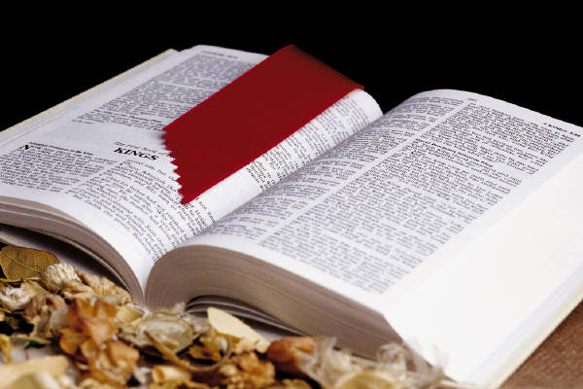
Scripture…
…displays God’s power and genius.
Notes:
Moreover… [READ SLIDE]
Just as everything God has made and sustains bear the distinct marks of their Divine Author, so Scripture, the very Word and words of God, bears the clear, comprehensive, and convincing marks of its Divine Author. In speaking of Scripture and the Gospel, Edwards writes: <NEXT>

Slide 87
Scripture…
“The divine glory and beauty of divine things is in itself a real evidence of their divinity, and the most direct and strong evidence….
…displays God’s power and genius.
Notes:
[READ SLIDE]
<NEXT>

Slide 88
Scripture…
We cannot rationally doubt but that things that are divine, and that appertain to the Supreme Being, are vastly different from the things that are human: that there is a God-like, high, and glorious excellency in them,
…displays God’s power and genius.
Notes:
[READ SLIDE]
<NEXT>

Slide 89
that does so distinguish them from the things which are of men that the difference is ineffable; and therefore such as, if seen will have a most convincing, satisfying influence upon any one that they are what they are, viz., divine.”
Source: Religious Affections, Banner of Truth, 224-5.
Notes:
[READ SLIDE]
<NEXT>

Slide 90
Scripture…
…displays God’s power and genius.
Notes:
Therefore, if someone cannot see the beauty of a bouquet of flowers by looking at it, what better evidence can be given when the greatest evidence is in the flowers themselves. No description of the colors, symmetry, or other feature will convince someone who has no taste for the beauty of flowers. And so it is with the beauty of Scripture as it reveals the infinite excellence of God. Someone without the taste or heart to see the beauty of God’s excellence will not see it in Scripture.
The reason why unbelievers look at the glorious and call it foolish is the same reason the crowds who saw Christ’s miracles and perfect character cried for His crucifixion--they love darkness and hate the moral beauty of God. The excellence of Scripture is not seen because unbelievers are spiritually blind to the beauty of God.
That people reject the authority of Scripture, as they reject the testimony of creation, providence, and their own conscience, is not from a lack of evidence, but from a lack of will. Just as Christ said… <NEXT>

Slide 91
Scripture…
“If any man is willing to do His will, he shall know of the teaching, whether it is of God, or whether I speak from Myself.”
John 7:17
…displays God’s power and genius.
Notes:
[READ SLIDE]
The heart unwilling to do God’s will rejects Scripture as the revelation of God’s will.
<NEXT>

Slide 92
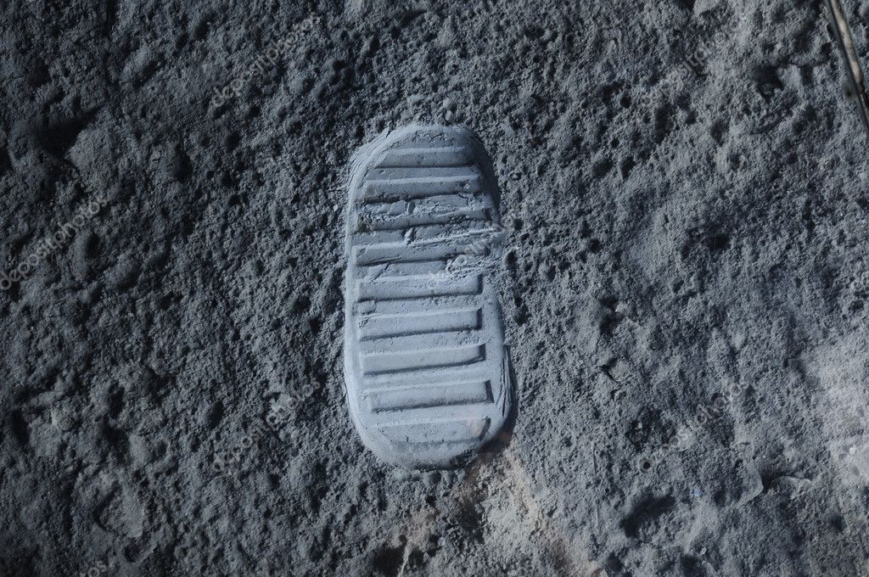
All unbelief…
…is contrary to the evidence.
Notes:
Further… [READ SLIDE]
For good reason, God says, “The fool says in his heart, ‘there is no God’” (Psalm 14:1, 53:1). The clear and comprehensive nature of the evidence makes all unbelief blameworthy and foolish. Using the mind and reasoning God gave us, breathing the air God created, in an amazing body He formed in the womb for us, in a beautiful world where the creative genius of God is displayed at every turn, unbelievers ask for evidence for God’s existence. They breathe and see the trees bending in the wind and ask for evidence of air. <NEXT>

Slide 93
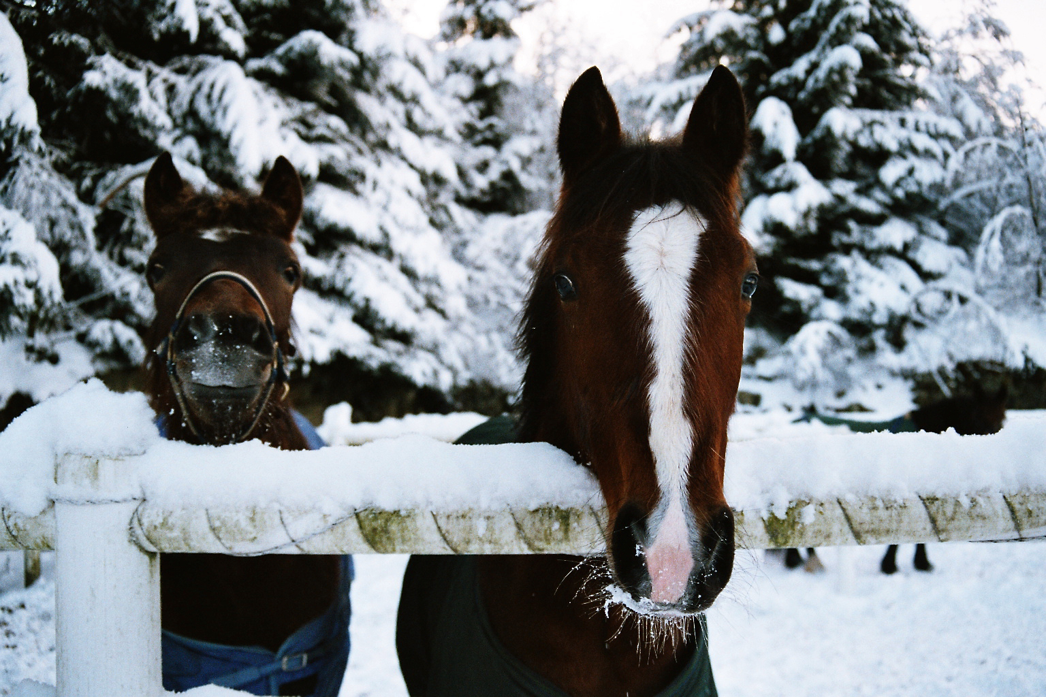
All unbelief…
…is contrary to the evidence.
Notes:
Where does evidence for God not exist? Asking for evidence reveals a heart in need of repentance and faith. Unbelief is sin precisely because it is a choice of the will contrary to the evidence.
Unbelief would be reasonable and innocent if God did not provide enough evidence. But Scripture calls unbelief sin and says that unbelievers are guilty of it because their rejection of God is contrary to the evidence. They deny the obvious because they don’t like its implications. Because they refuse to bow the knee to God’s authority, they interpret all evidence and arguments for God’s existence in a way that justifies their rejection of God. And while faith in Christ requires Scripture, the refusal to worship, give thanks, or actively pursue a right relationship with God is willful and blameworthy. Unbelievers know better, no matter what they say. <NEXT>

Slide 94
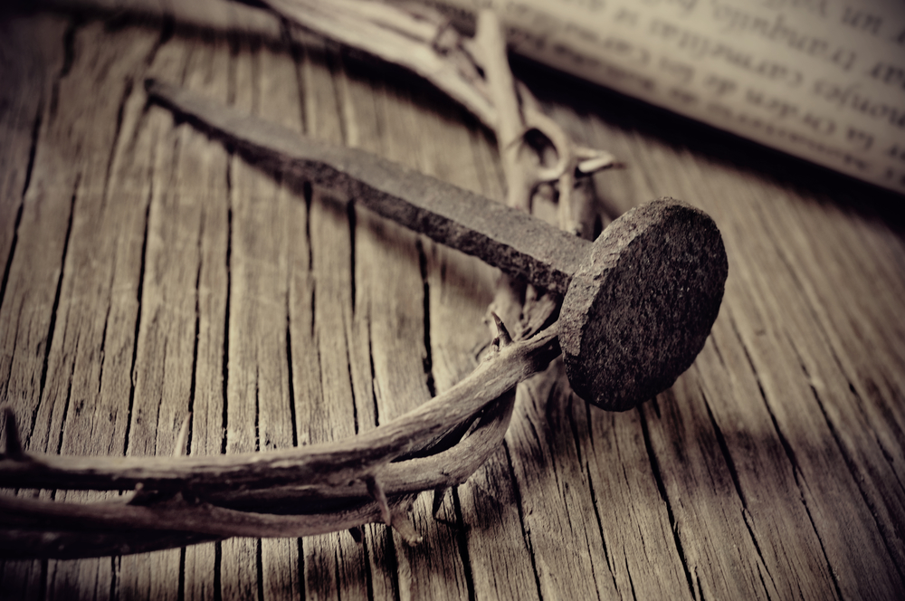
All unbelief…
…is contrary to the evidence.
Notes:
Consider that it only took a few days for the shouts of “hosanna!” to turn to shouts of “crucify!” Yet, many ate the loaves and fishes or saw Lazarus emerge from his tomb. Thousands were amazed and gave glory to God for Christ's many miracles. Shouts of “crucify” were not from a lack of evidence, but from fickle hearts that saw their would-be destroyer of Rome under the power and punishment of Rome. Consider the Pharisees when they interviewed the man born blind to whom Christ gave sight. They mocked him rather than falling on their knees to give glory to their long-awaited Messiah. The issue wasn't the evidence, the evidence was staring them in the face. The issue was their wicked hearts. Unbelief rejects God, despite the evidence. <NEXT>

Slide 95
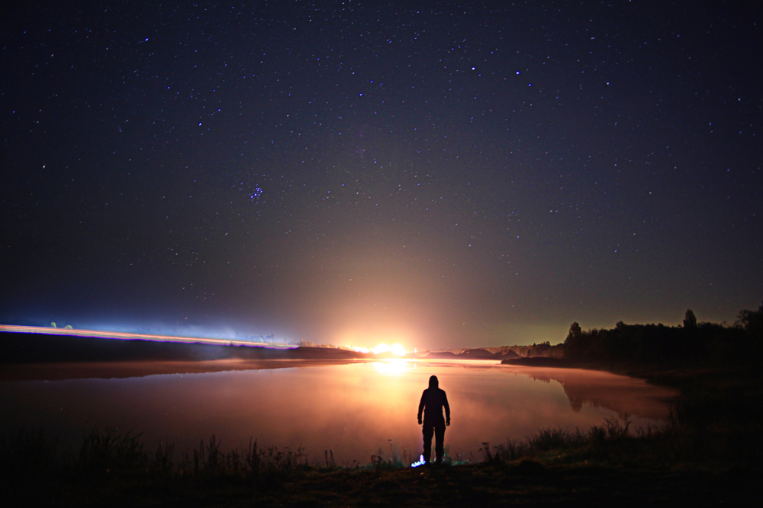
Neutral or innocent unbelievers…
…do not exist.
Notes:
Therefore… [READ SLIDE]
Just as Christ tells us in Mt. 12:30…
<NEXT>

Slide 96
“He who is not with Me is against Me”
Notes:
[READ SLIDE]
How we view God and His universe is a moral issue, determined by our heart. Believers see the marks of God’s genius in the universe and gladly accept God as Creator and their dependence on Him. Unbelievers deny the evidence for God and the truth of Scripture according to their hostility toward God, from a desire for their own authority and independence from God. The marks of God’s genius and lordship in the universe continually call this sinful desire to account, reminding would-be-independent sinners of their responsibility before God and their sin of ignoring Him. Yet… <NEXT>

Slide 97
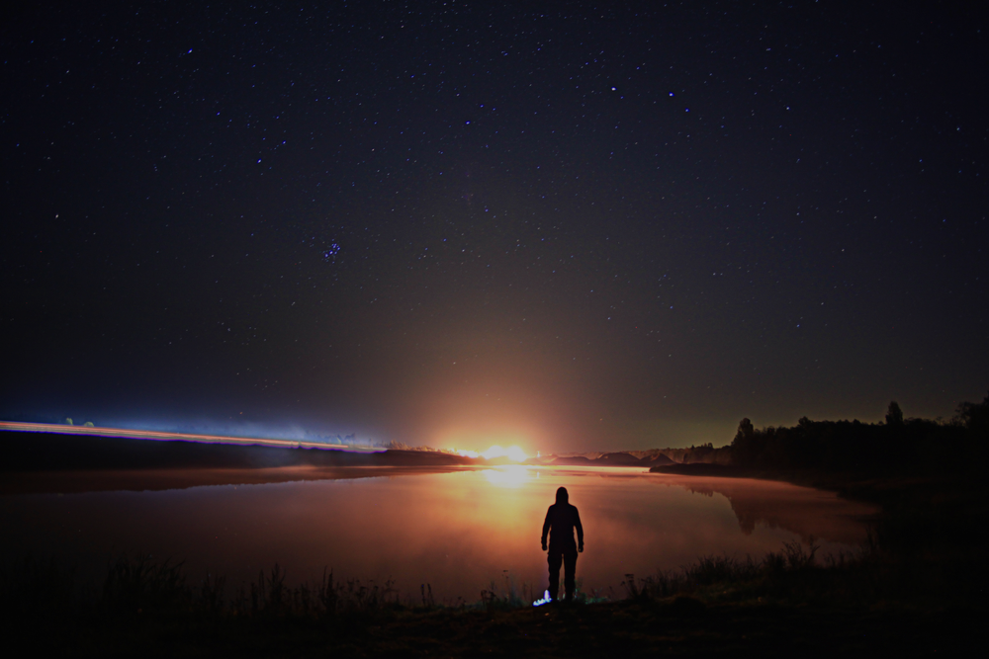
“Though they know God’s decree that those who practice such things deserve to die, they not only do them but give approval to those who practice them.”
Romans 1:32
Notes:
[READ SLIDE]
<NEXT>

Slide 98
“And this is the judgment, that the light is come into the world, and men loved the darkness rather than the light; for their deeds were evil…
Notes:
[READ SLIDE]
<NEXT>

Slide 99
For everyone who does evil hates the light, and does not come to the light, lest his deeds should be exposed.”
John 3:19-20
Notes:
[READ SLIDE]
<NEXT>

Slide 100
The testimony to God’s power and authority is so clear and comprehensive that unbelievers refuse to view the universe with neutral objectivity, because viewing the world rightly denies their pretended independence from God.
Notes:
[READ SLIDE]
<NEXT>

Slide 101
Notes:
For instance, apart from the lack of any compelling scientific evidence for the hypothesis of evolution, the idea that universal and uniform laws came from random chance and everything came from nothing or eternally existing energy and matter is absurd.
But unbelievers would rather believe the impossible and ridiculous over bowing the knee before God and admitting they owe God everything. <NEXT>

Slide 102
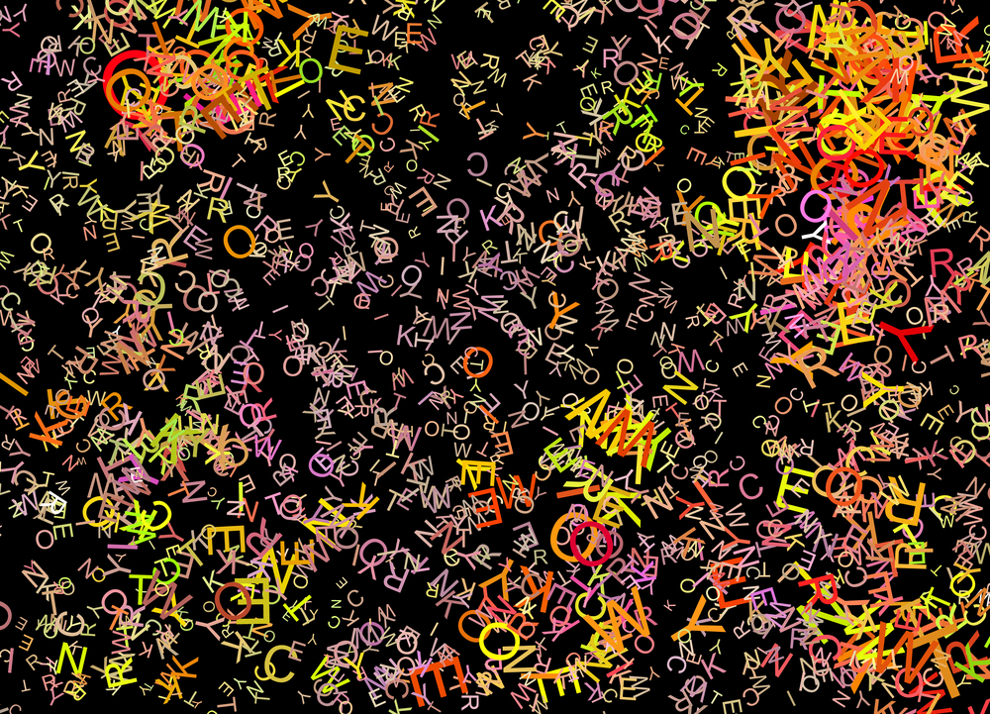
Notes:
They prefer to view the amazing design and complexity of life as the product of chaos, when all of the scientists and resources in the world cannot even make a single cell, let alone any other form of life. Apparently, the best minds in the world are not as smart as nothing and random chance.
Unbelievers are anything but neutral or innocent. Next… <NEXT>

Slide 103
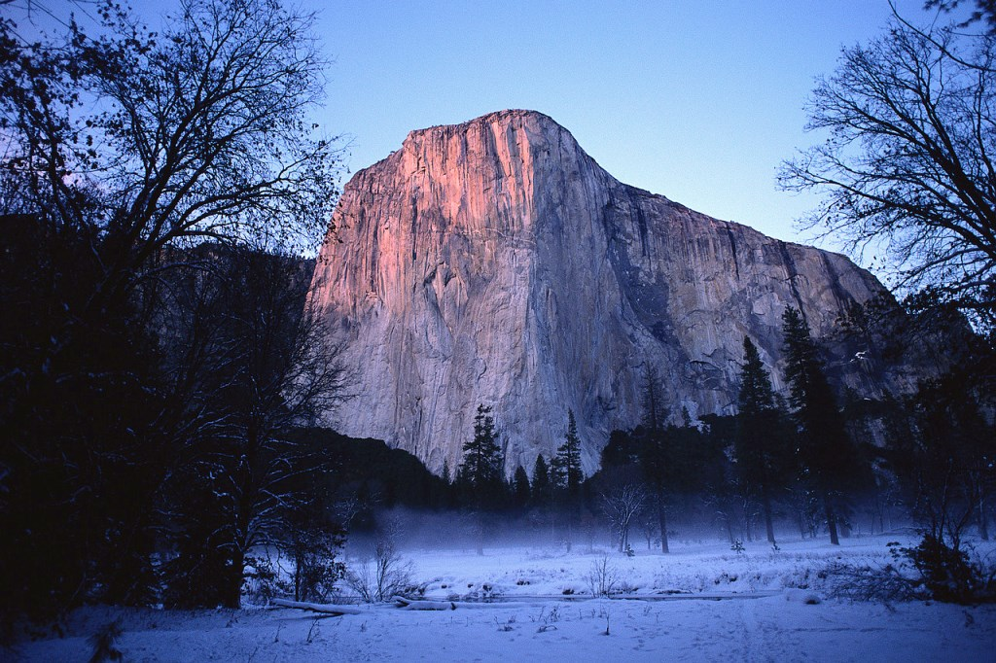
God exists…
…regardless of human beliefs.
Notes:
[READ SLIDE] The existence and attributes of God are independent of His creation. He is who He is regardless of what we think. “I think God is like this, I think God would or would not do this,” are meaningless statements apart from what God has revealed about Himself. Our thoughts do not determine who God is, what He can and cannot do, or the reality He created. Yet, as obvious as this simple truth is, people think God is what they imagine Him to be. The golden calf in the desert was a variation of a universal theme. And while we may not make statues to worship, we do so mentally when we imagine a god that suits us, as if thinking makes it so.
But thinking does not make it so. Anything we imagine about God has no effect on His nature and existence. Even what professing believers may imagine about their experience with God over the centuries has no effect upon the nature and existence of God. God is who and what He is, regardless. We know His nature and works by what He has revealed to us in Scripture. We need not be intimidated if the whole world should embrace atheism; God and His promises remain unaffected. Should every college professor laugh at our faith, Christ endures forever. <NEXT>

Slide 104
God exists…
“The way is narrow that leads to life.”
Matthew 7:14
…regardless of human beliefs.
Notes:
He told us the way is narrow that leads to life and few people find it (Mt. 7:13-14)… <NEXT>

Slide 105
God exists…
“If the world hates you, you know that it has hated Me before it hated you.” John 15:18
…regardless of human beliefs.
Notes:
and if people hated Him, they will hate us also [John 15:18-21]. We need not be moved to compromise or deny Christ by the popularity of unbelief. <NEXT>

Slide 106
God exists…
“The fear of man brings a snare”
Proverbs 29:25
…regardless of human beliefs.
Notes:
The fear of man is a snare (Prov. 29:25), while God remains our firm foundation. <NEXT>

Slide 107
God exists…
“When the Son of Man comes, will He find faith on the earth?” Luke 18:8
…regardless of human beliefs.
Notes:
[READ SLIDE]
…I hope so, but His existence and rule will not be affected if He does not. <NEXT>

Slide 108
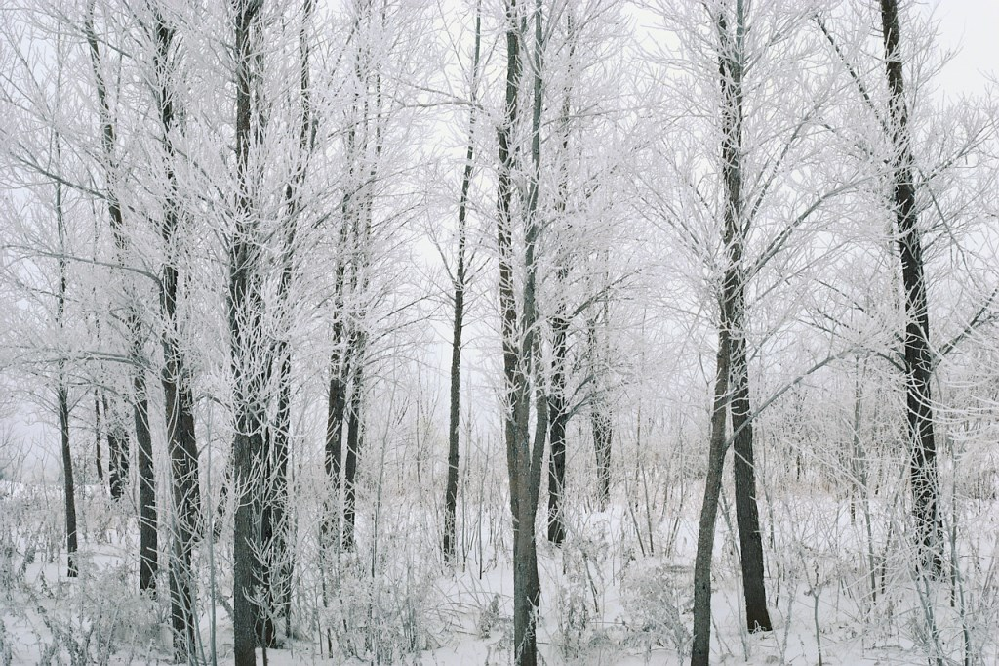
Creation exists…
…regardless of human perception.
Notes:
In the same way… [READ SLIDE] The reality of God’s creation is determined by God and unaffected by human perception and beliefs. Real things exist because God created and sustains them, not our perception. For believers, this should be obvious. But, in trying to explain reality without God as its maker, the question of the real existence of things, apart from our perception, becomes a philosophical riddle. <NEXT>

Slide 109
Notes:
The problem is illustrated by the question, “If a tree falls in the forest and no one is there it hear it, did it make a sound?” Philosophers have yet to agree on an answer. Like the chicken and the egg riddle, the question poses big problems if God is denied as the Creator. Yet, when we properly acknowledge God as the source and sustainer of reality, no problem exists. God made the tree and the sound it makes, and each exist regardless of our perception because their existence depends on God. And whether or not someone is there to hear the sound, God hears it. He is behind the tree and the sound it makes, and He gives us the perception of it. <NEXT>

Slide 110
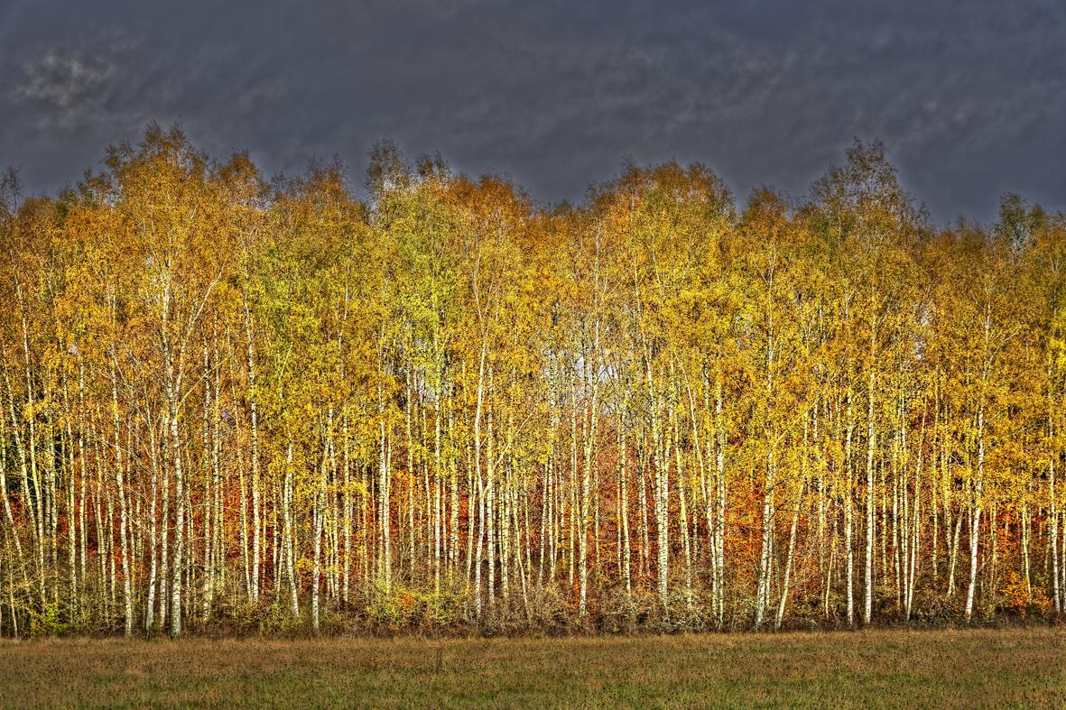
Creation exists…
…regardless of human perception.
Notes:
Everything in God’s universe has objective, real existence because they are made and sustained by God, not because we perceive them. If God made a universe with no one to perceive it, it would still exist. <NEXT>

Slide 111
Notes:
People may deny the reality of angels and demons, but their existence and nature are unaffected. People may “imagine there’s no heaven” and imagine there’s no hell, but they exist if God says they exist, regardless of what people think. We kid ourselves when we think they will go away just because we pretend they will go away. If the whole world should deny the existence of hell it would not prevent a single soul from going there. Pretending God does not exist will not prevent a single soul from standing before Him on judgment day. All people will someday be confronted with reality as God made it, regardless of what they imagined it to be. <NEXT>

Slide 112
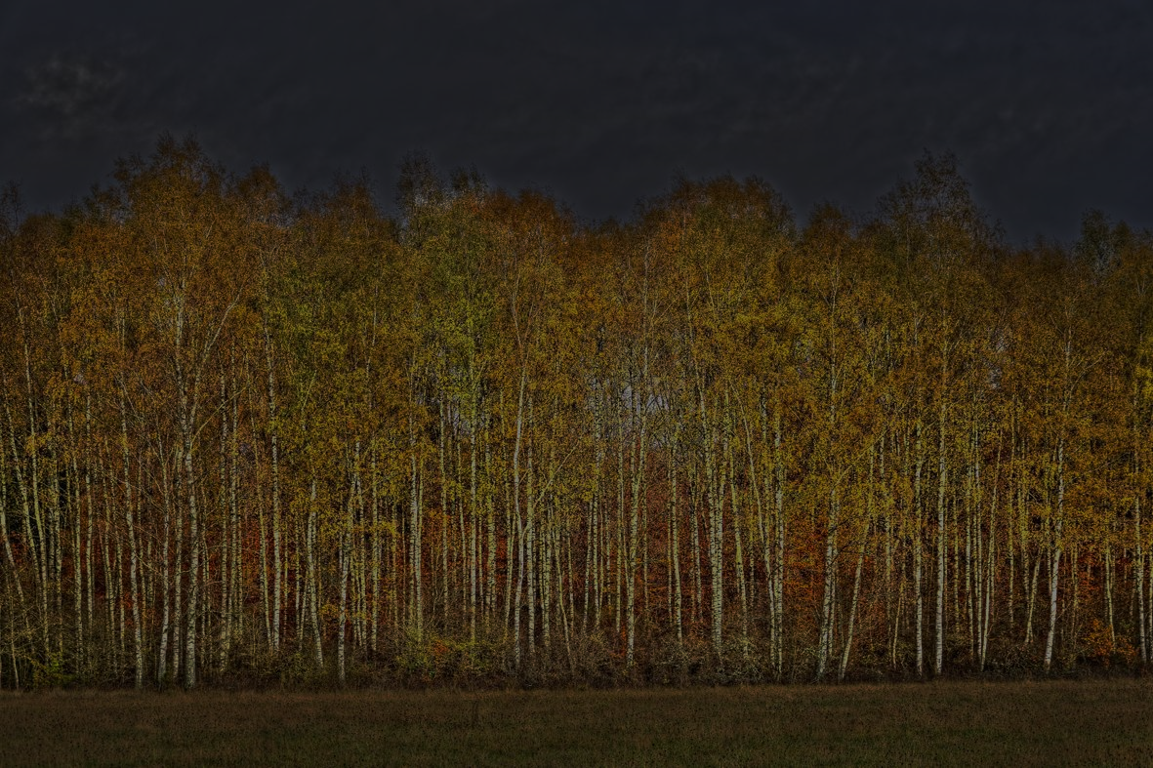
Creation exists…
“In the beginning God created the heavens and the earth.” Genesis 1:1
…regardless of human perception.
Notes:
In a sense, the present point is merely a restatement of the first words of Scripture, “In the beginning God created the heavens and the earth.” God alone determines reality. We observe, make judgments, and discover truth about the reality God created, but we do not determine that reality. <NEXT>

Slide 113
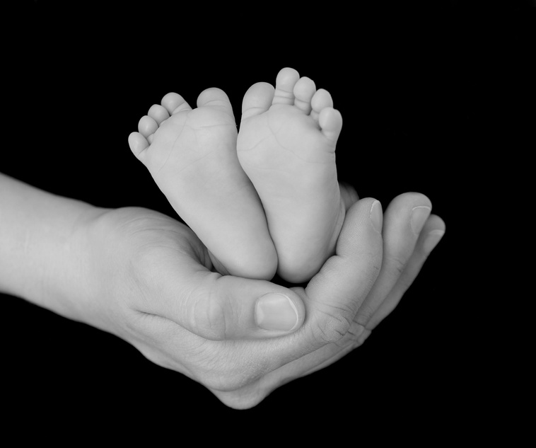
God necessarily exists...
…He does not probably exist.
Notes:
Also… [READ SLIDE]
Life begets life, and nothing begets, well, nothing. Nothing exists or has meaning apart from God creating, ordering, and sustaining it. God alone can account for the universe as it is. Apart from acknowledging this, all is reduced to absurdity.
For the sake of argument, imagine God does not exist and that all matter and energy came from nothing or have existed forever. Founded on random chance, all things are random chance accidents floating in a sea of unrelated random chance accidents. Now imagine some of the problems with such a universe. <NEXT>

Slide 114
?
?
?
?
?
?
?
?
?
?
?
?
?
?
?
?
?
?
?
?
?
?
Notes:
First, how can an unrelated random chance accident, itself without meaning or purpose…
<NEXT>

Slide 115
?
?
?
?
?
?
?
?
?
?
?
?
Meaning & Purpose
?
?
?
?
?
?
?
?
?
?
Notes:
… attribute meaning or purpose to other unrelated random chance accidents? No basis for meaning and purpose for anything is possible in a random chance and impersonal universe. <NEXT>

Slide 116
?
?
?
?
?
?
?
?
?
?
?
?
Meaning & Purpose
?
?
?
?
?
?
Interpretation
?
?
?
?
Notes:
Second, how does one random accident interpret another random accident? In a random chance universe, everything always changes and nothing exists in the same form or relationship with everything else from one moment to the next. How does one random thing interpret another when neither will be the same or even exist from one moment to the next? Meaningful interpretation of reality would be impossible in such a universe.
<NEXT>

Slide 117
?
?
?
?
?
?
?
?
Language
?
?
?
?
Meaning & Purpose
?
?
?
?
?
?
Interpretation
?
?
?
?
Notes:
Third, on what basis can one random accident describe another? Language assumes a fixed meaning from one moment to the next. For instance, birds have feathers and a beak, cats meow and ruin perfectly good carpets, dogs go bow wow, wag their tails and ruin perfectly good furniture. But, how can a term with a specific meaning apply to something that will not exist as the same thing from one moment to the next? What would the words dog, cat, bird, cloud, or flower mean if they were not the same thing from one moment to the next? We use language to describe things because they have certain fixed and common characteristics. In a random chance universe, words, which themselves would be random, could never refer to one specific thing and language would be meaningless.
<NEXT>

Slide 118
?
?
?
?
?
Truth
?
?
?
Language
?
?
?
?
Meaning & Purpose
?
?
?
?
?
?
Interpretation
?
?
?
?
Notes:
Fourth, like language, truth requires continuity of meaning and existence. But, how can something be true of something that will not be the same thing the next moment? Think about it, what is truth if nothing can be said to be true of anything? If nothing remains as it is, and what anything will be in the next moment cannot be predicted, how could one random accident know anything to be true of another random accident? Truth and knowledge of truth would be impossible.
<NEXT>

Slide 119
?
?
?
?
?
Truth
?
?
?
Language
?
?
?
?
Meaning & Purpose
?
?
Knowledge
?
?
?
?
Interpretation
?
?
?
?
Notes:
Fifth, knowledge and thought would be impossible, as it not only requires the distinct ordering and continuity of language, it requires the ordering and continuity of the cells of the brain, and everything supporting it, none of which are possible in a random chance universe. <NEXT>

Slide 120
?
?
?
?
?
Truth
Science
?
?
?
Language
?
?
?
?
Meaning & Purpose
?
?
Knowledge
?
?
?
?
Interpretation
?
?
?
?
Notes:
Sixth, science would be impossible in a random chance universe because it requires all of the above. Try observing and measuring something that randomly changes from one moment to the next. Or, try repeating an experiment, which itself could not be done in the first place, when both the scientist and the things examined are continually and randomly changing from one moment to the next. <NEXT>

Slide 121
God necessarily exists...
…He does not probably exist.
Notes:
Now you may be thinking…Unbelievers might object to this line of reasoning by pointing out that our universe has none of the problems as we have described them here. Life is ordered, we use language, know truth, interpret things, do science, and try to play baseball. <NEXT>

Slide 122
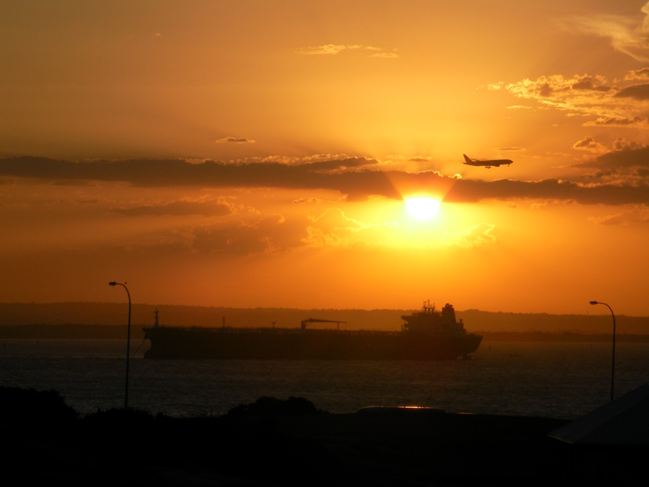
God necessarily exists...
…He does not probably exist.
Notes:
The sun still rises and the laws of physics, biology, etc., work today as they did yesterday. And all of this is quite true, but only because God exists and we do not live in a random chance universe. The only reasonable explanation of the universe, as we know it, is the creating and sustaining power of God. Random chance simply cannot account for the order of the world. Again, apart from God, purpose, meaning, interpretation, language, truth, knowledge, and science could not exist. Given the world as it is, God must exist. That we can even discuss this proves He exists.
Of course, unbelievers will continue to deny the obvious until God changes their heart. <NEXT>

Slide 123
All people presume God’s existence…
Air does not exist!
…even while denying Him.
Notes:
At the same time… [READ SLIDE] The thought and language by which people deny God only exist because God exists. Greg Bahnsen would say that atheists lose debates with Christians by showing up. By using their mind, language, and knowledge, by assuming meaning and continuity in the universe, by using uniform and universal laws of logic, they presume God’s existence. Indeed, when atheists think to deny God’s existence, they have already presumed it. <NEXT>

Slide 124
Notes:
They expect to wake up in the morning as the same person, in the same house, with the same dog, car, and job. They expect that words refer to the same things today as yesterday. They assume order, fixed laws, and continuity in their lives and don’t live according to a random chance world. They live as if God exists even as they deny Him; they deny their explanation of the world by how they live. Because life is impossible as a random accident in a random chance world, all unbelievers are practical believers in God. <NEXT>

Slide 125
?
?
?
?
?
Truth
Science
?
?
?
Language
?
?
?
?
Meaning & Purpose
?
?
Knowledge
?
?
?
?
Interpretation
?
?
?
?
Notes:
People have purpose and meaning because they do not live in such a universe, because God orders and sustains all things. So, when atheists point to their moral standards or affirm order, purpose, and meaning in life without God, they presume God even while they deny Him. Apart from God, they could do none of these things. <NEXT>

Slide 126
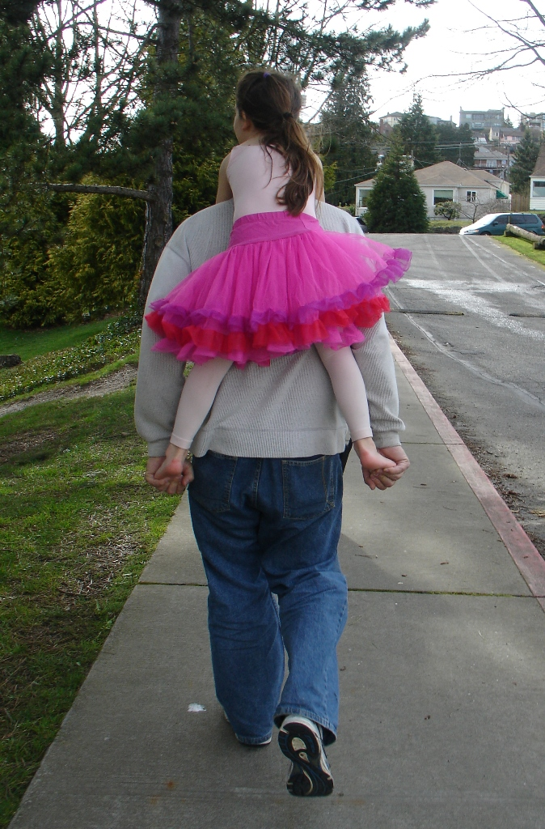
Notes:
Dr. Van Til told the story of a train ride where he observed a small child slap her father in the face, and saw in this a picture of unbelief. In the same way she could not slap him if he did not hold her in his lap, so unbelievers could never deny God if He did not create and sustain them and the world, and give them the gifts by which they deny Him.
So, even in denying God’s existence, the atheist affirms it because he could not even deny God if God did not exist. Even those who make lots of money writing books that say God doesn’t exist, presume His existence by writing a book. They could never write a book if God did not exist. <NEXT>

Slide 127
Scientists presume God’s existence…
…even if they deny Him.
Notes:
In the same way…[READ SLIDE] Again, science is impossible for random accidents in a random chance universe.
Scientists assume a universe of fixed laws, that the test tube and lab will be there tomorrow, that the reaction between baking soda and vinegar and the properties of all material and energy will not change overnight. In a random chance universe, assuming that an observer could exist long enough to observe and interpret the objects of such a universe, no experiment could be conducted, for no fixed laws and properties would exist. <NEXT>

Slide 128
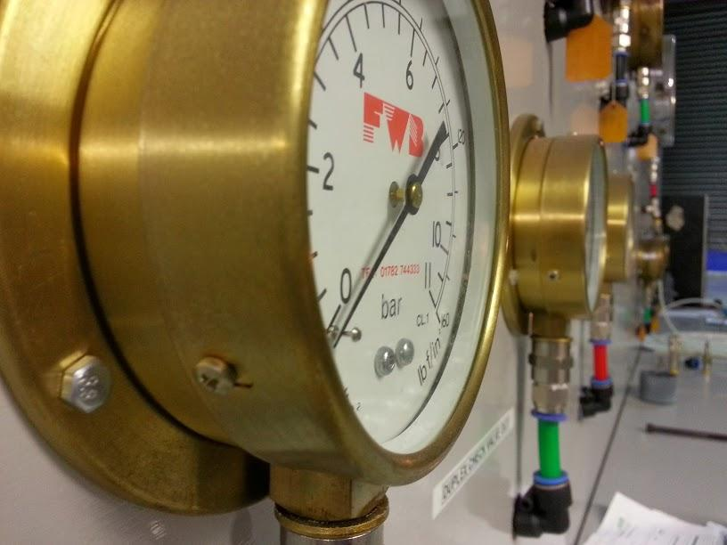
Scientists presume God’s existence…
…even if they deny Him.
Notes:
Measurements and definitions would be worthless, nothing could be described, as nothing would be the same from one moment to the next, and no outcome could be predicted or repeated. We could not have iPhones, computers, or anything else. We can only make such things because God exists, because everything has fixed properties by the sustaining power of God. Again, a random chance universe has no fixed properties.
Science requires observation, repeatability, testability, but if you can’t repeat something and test it, you can’t do science. How do you do science when nothing is the same from one moment to the next? <NEXT>

Slide 129
Notes:
Yet, we do science with great success and benefit to humanity as we assume and live in a world of uniform and universal laws, a world that could only exist because God exists as the creator and sustainer of all things. Like the child that can slap her father because he holds her on his lap, so atheistic scientists deny the God who makes science possible, presuming God’s existence in order to deny Him. <NEXT>

Slide 130
What came first…
…the chicken or the egg?
Notes:
Next, the lowly chicken gives us a simple model of why it is impossible that God does not exist. [READ SLIDE]
Apart from God, the chicken could not be first, as the chicken came from an egg. But the egg can’t be first because the egg was laid by a chicken. Apart from God, no reasonable account for the existence of the chicken or the egg is possible. The answer, of course, is in the beginning, God created the chicken that laid the egg.
Moreover, all life displays the chicken and egg conundrum. <NEXT>

Slide 131
Notes:
For instance, all mothers were once a baby and all babies come from a mother. What came first, the mother or the baby? Apart from God creating the mother or the baby (and we know he first created the mother), no answer is possible. The problem is compounded further… <NEXT>

Slide 132
Notes:
…by the need of both a father and mother to produce a baby. Where did the father come from? He, too, was once a baby that required a father and mother. If God did not create both the father and the mother, no baby would be possible. The same goes for dogs, cats, whales, bugs, birds… <NEXT>

Slide 133
Notes:
…and even plants. Plants come from seeds, but seeds are produced by plants. What came first? Apart from God creating the plant or the seed (and we know He created the plant with seeds), plants are impossible. The same problem exists with the building blocks of life. <NEXT>

Slide 134
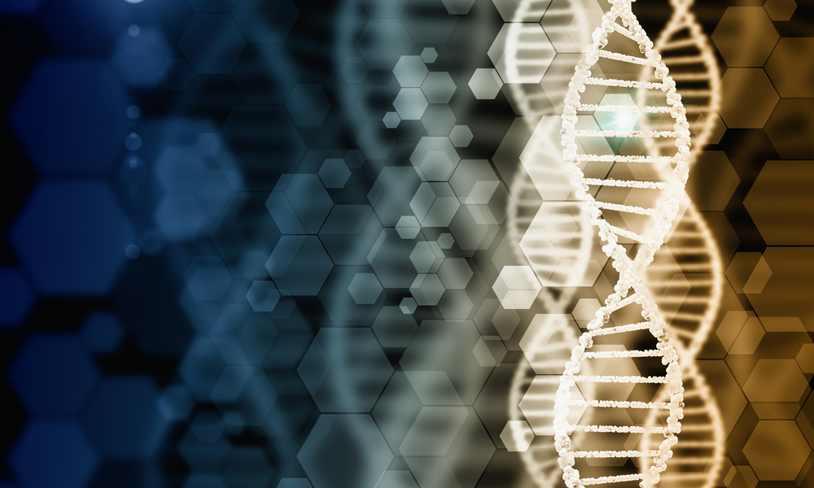
Notes:
For example, DNA is required for life, but can only be produced by life. What came first? As with people, plants, and animals, no answer is possible apart from God. The same goes for the other building blocks of life.
<NEXT>

Slide 135
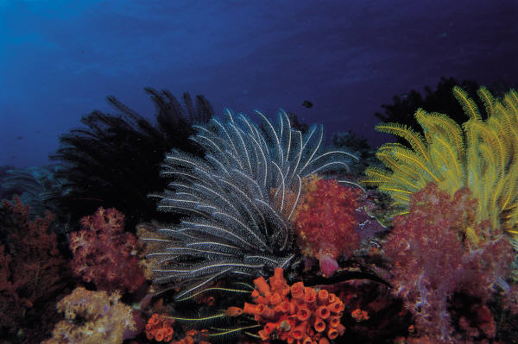
Notes:
Without God, life, as we know it, is quite impossible. Thus, even ignoring the lack of objective, verifiable, and repeatable scientific evidence for the hypothesis of evolution, the simple chicken and egg riddle renders it impossible. That anyone can take a biology class and deny the existence and genius of God tells us that unbelief has nothing to do with the evidence, but has everything to do with the nature of the heart. <NEXT>

Slide 136
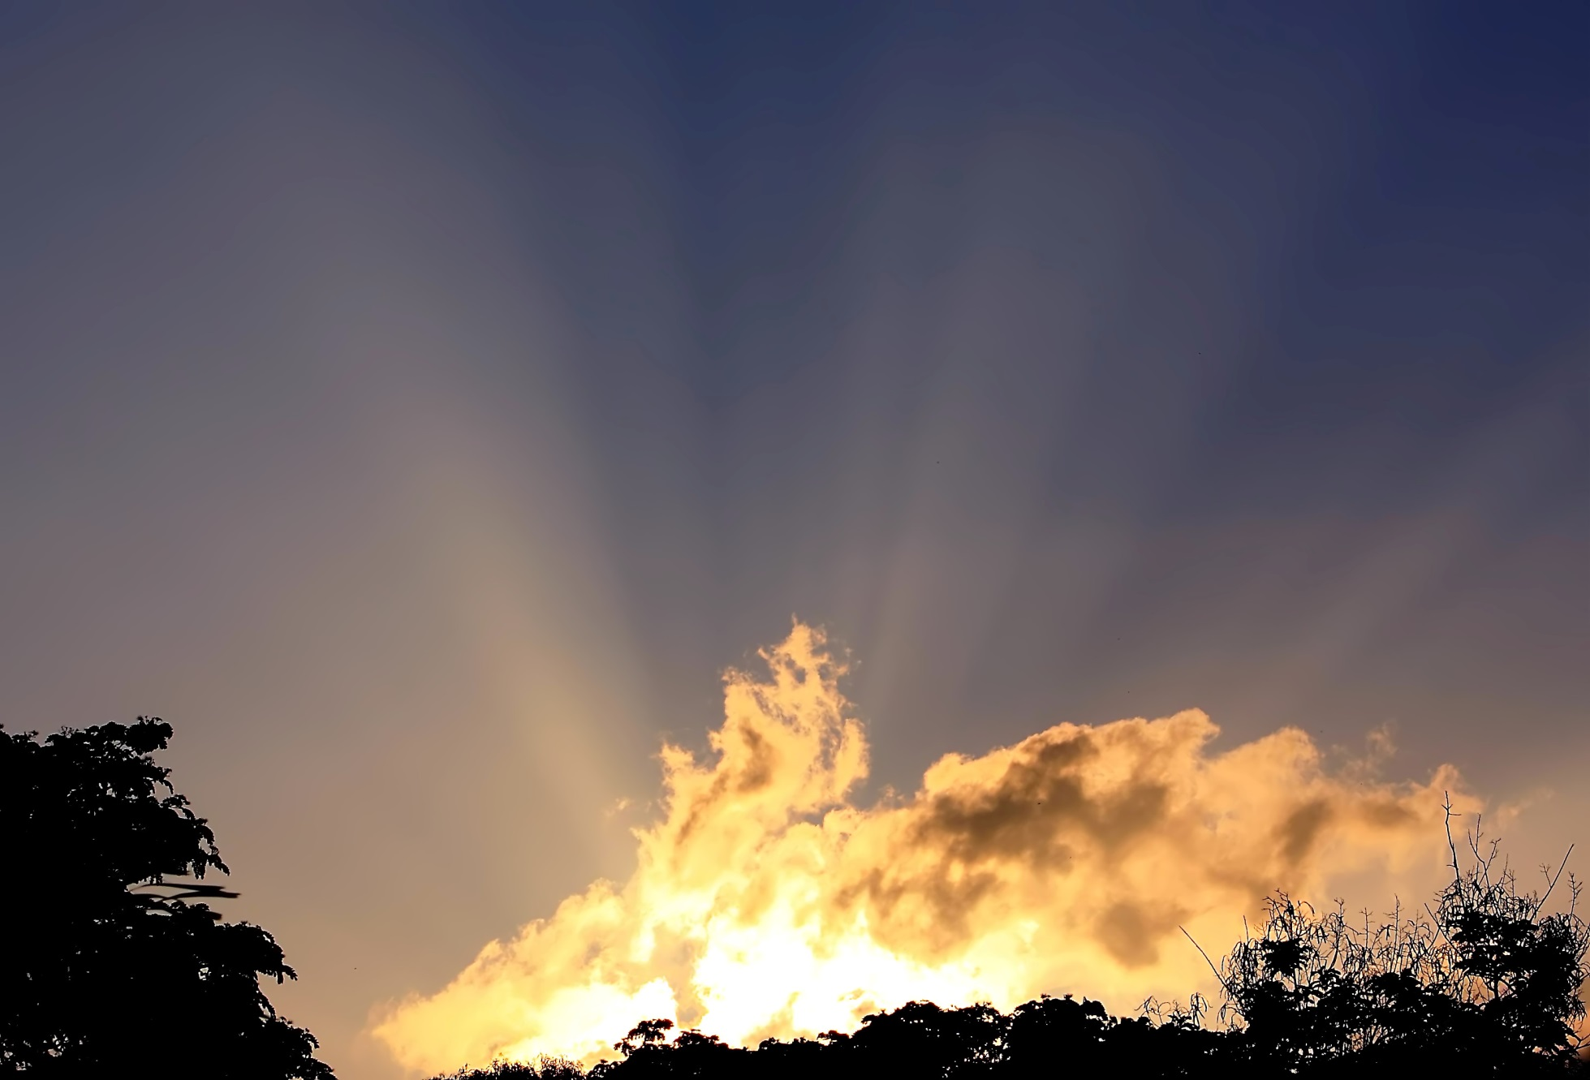
Notes:
The chicken and egg riddle also explains the inability of atheistic philosophy to explain the ultimate meaning of the universe and answer its deepest questions. Apart from God, no reasonable answers can be found. Like mathematicians trying to solve 2+2 without 4, you can’t answer questions when only possible answer is denied or ignored. Ultimate questions become unsolvable without God. <NEXT>

Slide 137
Arguments for the Probability of God Excuse Unbelief
Notes:
[READ SLIDE] Arguing that God probably exists grants the possibility that He does not exist. And to the extent it is possible that God does not exist, unbelief is justified. <NEXT>

Slide 138
Arguments for the Probability of God Excuse Unbelief
Notes:
For the sake of illustration...
<NEXT>

Slide 139
Arguments for the Probability of God Excuse Unbelief
Justified Unbelief
20%
80%
God Exists
Notes:
…assume an apologist can show an 80% probability that God exists. This means that unbelief is then 20% justified or excusable. Further, imagine someone who has never taken a class in apologetics or has never heard arguments for the existence of God that give the hypothetical 80% probability of God’s existence, their unbelief is further justified. <NEXT>

Slide 140
Arguments for the Probability of God Excuse Unbelief
God Exists
20%
80%
Justified Unbelief
Notes:
If someone only has evidence enough to support a 20% probability that God exists, unbelief is 80% justified. <NEXT>

Slide 141
Arguments for the Probability of God Excuse Unbelief
No Evidence
Complete Evidence
Partial
Justified Unbelief
Partial
Unjustified Unbelief
Notes:
As illustrated by this continuum, to the extent that objective evidence is lacking, unbelief is justified. If you tell unbelievers they just have to believe, despite the lack of evidence…
<NEXT>

Slide 142
Arguments for the Probability of God Excuse Unbelief
No Evidence
Complete Evidence
Partial
Justified Unbelief
Partial
Unjustified Unbelief
Notes:
…you validate unbelief, giving the unbeliever the right to say, “I am scientific and follow the evidence, and since you say the evidence is lacking, then I am the one who is being reasonable and logical”
But to the extent that evidence exists, unbelief is unjustified and without excuse. <NEXT>

Slide 143
Arguments for the Probability of God Excuse Unbelief
No Evidence
Complete Evidence
Partial
Justified Unbelief
Partial
Unjustified Unbelief
Notes:
If the evidence is partial, unbelief is partially justified. <NEXT>

Slide 144
Arguments for the Probability of God Excuse Unbelief
No Evidence
Complete Evidence
Partial
Justified Unbelief
Partial
Unjustified Unbelief
Notes:
If the evidence is complete, then unbelief is without excuse.
Some who argue for the probability of God often see unbelief as the result of a lack of data and not primarily from the sinful rejection of clear evidence (as Scripture teaches). But this view would make calls to repent unjustified until unbelievers gained sufficient knowledge of the existence of God. <NEXT>

Slide 145
Arguments for the Probability of God Excuse Unbelief
No Evidence
Complete Evidence
Partial
Justified Unbelief
Partial
Unjustified Unbelief
Notes:
Yet, Christ and the apostles assumed that unbelief is without excuse, with or without a course in apologetics. The first spoken sentence of Christ in the Gospel of Mark includes a call to repent and believe the Gospel, while Paul called on pagans at Mars Hill to repent, even though they were unfamiliar with the Old Testament.
Ultimately, arguments for the probability of God deny Scripture’s testimony that God has revealed Himself clearly, comprehensively, and convincingly, such that all are without excuse for not seeking Him and giving Him thanks. If God can only be shown to probably exist, God is at least partially responsible for the unbelief He condemns because He did not provide enough evidence. <NEXT>

Slide 146
Arguments for the Probability of God Excuse Unbelief
No Evidence
Complete Evidence
Partial
Unbelief is sinful because it is contrary to the evidence
Justified Unbelief
Partial
Unjustified Unbelief
Notes:
But on the contrary... [READ SLIDE]
<NEXT>

Slide 147
Arguments for the probability of God excuse unbelief.
“For since the creation of the world His invisible attributes, His eternal power and divine nature, have been clearly seen, being understood through what has been made, so that they are without excuse.”
Romans 1:20
Notes:
Again, as Romans 1:20 tells us, God’s invisible attributes have been clearly seen and understood such that unbelief is without excuse. <NEXT>

Slide 148
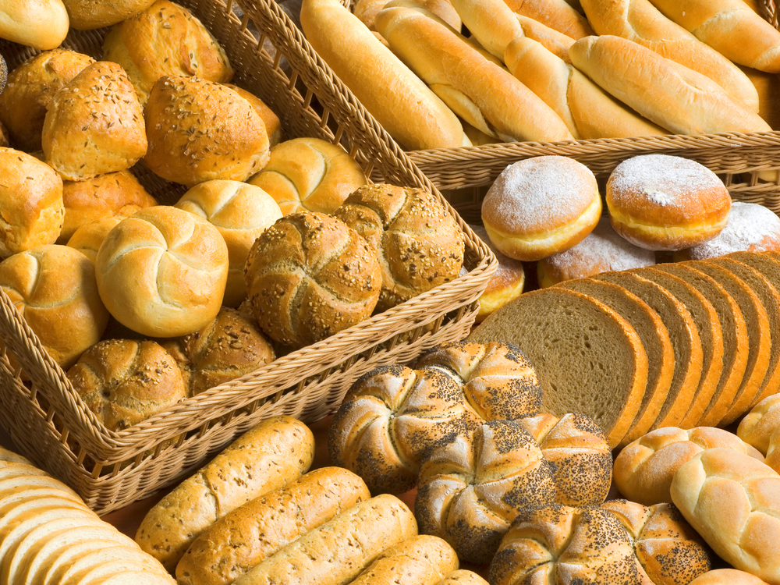
Notes:
So, the question for us is, do we really believe this? Do we believe what God has told us? Do we believe the evidence is clear, convincing, compelling, comprehensive? If we don’t, perhaps we need to have our spiritual glasses cleaned, because we are not seeing reality correctly. Now, listen to these illustrations. Nobody goes into a bakery and wonders if a baker exists.
<NEXT>

Slide 149
Notes:
How many people turn on a computer and wonder if computer engineers or programmers exist? I do not know anyone who does that, nor do you. <NEXT>

Slide 150
Notes:
But people look at all of the amazing design, order, and complexity of His universe and ask if God exists, while the weight of evidence for God’s existence is far greater than the evidence for programmers, engineers, and bakers, since everything in the universe displays the power and genius of God. <NEXT>

Slide 151
Arguments for the Probability of God Require Blind Faith
Notes:
Additionally… [READ SLIDE]
And blind faith is not the faith of true belief.
<NEXT>

Slide 152
Notes:
True faith is not a leap in the dark. Again, the God of Scripture has revealed Himself so clearly and comprehensively that unbelief is without excuse. <NEXT>

Slide 153
Arguments for the Probability of God Require Blind Faith
No Evidence
Complete Evidence
Partial
Blind Faith
Partial
Justified Belief
Notes:
And to the extent that evidence is lacking…
<NEXT>

Slide 154
Arguments for the Probability of God Require Blind Faith
No Evidence
Complete Evidence
Partial
Blind Faith
Partial
Justified Belief
Notes:
...the greater the need for blind faith, a leap in the dark.
<NEXT>

Slide 155
Arguments for the Probability of God Require Blind Faith
No Evidence
Complete Evidence
Partial
Blind Faith
Partial
Justified Belief
Notes:
But mark it, Christian faith is not blind faith in the dark, but is a justified, warranted, provable, and supported faith. Everything in the universe screams God’s existence, everything in the universe supports the fact that our faith is accurate and true. Not just hints.
The evidence is… <NEXT>

Slide 156
Complete
Notes:
[READ SLIDE]
<NEXT>

Slide 157
Complete
Compelling
Notes:
[READ SLIDE]
<NEXT>

Slide 158
Complete
Compelling
Comprehensive
Notes:
[READ SLIDE]
<NEXT>

Slide 159
Complete
Compelling
Comprehensive
Clear
Notes:
[READ SLIDE]
It is impossible that God does not exist.
By the time Christ rebuked His disciples for their lack of faith after He calmed the storm on the Sea of Galilee, He had already healed Simon’s mother-in-law, cast out demons, healed a leper, a paralytic, a man with a withered hand, and “healed many who were ill with various diseases” (Mark 1:34). Had He provided them enough evidence to trust Him in the storm on the sea? Had Peter seen enough before He denied Christ 3 times? Did the crowds who shouted for Christ’s death lack evidence? <NEXT>

Slide 160
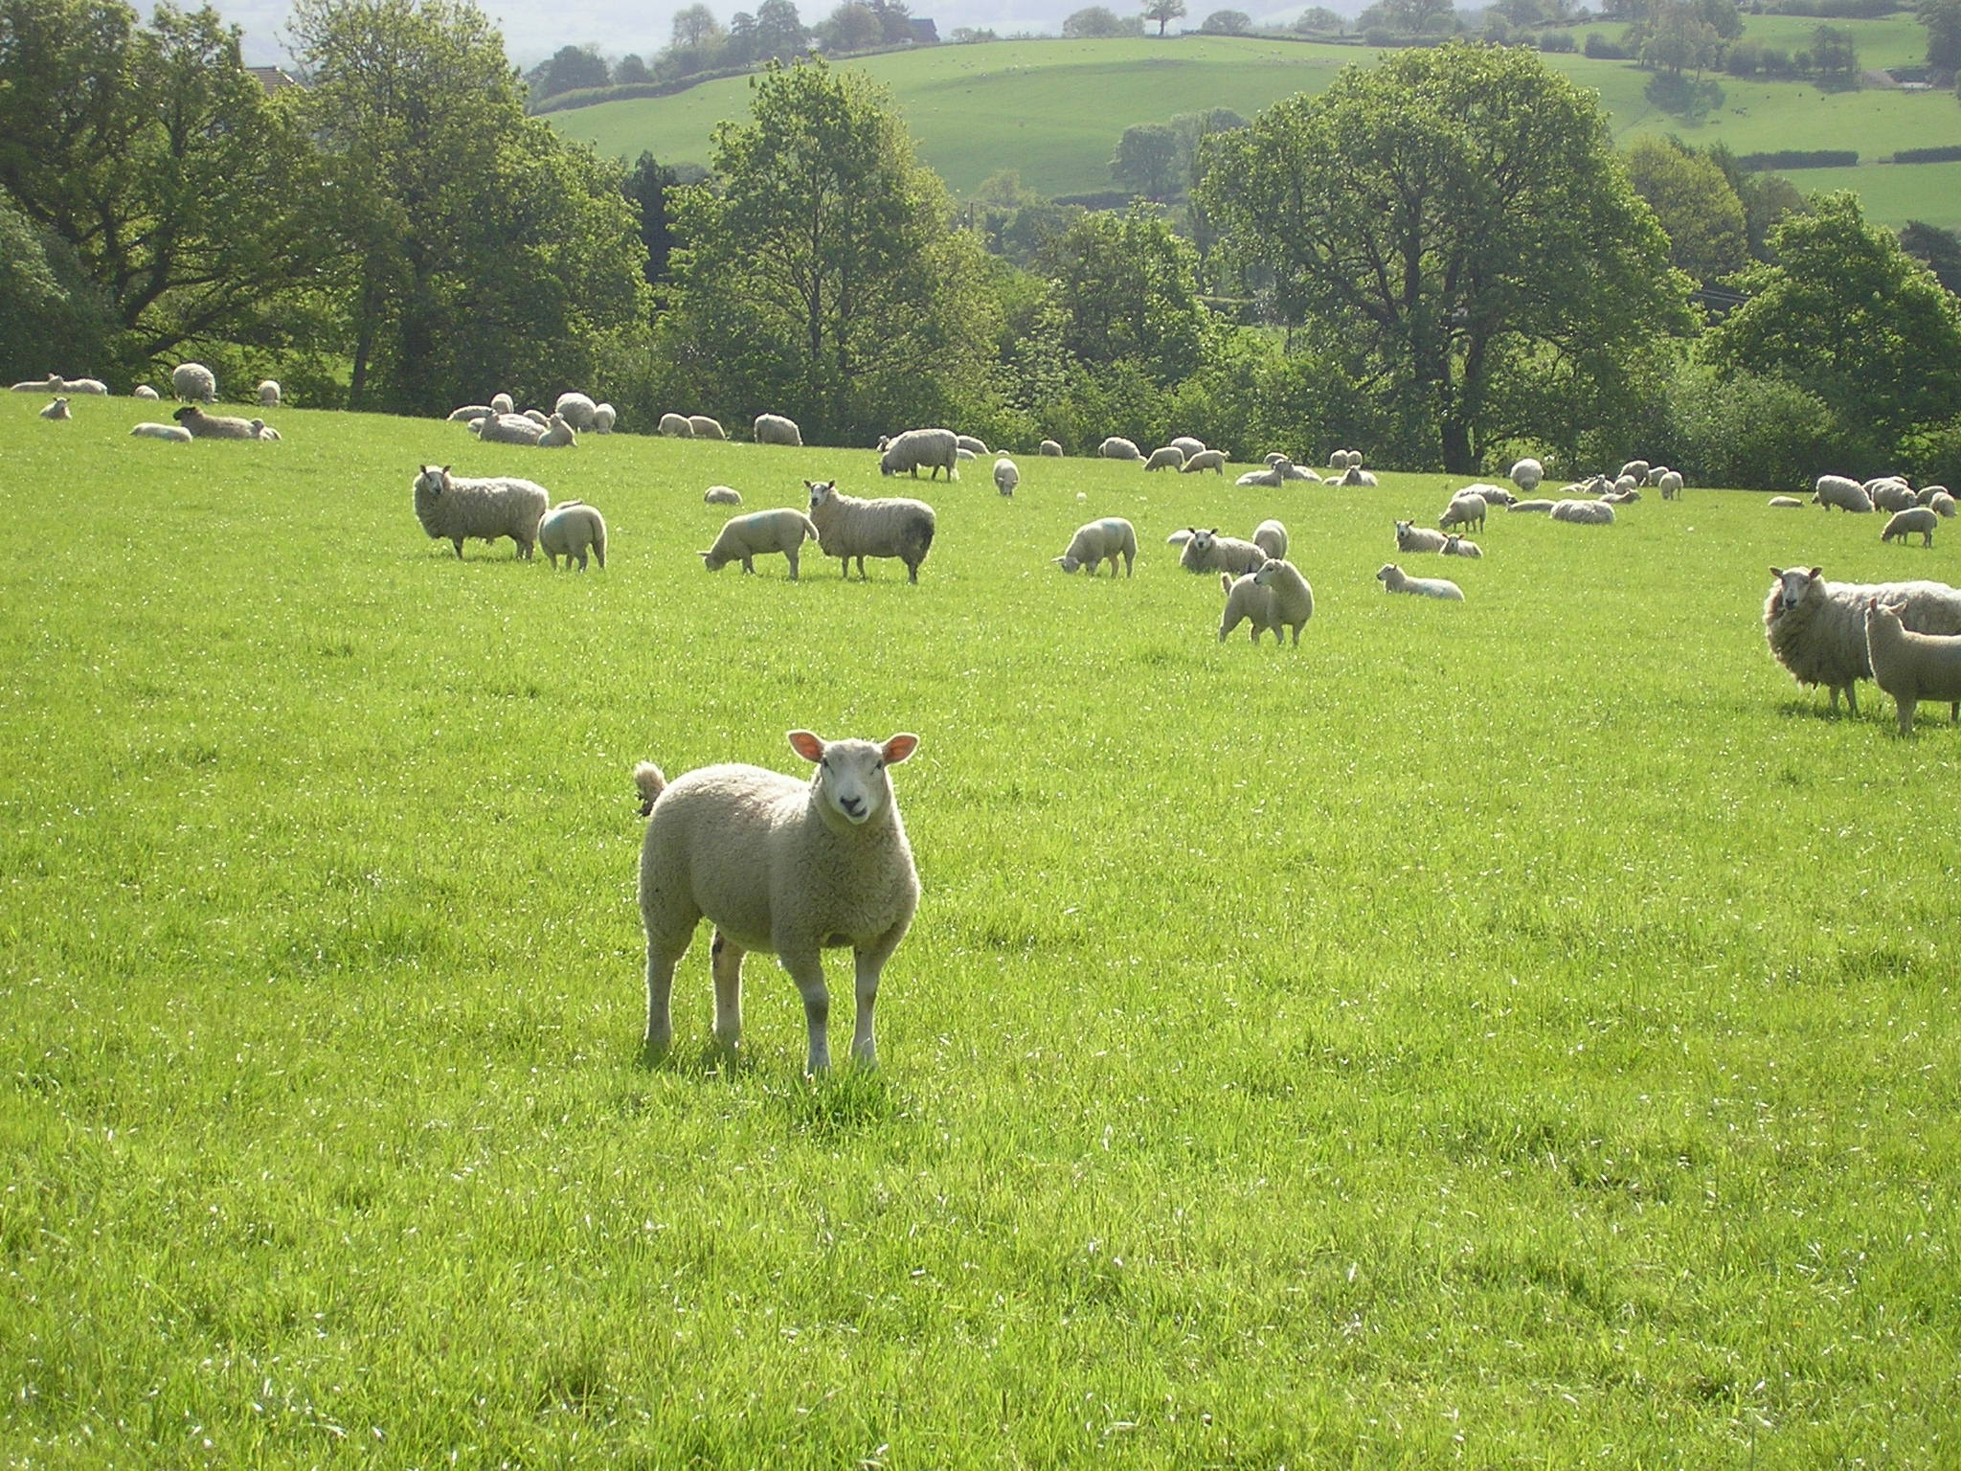
Baa! I’ll do it MY way!
Notes:
No. A heart unwilling to bow the knee before God as Lord will never see the universe for what it really is. Unbelief has nothing to do with God not providing enough evidence. At issue is the nature of the heart. <NEXT>

Slide 161
Arguments for the Probability of God
Hinder Full Assurance
No Evidence
Complete Evidence
Partial
No Objective Assurance
Partial
Complete Objective Assurance
Notes:
Moreover… [READ SLIDE]
To the extent that evidence is lacking, assurance will be lacking. Returning to our hypothetical example… <NEXT>

Slide 162
Arguments for the Probability of God
Hinder Full Assurance
Lack of Assurance
20%
80%
God Exists
Notes:
…and assuming that we can only know and show that God exists to an 80% comfort level. The believer, then, would have a 20% lack of assurance, with odds at 1 in 5 that Christianity is a hoax. Partial, but not complete assurance is justified. Doubt is reasonable and consistent with the odds. The promises of God are “mostly sure.” <NEXT>

Slide 163
Arguments for the Probability of God
Hinder Full Assurance
God Exists
20%
80%
Lack of Assurance
Notes:
But what if people are not familiar with the arguments for God’s existence, or have not been to a course like this, so they only have evidence enough for, say, a 20% probability that the God of Scripture exists? <NEXT>

Slide 164
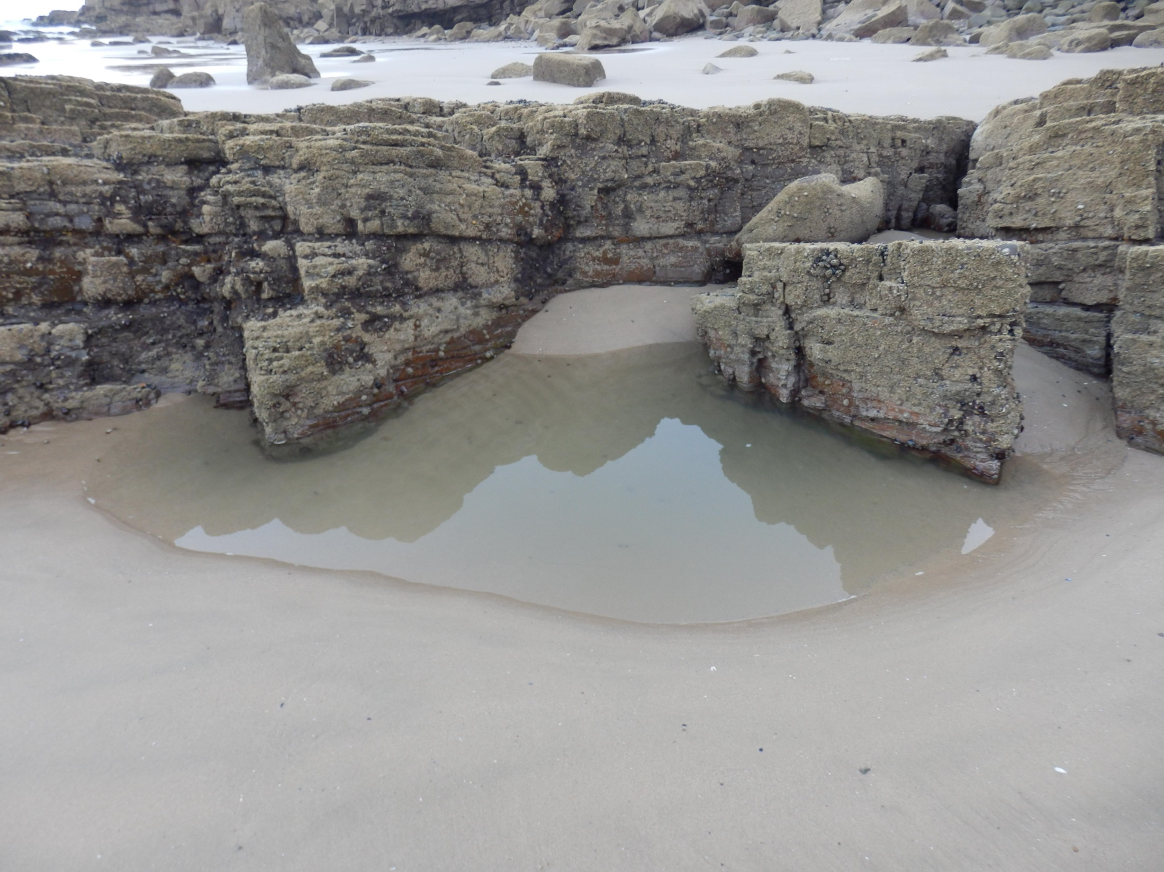
Notes:
The believer would be standing with one foot barely on the rock, and the other in the sinking sand. <NEXT>

Slide 165
Arguments for the Probability of God
Hinder Full Assurance
No Evidence
Complete Evidence
Partial
No Objective Assurance
Partial
Complete Objective Assurance
Notes:
An 80% lack of assurance would be justified and reasonable while the promises of God would be unsure. Doubt would be consistent with reality, and certainly not blamable.
Or, if you can only know that God exists to the 50% confidence level, then your assurance is a flip of a coin; maybe yes, maybe no. Your assurance will always be unstable.

Slide 166
Notes:
But does Scripture say that true faith and assurance only come from a seminary education or a course in apologetics? The testimony of the many saints and martyrs of history would deny this. Many died for their faith having known Christ a short while, with most never having taken a theology or apologetics course. <NEXT>

Slide 167
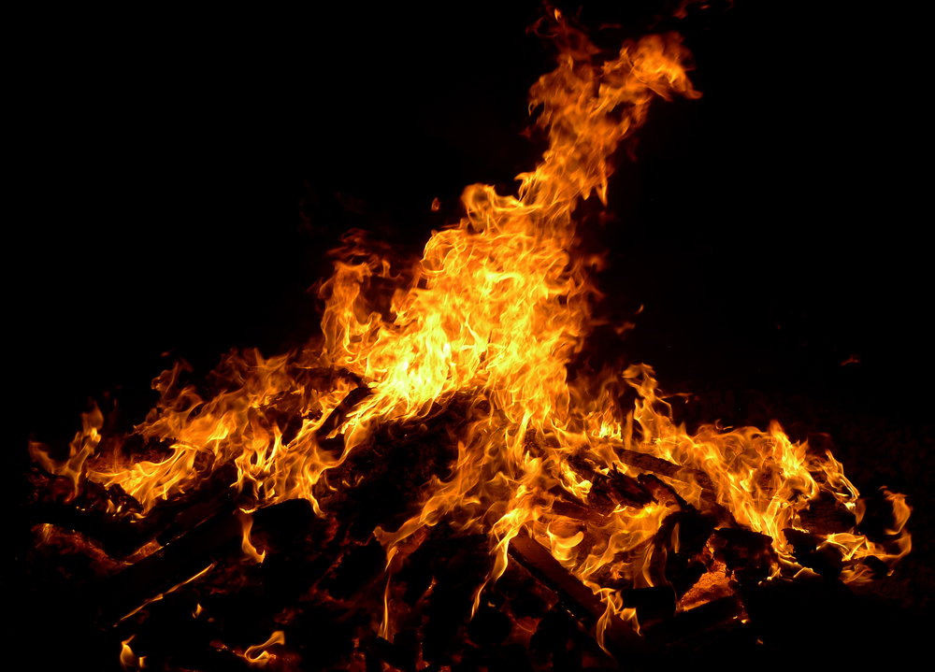
Notes:
During the Reformation, many willingly went to the stake for their faith in Christ, having known Christ but a short while. And as far as I know, they didn’t first ask to take an apologetics course to decide whether or not to deny the faith. The testimony of the martyred saints tells us that God gives assurance. And of course, this is what Scripture teaches. <NEXT>

Slide 168
Notes:
We see God’s glory clearly when He changes our heart. The problem isn’t He hasn’t displayed His glory, but that unbelievers have no spiritual eyes to see it. Scripture says they are spiritually blind. Not to the words on the written pages of Scripture, but to the beauty and excellence of the message, of the God it reveals. They see the infinite excellence of Christ and the Gospel and call it stupid. Why? Because, as John 3 tells us, they hate the light and love darkness. <NEXT>

Slide 169
Notes:
When believers see a sunset, we see the evidence of God’s power and genius, and understand that apart from Him, it could not exist. <NEXT>

Slide 170
Notes:
When believers read Scripture, we see the clear marks of divinity, the infinite excellence of the Author it reveals. That it is the Word of God is obvious. <NEXT>

Slide 171
Notes:
Anyone can tell the difference between a Rembrandt and a finger painting. But people have difficulty seeing the impossibility and foolishness of evolution and the obvious necessity and evidence of God creating and sustaining all things. But why? Let’s see.
Can unbelievers admit the existence of a chair? Sure. But could they as easily admit the existence of God if the evidence were just as clear? Absolutely not. Why? Because God’s existence has huge implications, it challenges our deepest beliefs about everything. If God exists, He created me, He owns me, and I owe Him everything.
If God exists and I have been ignoring Him my whole life, I am a rebel. If God exists and He has certain standards of behavior and I have broken every one of them, I am a sinner and I am in trouble, I am under judgement. If God exists, I will be held accountable for what I do in this life. There are many reasons why the evidence for God’s existence will be denied, suppressed, and ignored. The implications are just too great for a heart that loves darkness and hates the light. <NEXT>

Slide 172
“‘You shall love the LORD your God with all your heart, and with all your soul, and with all your mind.’ This is the great and foremost commandment.”
Matthew 22:37-38
Notes:
Scripture tells us [READ SLIDE]
<NEXT>

Slide 173
Notes:
If God exists, I have ignored and treated Him with contempt and must turn from my ways, ask for forgiveness, and humbly seek Him. <NEXT>

Slide 174
“The time is fulfilled, and the kingdom of God is at hand; repent and believe in the gospel.”
Mark 1:15
Notes:
[READ SLIDE]
We simply can’t discuss God without the influence of our will, or discuss Him in the same way we discuss a chair (BTW, even a chair, when viewed rightly, gives evidence for God). <NEXT>

Slide 175
Notes:
Admitting God’s existence means admitting we are no longer captain of our own ship and must bow the knee, something unbelievers do not want to do, something we did not want to do until God changed our heart. Evidence is not the problem. What’s lacking is the will to embrace Him. God has given us complete evidence that we might have complete assurance.
Our problem is we need to start viewing the world through spiritual eyes, through the lens of Scripture, and see the glory of God’s genius and power in everything. And when we do, when we have a comprehensive and coherent worldview--Christian worldview, biblical worldview--all things will begin to look different and we will see that indeed everything in the universe gives clear evidence of God’s glory, God’s excellence, God’s genius, and God’s existence. <NEXT>

Slide 176
Next Up:
God Cannot Be Known Unless He Makes Himself Known

Slide 177
Copyright © 2014 Craig Biehl, Pilgrim’s Rock, LLC
Unless otherwise indicated, Scripture taken from the NEW AMERICAN STANDARD BIBLE, © Copyright The Lockman Foundation 1960, 1962, 1963, 1968, 1971, 1972, 1973, 1975, 1977, 1988, 1995. Used by permission.
Scripture quotations marked (ESV) are from The Holy Bible, English Standard Version® (ESV®), copyright © 2001 by Crossway, a publishing ministry of Good News Publishers. Used by permission. All rights reserved.
Space images courtesy of NASA. Use of NASA images does not constitute an endorsement of the content of this presentation by NASA or any NASA affiliate. Used by permission.

