Slide 1
The Study of the Church
Lesson 9: Core Faith
James F. Davis, PhD

Slide 2
Copyright Notice
You may download this presentation on your computer for personal study or you can print it or use it in a multimedia presentation for yourself and others as long as you give the printed material away and do not charge for it. In this case, free means free. It cannot be bundled with anything sold, nor can you charge for shipping, handling, or anything. It cannot be posted on other websites or servers. It is provided for personal study or for use in preparation and presentation of sermons, Sunday school classes, undergraduate or seminary religion classes or other non-commercial study. Material in the presentation may be edited (added to , deleted or changed) on the condition that no revision contradicts the Bible.org doctrinal statement and that substantive revisions are identified as being the work of a reviser and not that of Dr. Davis.

Slide 3
10 Reasons People do not go to Church
Reason 1 - Christians are judgmental and negative.
Reason 2 -Church is boring.
Reason 3 The church is exclusive.
Reason 4 Christians are homophobic.
Reason 5 'I don't like organized religion'
Pete Brookshaw, http://www.petebrookshaw.com/2012/08/10-reasons-why-people-dont-go-to-church.html#.UOStWnexm4k (Date accessed Jan 2, 2013).

Slide 4
10 Reasons People do not go to Church
Reason 6 Churches are full of hypocrites
Reason 7 The church just wants your money.
Reason 8 Life is better without religion.
Reason 9 Christians live on another planet.
Reason 10 ‘I don't have time.’

Slide 5
Jesus stated “I will build My Church and the gates of Hades will not overpower it” (Matt 16:18).
What is the church?
When did it start?
What is its purpose?
How should it operate?
How important is it to go to church?

Slide 6
Overview of the Lesson
Definition and Metaphors for the Church
The Start of the Church
The Purpose
The Practice(s) of the Church
The Organization of the Church
The Distinction between the Church and Israel
The Importance of Church

Slide 7
What is the Church?
From the Greek word ekklessia which means assembly or congregation.
It does not refer to a building in the New Testament it refers instead to people.
In the New Testament it generally refers to believers Jew or Gentile who have placed their faith in Jesus Christ and have received the Holy Spirit following Pentecost in Acts 2.
In the New Testament it may refer to a local assembly such as the church at Thessalonica (1 Thess 1:1) or the universal church all believers in this age everywhere.

Slide 8
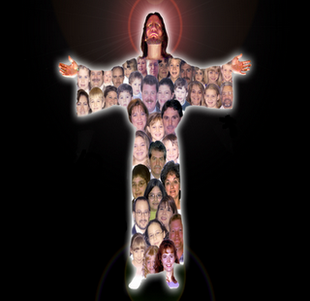
Metaphors of the Church
The Body of Christ
1) He [Christ] is the head of the body, the church, (Col 1:18)
2) The husband is the head of the wife as also Christ is the head of the church – he himself being the savior of the body. (Eph 5:21-22)

Slide 9
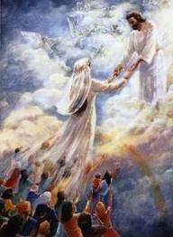
Metaphors of the Church
The Bride of Christ
Let us rejoice and exult and give him glory, because the wedding celebration of the Lamb has come, and his bride has made herself ready. She was permitted to be dressed in bright, clean, fine linen” (for the fine linen is the righteous deeds of the saints) (Rev 19:7-9).

Slide 10
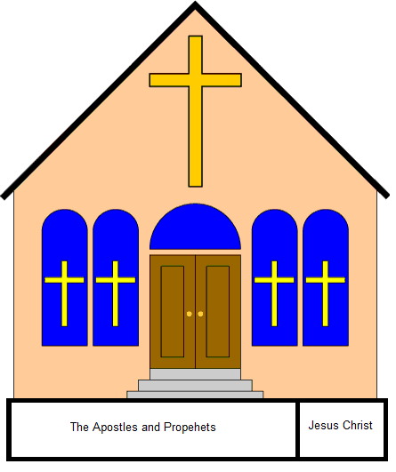
Metaphors of the Church
A Building/Temple
So then you are . . . members of God’s household, because you have been built on the foundation of the apostles and prophets, with Christ Jesus himself as the cornerstone. In him the whole building, being joined together, grows into a holy temple in the Lord, in whom you also are being built together into a dwelling place of God in the Spirit. (Eph 2:19-22)

Slide 11
Metaphors of the Church
A Royal Priesthood
But you are a chosen race, a royal priesthood, a holy nation, a people of his own, so that you may proclaim the virtues of the one who called you out of darkness into his marvelous light. You once were not a people, but now you are God’s people (1 Peter 2:8-9).

Slide 12
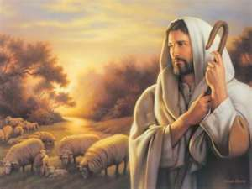
Metaphors of the Church
A Flock
Watch out for yourselves and for all the flock of which the Holy Spirit has made you overseers, to shepherd the church of God that he obtained with the blood of his own Son (Acts 20:28)

Slide 13
When did the Church Start?
Jesus spoke of the establishment of the church as a future event in His life
And I tell you that you are Peter, and on this rock I will build my church, and the gates of Hades will not overpower it. I will give you the keys of the kingdom of heaven (Matt 16:18-19).

Slide 14
When did the Church Start?
Church Obtained by the Finished Work of Christ on the Cross.
Watch out for yourselves and for all the flock of which the Holy Spirit has made you overseers, to shepherd the church of God that he obtained with the blood of his own Son (Acts 20:28)
This implies the church did not start until after the death of Christ.

Slide 15
When did the Church Start?
The church is defined by the “body of Christ” and members of the body of Christ are placed there by the baptism of the Spirit
12:12 For just as the body is one and yet has many members, and all the members of the body – though many – are one body, so too is Christ. 12:13 For in one Spirit we were all baptized into one body. Whether Jews or Greeks or slaves or free, we were all made to drink of the one Spirit.

Slide 16
When did the Church Start?
The Baptism of the Spirit occurred in Acts 2
John the Baptist stated that the Messiah would baptize (future) with the Holy Spirit (Mark 1:8)
Jesus stated that the baptism would take place “not many days from now (Acts 1:5) .
The Holy Spirit descends Acts 2
In hindsight this event is referred to as the “baptism of the Spirit”
Then as I began to speak, the Holy Spirit fell on them just as he did on us at the beginning. And I remembered the word of the Lord, as he used to say, ‘John baptized with water, but you will be baptized with the Holy Spirit’ (Acts 11:15-16).

Slide 17
When did the Church Start?
Church Obtained by the Finished Work of Christ on the Cross.
This implies the church did not start until after the death of Christ

Slide 18
The Purpose/Function of the Church
Worship God
But a time is coming – and now is here – when the true worshipers will worship the Father in spirit and truth, for the Father seeks such people to be his worshipers. 4:24 God is spirit, and the people who worship him must worship in spirit and truth. (John 4:23-24)

Slide 19
The Purpose/Function of the Church
Edify and Instruct Itself
They were devoting themselves to the apostles’ teaching and to fellowship, to the breaking of bread and to prayer (Acts 2:42).
It was he who gave some as apostles, some as prophets, some as evangelists, and some as pastors and teachers, 4:12 to equip the saints for the work of ministry, that is, to build up the body of Christ, until we all attain to the unity of the faith and of the knowledge of the Son of God – a mature person, attaining to the measure of Christ’s full stature (Eph 4:11-13).

Slide 20
The Purpose/Function of the Church
Evangelize the World
Therefore go and make disciples of all nations, baptizing them in the name of the Father and the Son and the Holy Spirit, teaching them to obey everything I have commanded you (Matt 28:19-20).
But you will receive power when the Holy Spirit has come upon you, and you will be my witnesses in Jerusalem, and in all Judea and Samaria, and to the farthest parts of the earth.” (Acts 1:8)

Slide 21
The Ordinances of the Church
Baptism and The Lord’s Supper (Communion) are two mandates or ordinances that Jesus gave to the church.
The Catholic church refers to these mandates as well as others as sacraments.

Slide 22
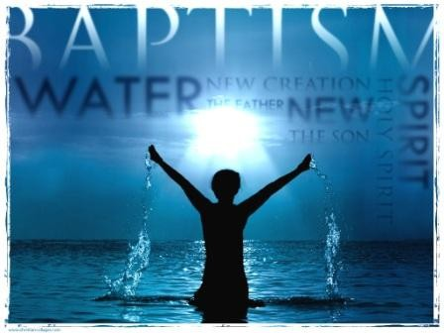
The Ordinances of the Church
Purpose of Baptism is to identify with Christ and His message
Peter said to them, “Repent, and each one of you be baptized in the name of Jesus Christ for the forgiveness of your sins, and you will receive the gift of the Holy Spirit (Acts 2:38).

Slide 23
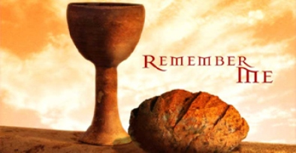
The Ordinances of the Church
The Purpose of the Lord’s Supper (Communion) is to remember what Jesus did for us on the cross
[T]he Lord Jesus on the night in which he was betrayed took bread, and after he had given thanks he broke it and said, “This is my body, which is for you. Do this in remembrance of me.” In the same way, he also took the cup after supper, saying, “This cup is the new covenant in my blood. Do this, every time you drink it, in remembrance of me.” (1 Cor 11:23-25)

Slide 24
The Organization of the Church
Types of Church Government
National Government: Churches that are headed by the State (Anglican Church of England or Lutheran Church of Germany)
Hierarchical Government: The body of clergy is divided into various ranks reporting eventually to a single person like the Pope (Roman Catholic Church, Episcopal and Orthodox and Anglican (in Part).

Slide 25
The Organization of the Church
Types of Church Government
Congregation Government: Ultimate authority for the church rests with the members themselves, ministry, budget, choosing leaders etc (Some Baptist churches)
Regional Federal Government: Synods and General Assemblies appoint pastors, determine doctrine etc Presbyterian, Lutheran and some Reformed
Local Federal Government: Elders/Pastors in the local church are ultimately responsible for governing the church (Brethren, Bible Churches Some Baptist and Reformed).

Slide 26
The Organization of the Church
Leadership of the church
Pastors/Elders
Paul to Titus: The reason I left you in Crete was to set in order the remaining matters and to appoint elders in every town, as I directed you (Titus 1:5).
Men who are spiritual qualified (Titus 1; 1 Tim 3)
Multiple Leadership
Responsible to Shepherd the Flock of God (1 Pet 5:20)

Slide 27
The Organization of the Church
Leadership of the church
Deacons
Now in those days, when the disciples were growing in number, a complaint arose on the part of the Greek-speaking Jews against the native Hebraic Jews, because their widows were being overlooked in the daily distribution of food. So the twelve called the whole group of the disciples together and said, “It is not right for us to neglect the word of God to wait on tables. But carefully select from among you, brothers, seven men who are well-attested, full of the Spirit and of wisdom, whom we may put in charge of this necessary task (Acts 6:1-3)
Spiritual qualified (Acts 6; 1 Tim 3)
Responsible to serve the needs of the church under the leadership of the pastors/elders

Slide 28
The Distinction between Israel and the Church
How do I distinguish between Israel and the Church?
Church = Jew and Gentile who believe in Jesus and are baptized into the body of Christ
Israel (2515 times in the OT and 68 in the NT) refers ethnically to the descendants of Abraham that came though Isaac and Jacob.
Sometimes the term is qualified with a word like “true” to reflect the idea of saved Israel.

Slide 29
The Distinction between Israel and the Church
Israel was under the Old Covenant the Church is under the provisions of the New Covenant.
The Old Covenant included: Animal Sacrifices, Proscribed Festivals, Dietary laws, Sabbath Keeping (Meeting on Saturday), Moral laws and penalties for violation
The Church is under the provisions of the New Covenant and directly stated requirements for it are included in the gospels and epistles.
There is both continuity and discontinuity in the relationship of these covenants to each other.

Slide 30
The Distinction between Israel and the Church
There is a future for national Israel though in which all the promises God gave to them will be fulfilled:
For I do not want you to be ignorant of this mystery, brothers and sisters, so that you may not be conceited: A partial hardening has happened to Israel until the full number of the Gentiles has come in. And so all Israel will be saved, as it is written, “The Deliverer will come out of Zion; he will remove ungodliness from Jacob. And this is my covenant with them, when I take away their sins.” In regard to the gospel they are enemies for your sake, but in regard to election they are dearly loved for the sake of the fathers. For the gifts and the call of God are irrevocable.

Slide 31
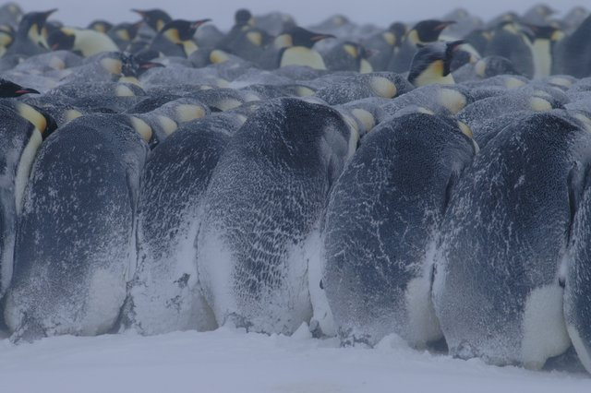
Importance of Meeting in Church
And let us take thought of how to spur one another on to love and good works, not abandoning our own meetings, as some are in the habit of doing, but encouraging each other, and even more so because you see the day drawing near (Hb 10:24-25).
Penguins cannot survive the external conditions in Antarctica if they do not stick together

Slide 32
Discussion Questions
What are some things the church is doing that is not part of its mandate and what things is it not doing that it should be doing? How about the local church that you are in?
Is there a difference between an church ordinance or a church sacrament? If so, what is it?
How is the modern church different than the early first century church? How much should the modern church adapt to its culture?
What are some reasons that some Christians give to not go to church? What are some biblical responses you can give to these reasons?
How can the church better connect with society?

Slide 33
Discussion Questions
How can I be more involved in the life and ministry of my church?
How should our view of the Bible affect our views on national policies toward Israel?
Should the church worship on Saturday? If not why not?
PowerPoint template used with permission from ChristianPPT.com

